Slide 1
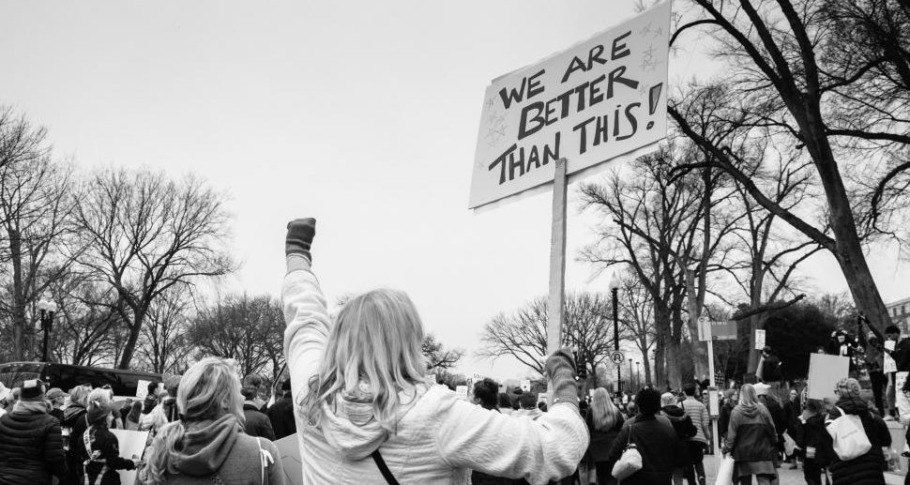
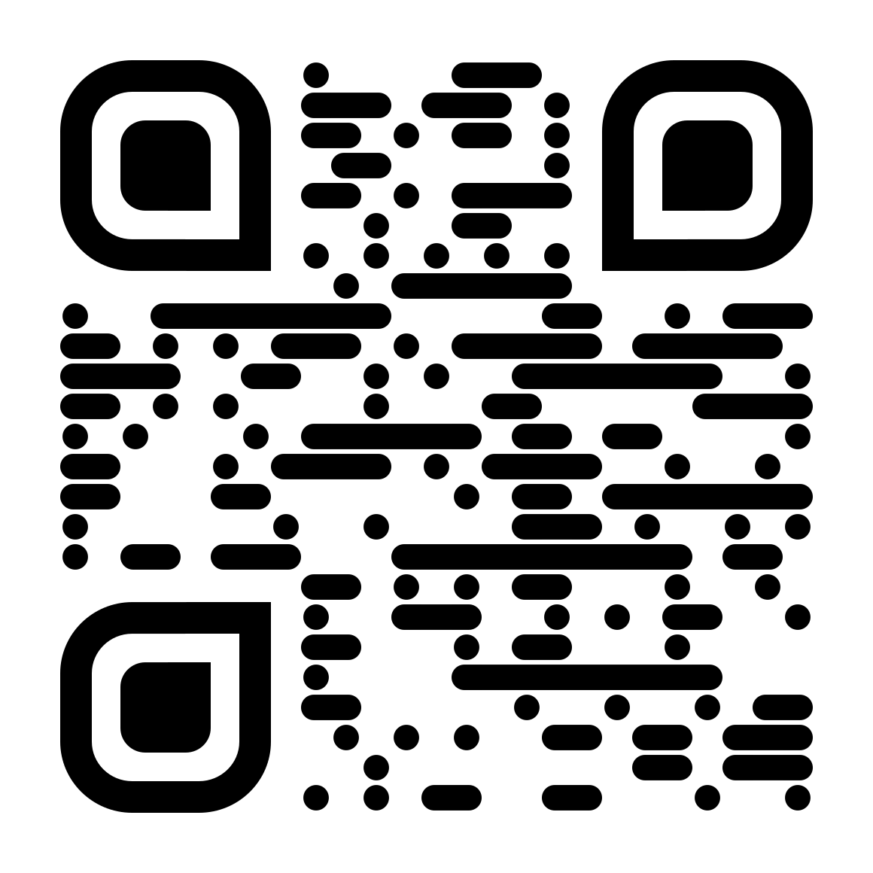
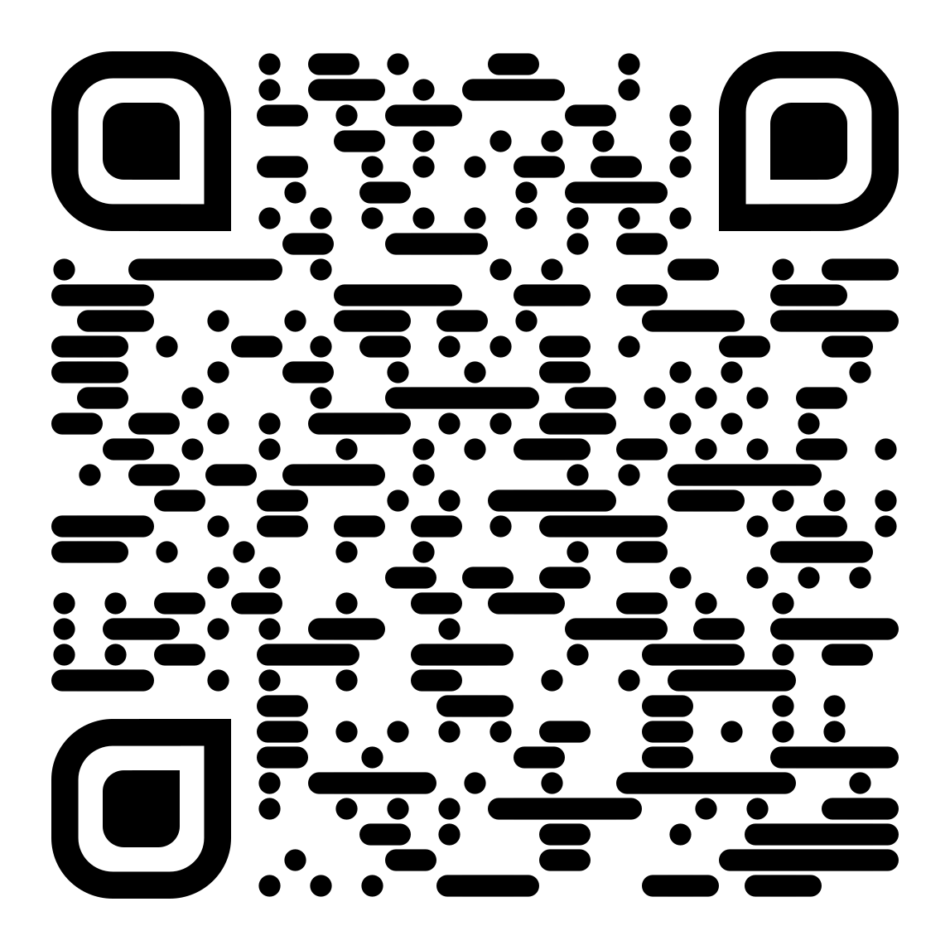
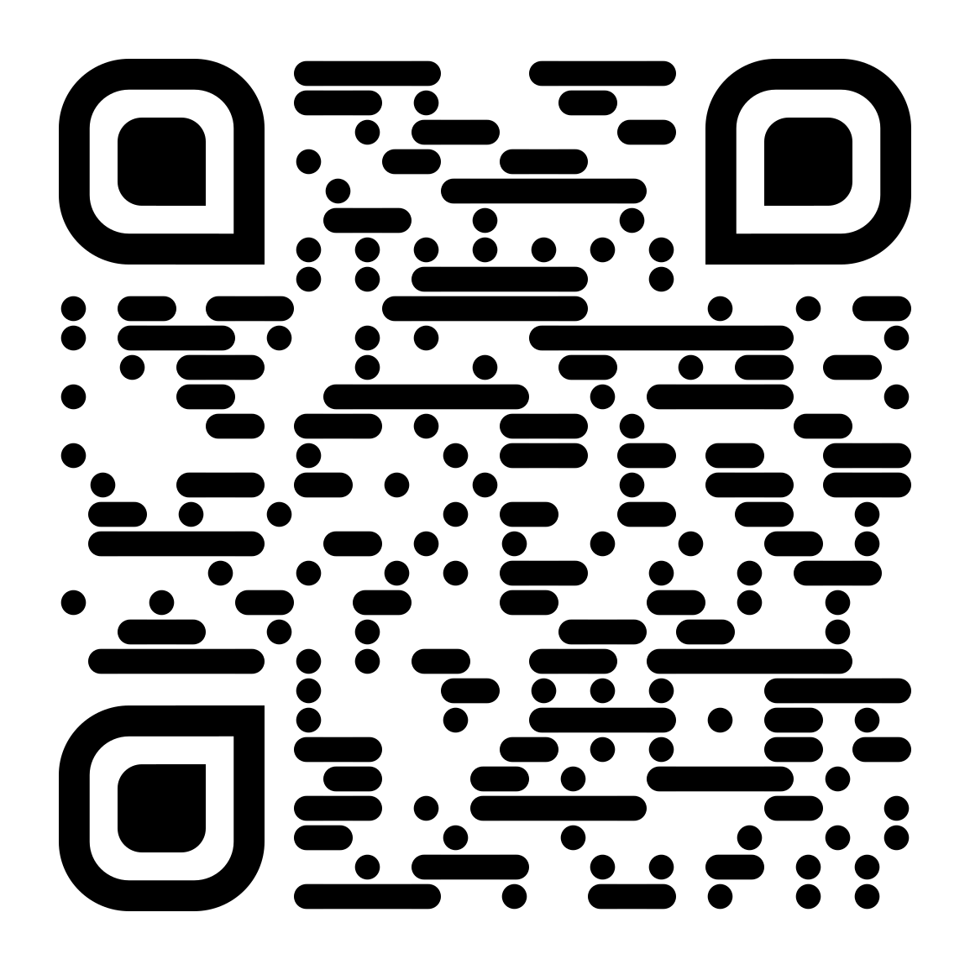
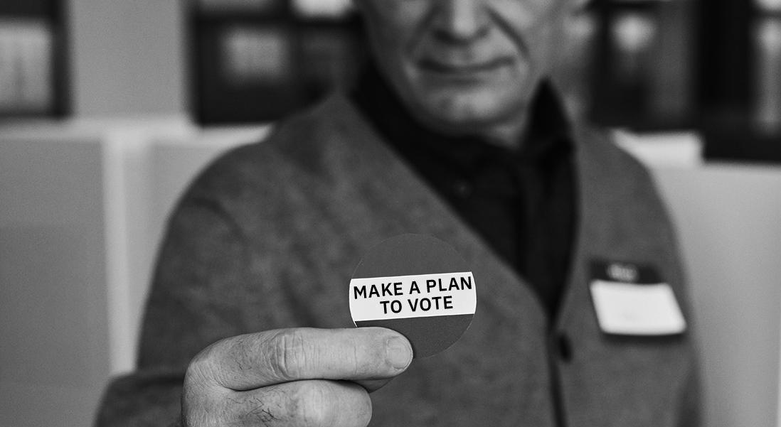
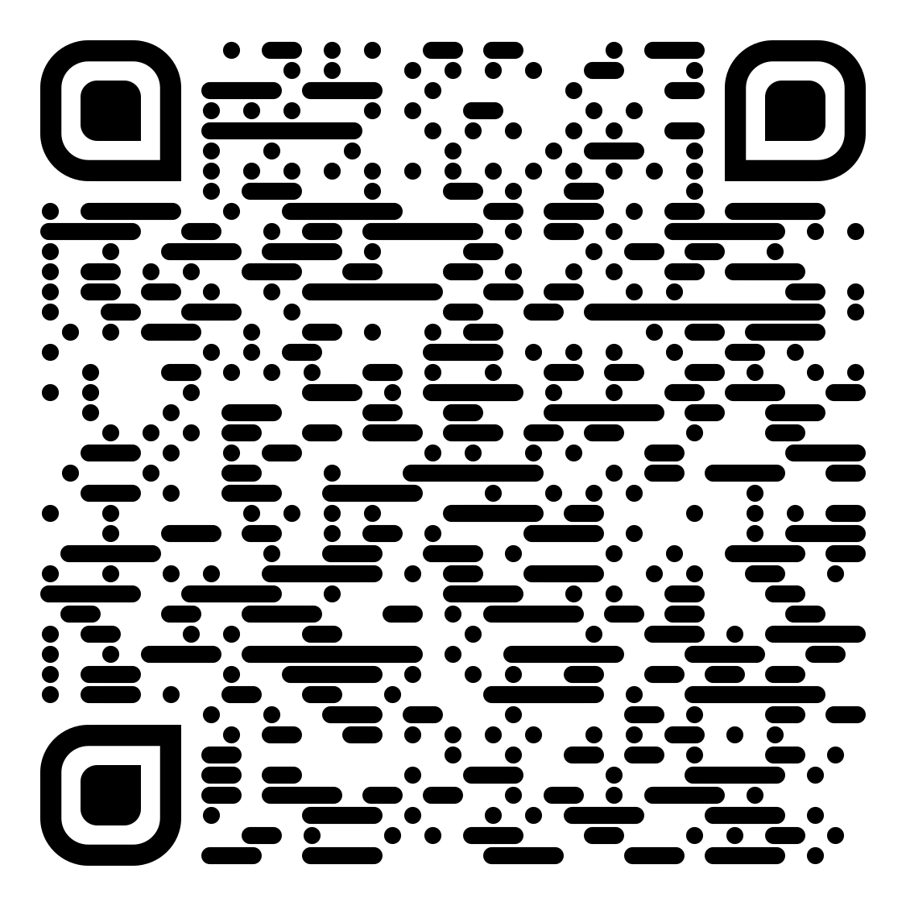
We all have a role to play in keeping our elections free and fair. Voting is the greatest power most Americans have and it is almost always a positive and rewarding experience.
Yet, some voters will likely encounter challenges this November.
Local election officials work hard to make sure elections run smoothly, but they can’t do it alone.
You can have a huge impact by keeping informed, getting involved, speaking out and, most importantly, voting.
Here are concrete steps you can take — as an individual voter, a community member and an American citizen — to protect your right to vote.
Use the QR codes and website URLs throughout to find the resources and tools you need.
AS AN INDIVIDUAL VOTER
MAKE A PLAN AND BE PREPARED:
Check your voter registration. Is it up
to date? Vote.gov will get you to the right place.
Know your voting options and requirements. Rules might have changed since the last election.
Make a plan for how and when to vote, whether in person, early or by mail.
Have a backup plan in case of an emergency.
Track your mail ballot and application if your state allows.
IF SOMETHING GOES WRONG:
Turn to trusted sources for election-related information. Your local election office is a great place to start. Vote411.org will direct you to your state’s election information.
Remember your rights. No one is allowed
to intimidate you or interfere with your
vote. Voters with disabilities or language
needs are entitled to help.
Know your options. There are alternative ways to vote if you run into problems. If your registration information is missing or incorrect, you can cast a provisional ballot. If voting machines break, ask for a paper ballot. If you make a mistake, get a new ballot. If you are in line when polls close, stay there until you get to vote.
Report intimidation to local election officials or law enforcement. You can also contact nonpartisan monitors such as Election Protection: 1-866-OUR-VOTE or 866ourvote.org.
Fix mistakes or “cure” your mail
ballot, if allowed in your state,
to make sure it counts.
Get ready
Your rights
AS A COMMUNITY MEMBER
PROMOTE FREE AND FAIR ELECTIONS:
Sign up to be a poll worker at your local
election office. Or go to powerthepolls.org.
Almost every election office needs them.
Be an observer at the polls or a ballot
counting location. Observers are often appointed by a campaign or political party to monitor the voting process.
Watch pre-election testing of voting machines or post-election audits. Contact your local election office to see if they allow this. Some also give tours.
Engage with local government officials on
how elections are run. Go to public
meetings. Express your opinion.
Sign up
1
2
3
4
“Curing”
We all have a role to play in keeping our elections free and fair. Voting is the greatest power most Americans have and it is almost always a positive and rewarding experience.
Yet, some voters will likely encounter challenges this November.
Local election officials work hard to make sure elections run smoothly, but they can’t do it alone.
You can have a huge impact by keeping informed, getting involved, speaking out and, most importantly, voting.
Here are concrete steps you can take — as an individual voter, a community member and an American citizen — to protect your right to vote.
Use the QR codes and website URLs throughout to find the resources and tools you need.
AS AN INDIVIDUAL VOTER
MAKE A PLAN AND BE PREPARED:
Check your voter registration. Is it up
to date? Vote.gov will get you to the right place.
Know your voting options and requirements. Rules might have changed since the last election.
Make a plan for how and when to vote, whether in person, early or by mail.
Have a backup plan in case of an emergency.
Track your mail ballot and application if your state allows.
IF SOMETHING GOES WRONG:
Turn to trusted sources for election-related information. Your local election office is a great place to start. Vote411.org will direct you to your state’s election information.
Remember your rights. No one is allowed
to intimidate you or interfere with your
vote. Voters with disabilities or language
needs are entitled to help.
Know your options. There are alternative ways to vote if you run into problems. If your registration information is missing or incorrect, you can cast a provisional ballot. If voting machines break, ask for a paper ballot. If you make a mistake, get a new ballot. If you are in line when polls close, stay there until you get to vote.
Report intimidation to local election officials or law enforcement. You can also contact nonpartisan monitors such as Election Protection: 1-866-OUR-VOTE or 866ourvote.org.
Fix mistakes or “cure” your mail
ballot, if allowed in your state,
to make sure it counts.
Get ready
Your rights
AS A COMMUNITY MEMBER
PROMOTE FREE AND FAIR ELECTIONS:
Sign up to be a poll worker at your local
election office. Or go to powerthepolls.org.
Almost every election office needs them.
Be an observer at the polls or a ballot
counting location. Observers are often appointed by a campaign or political party to monitor the voting process.
Watch pre-election testing of voting machines or post-election audits. Contact your local election office to see if they allow this. Some also give tours.
Engage with local government officials on
how elections are run. Go to public
meetings. Express your opinion.
Sign up
1
2
3
4
“Curing”

Slide 2
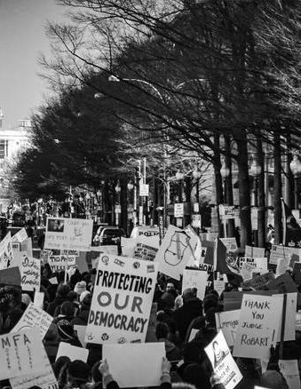
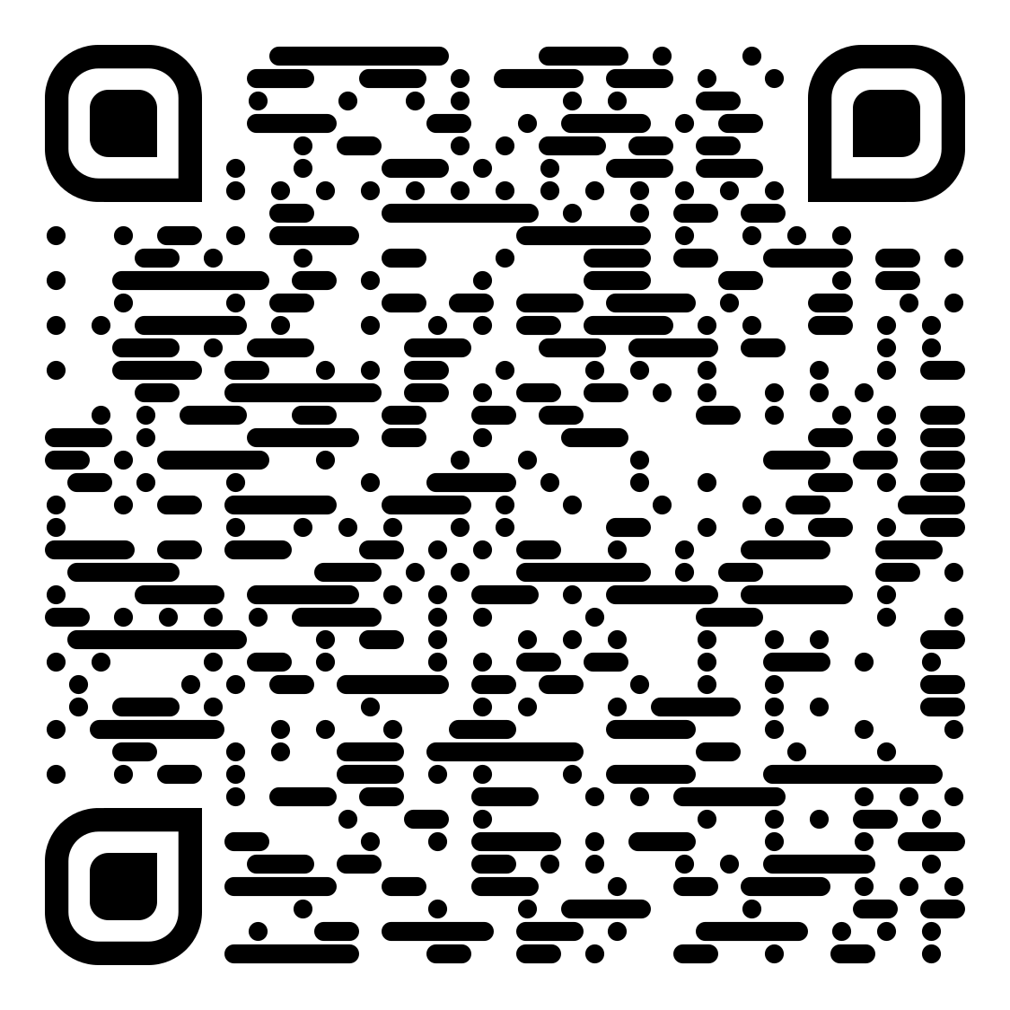
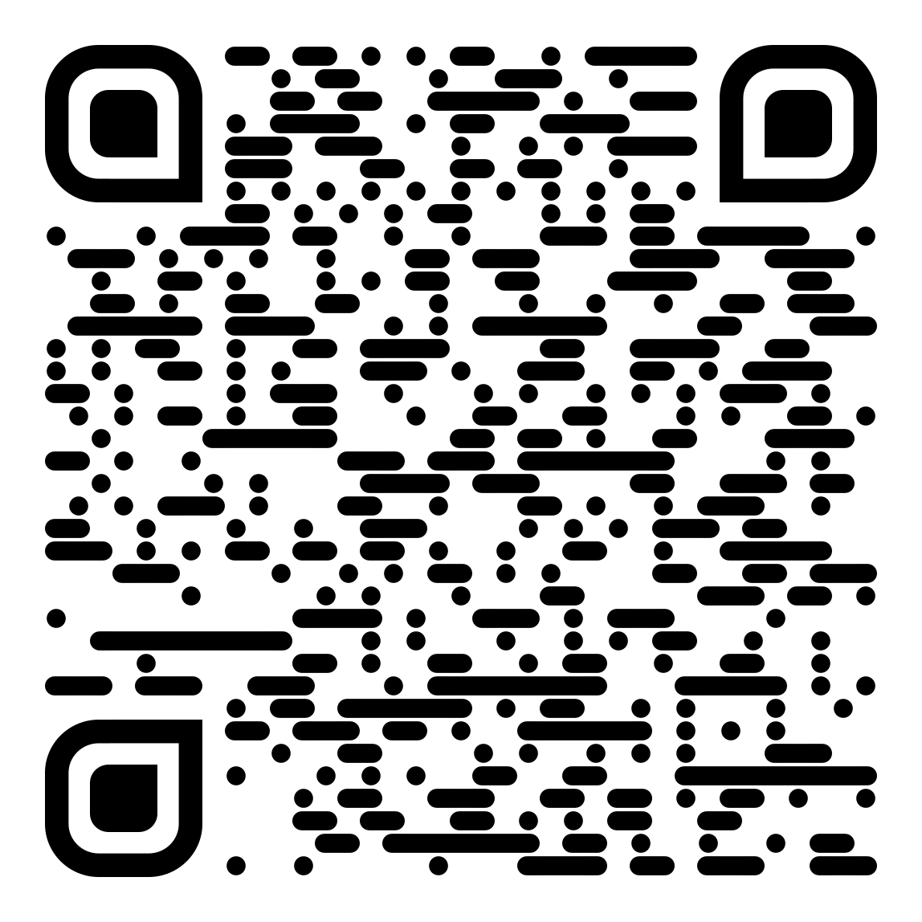
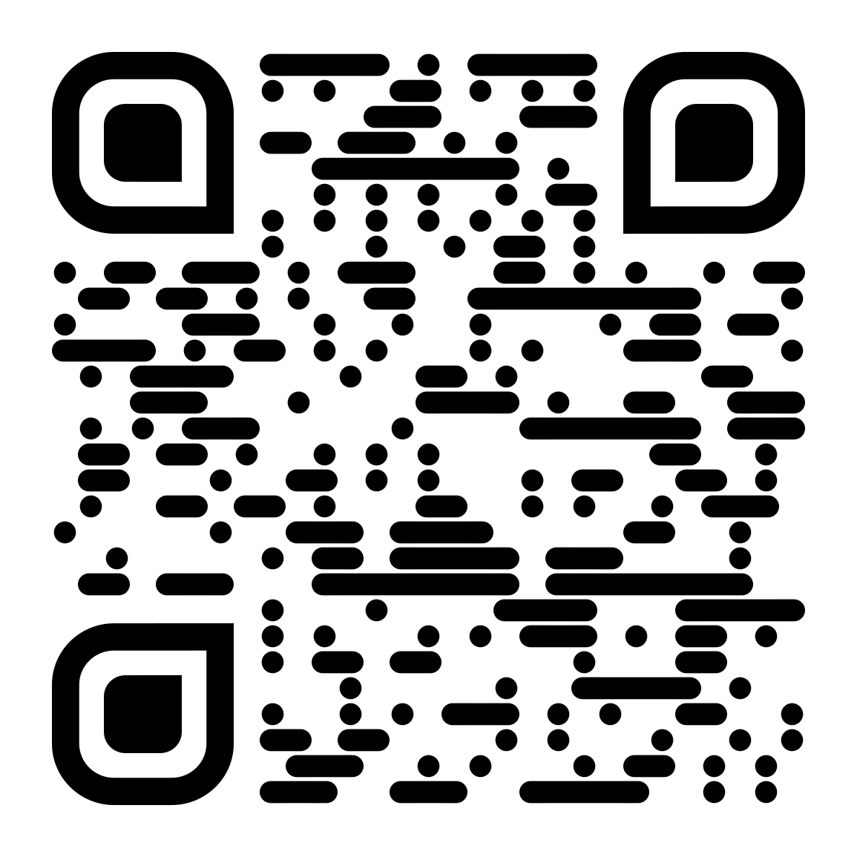
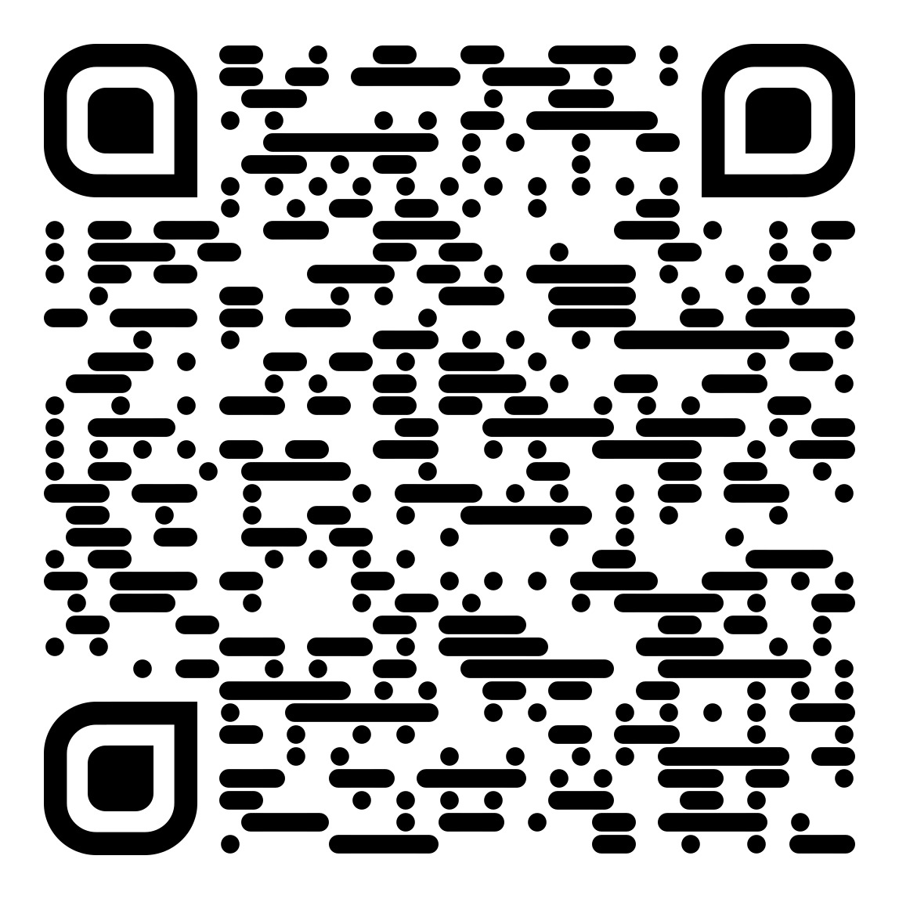
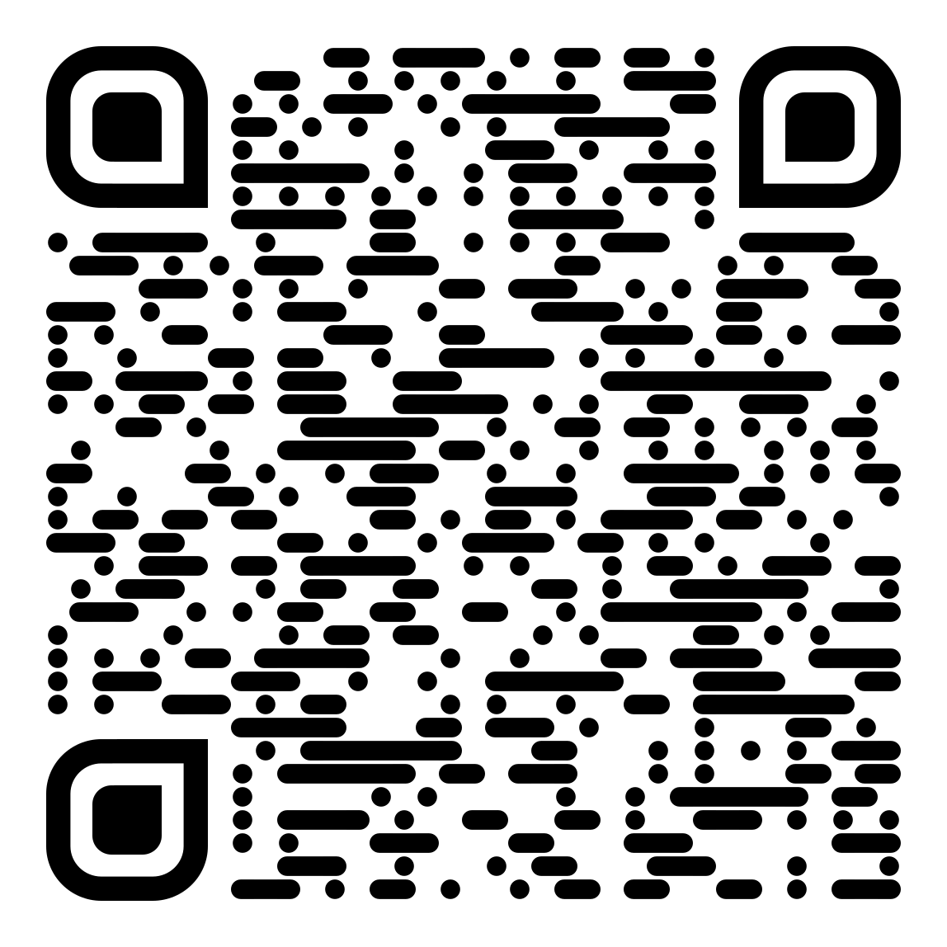
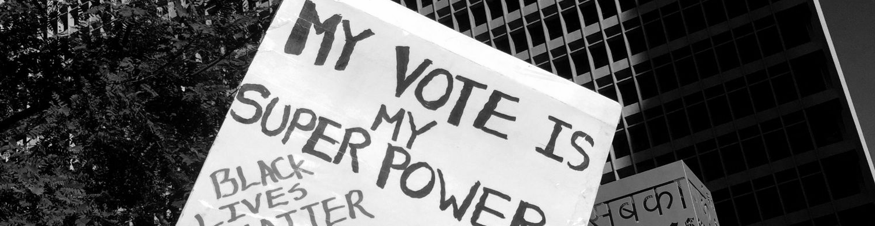
Learn how the voting process is supposed to work so you can know if something is going
wrong and how to report problems.
Keep up with election news and know
which media sources you can trust. Be
wary of information from unknown in-
dividuals. The closer an election is the more likely you will encounter rumors and false information.
Share what you learn with friends and neighbors. Encourage them to check their registration
and make a plan to vote.
Build coalitions with others in your community — perhaps at your church, school or neighborhood association — to discuss how elections are run
and votes protected.
Speak out if you believe election officials and
the voting process are unfairly attacked. Write
a letter to the editor or call in to a radio show.
Post your comments on social media.
AS AN AMERICAN CITIZEN
SUPPORT VOTING RIGHTS:
Stay informed about what Congress, top election officials and state legislatures are doing to
impact how elections are run. Check Votebeat.org and electionline.org. Contact lawmakers and express your opinions on pending legislation.
Keep up with the latest legal action.
Many disagreements about how elections
are run end up in court, often at the last
minute. This could affect how you cast
your ballot and whether it will count.
Counter unjustified efforts to undermine public confidence in elections by speaking out. If you believe voting is accurate and fair, say so publicly. Share your thoughts with people you know and those influencing the debate.
Consider providing financial support or
joining groups that work to protect elections.
Be vigilant. Watch for suspicious or threatening activity. Bring concerns to state or local authorities. Call 911 if you see or experience violence.
Learn your rights if observing law enforcement
or military activities. It is highly unlikely, but you could encounter such activity at or near
a polling place, despite laws prohibiting interference. Know the legal limits of
responding. You can generally observe
and express your opinion, but not interfere.
Check the rules for recording. Some incidents might motivate you to collect evidence to share with law enforcement, election officials or the media. Most polling places prohibit cell phones or recording inside to protect voters’ privacy.
Avoid escalating confrontations. Lower
the temperature if possible by listening to
those you disagree with and, if needed,
turn the dispute over to election officials
or other trusted authorities.
Whatever you do, do not interfere with
someone’s ability to vote. That is illegal.
Finally, celebrate voting. Proudly wear your
“I voted” sticker. Go to the polls with friends.
Make clear this is a vital civic duty, well
worth protecting.
PROTECT
YOUR VOTE
News literacy
Your rights
A Citizen’s Guide
ADD YOUR ORGANIZATION’S LOGO HERE OR DELETE BEFORE PRINTING
Legal action
De-escalation
RESOURCES YOU NEED
TO PROTECT YOUR VOTE
5
6
7
Learn how the voting process is supposed to work so you can know if something is going
wrong and how to report problems.
Keep up with election news and know
which media sources you can trust. Be
wary of information from unknown in-
dividuals. The closer an election is the more likely you will encounter rumors and false information.
Share what you learn with friends and neighbors. Encourage them to check their registration
and make a plan to vote.
Build coalitions with others in your community — perhaps at your church, school or neighborhood association — to discuss how elections are run
and votes protected.
Speak out if you believe election officials and
the voting process are unfairly attacked. Write
a letter to the editor or call in to a radio show.
Post your comments on social media.
AS AN AMERICAN CITIZEN
SUPPORT VOTING RIGHTS:
Stay informed about what Congress, top election officials and state legislatures are doing to
impact how elections are run. Check Votebeat.org and electionline.org. Contact lawmakers and express your opinions on pending legislation.
Keep up with the latest legal action.
Many disagreements about how elections
are run end up in court, often at the last
minute. This could affect how you cast
your ballot and whether it will count.
Counter unjustified efforts to undermine public confidence in elections by speaking out. If you believe voting is accurate and fair, say so publicly. Share your thoughts with people you know and those influencing the debate.
Consider providing financial support or
joining groups that work to protect elections.
Be vigilant. Watch for suspicious or threatening activity. Bring concerns to state or local authorities. Call 911 if you see or experience violence.
Learn your rights if observing law enforcement
or military activities. It is highly unlikely, but you could encounter such activity at or near
a polling place, despite laws prohibiting interference. Know the legal limits of
responding. You can generally observe
and express your opinion, but not interfere.
Check the rules for recording. Some incidents might motivate you to collect evidence to share with law enforcement, election officials or the media. Most polling places prohibit cell phones or recording inside to protect voters’ privacy.
Avoid escalating confrontations. Lower
the temperature if possible by listening to
those you disagree with and, if needed,
turn the dispute over to election officials
or other trusted authorities.
Whatever you do, do not interfere with
someone’s ability to vote. That is illegal.
Finally, celebrate voting. Proudly wear your
“I voted” sticker. Go to the polls with friends.
Make clear this is a vital civic duty, well
worth protecting.
PROTECT
YOUR VOTE
News literacy
Your rights
A Citizen’s Guide
ADD YOUR ORGANIZATION’S LOGO HERE OR DELETE BEFORE PRINTING
Legal action
De-escalation
RESOURCES YOU NEED
TO PROTECT YOUR VOTE
5
6
7

