Slide 1
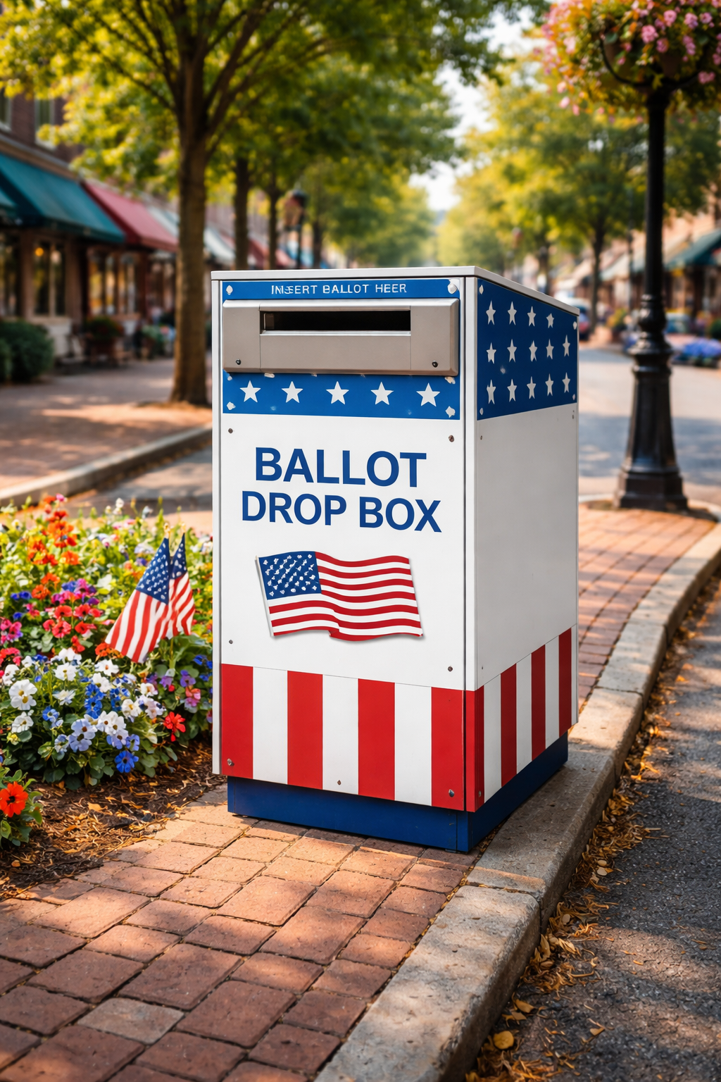
Be sure your vote counts:
Before printing:
Create a QR code linked to your web page or map showing drop box locations in your jurisdiction.
Replace the placeholder box in the lower-right corner with the QR code.
Test the QR code to be sure it works as expected.
Go to File > Download and select PDF. Print, address, stamp, and mail.
Note: To ensure the front of the postcard prints to the edge, send the file to a print shop and request a “full bleed” on the front.
Use a drop box the last week before Election Day.
REPLACE WITH QR CODE
Find the closest ballot drop box:

Slide 2
If you must return your ballot by mail the last week before Election Day:
1
Take your ballot to the counter at your local post office.
Ask the clerk to manually postmark or “hand-cancel” your ballot return envelope.
2
Remember: Your ballot will only be postmarked the same day if you request it.

