Slide 1
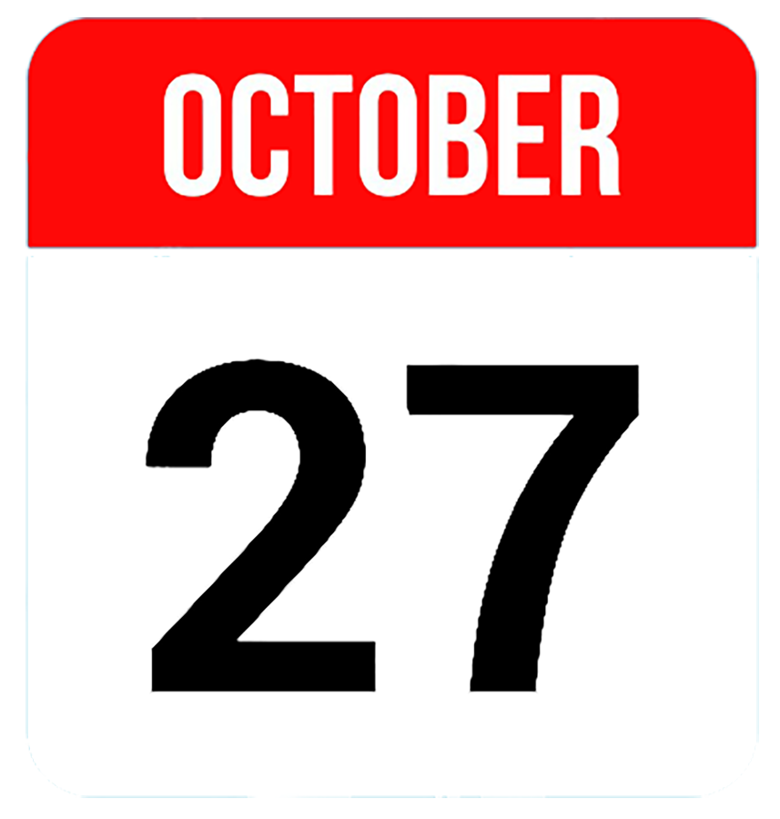
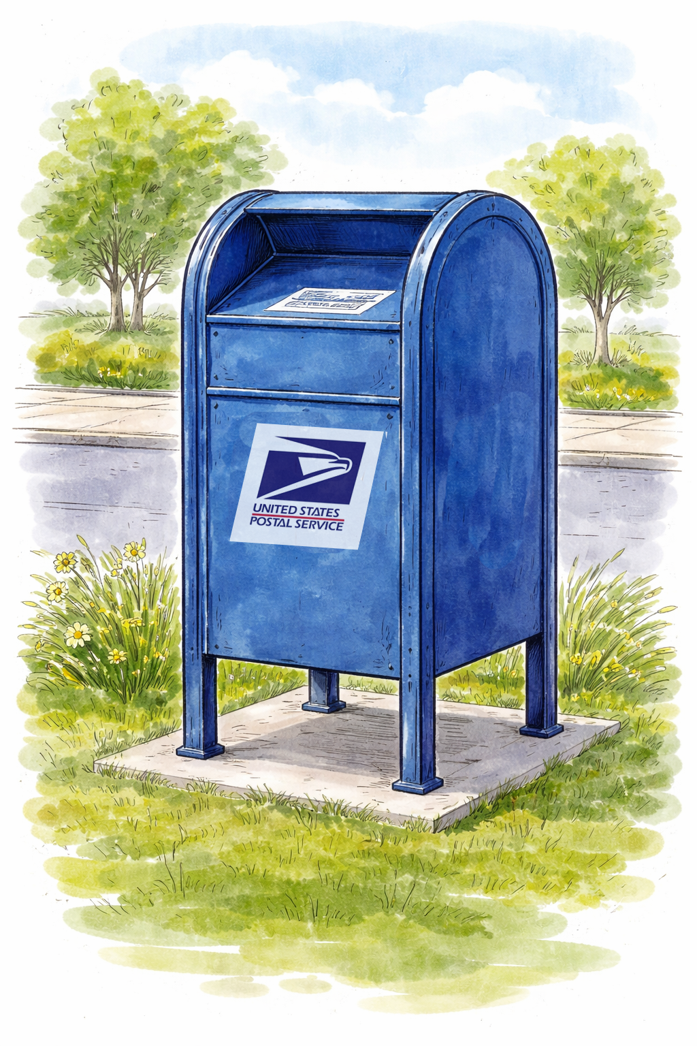
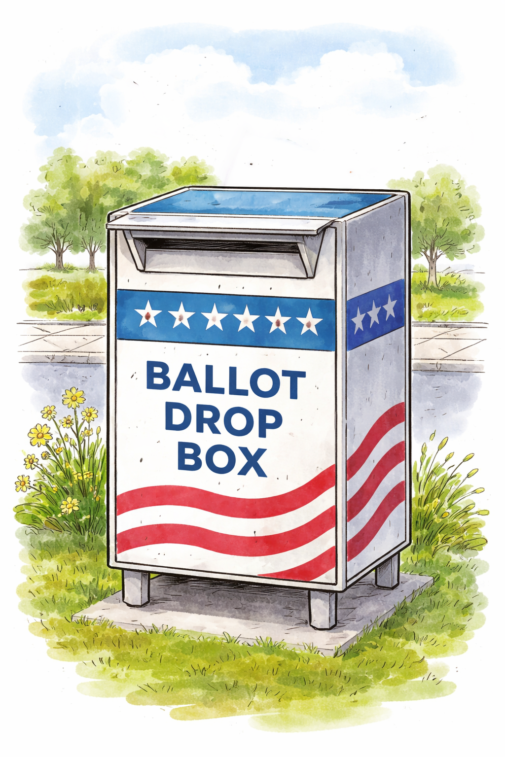
Election Day is November 3. Be sure your vote counts.
Before
Before printing:
Create a QR code linked to your web page or map showing drop box locations in your jurisdiction.
Replace the QR code placeholder box with the QR code.
Test the QR code to be sure it works as expected.
Replace the gray office seal or logo placeholder box with your seal or logo. This lets voters know this messaging is official.
Go to File > Download and select PDF. Print on 11x17-inch (tabloid) paper and display.
Vote early.
Late ballots
don’t count.
After
Find the closest ballot drop box:
QR CODE
Return your ballot:
By mail
Using a drop box
In person
Return your ballot:
Using a drop box
In person
ADD YOUR OFFICE’S SEAL OR LOGO HERE
Vote early.
Late ballots don’t count.

Slide 2
Election Day is Nov. 3. Be sure your vote counts.
Before
Before printing:
Create a QR code linked to your web page or map showing drop box locations in your jurisdiction.
Replace the QR code placeholder box with the QR code.
Test the QR code to be sure it works as expected.
Replace the gray office seal or logo placeholder box with your seal or logo. This lets voters know this messaging is official.
Go to File > Download and select PDF. Print on 11x17-inch (tabloid) paper and display.
ADD YOUR OFFICE’S SEAL OR LOGO HERE
Find the
closest
drop box:
QR CODE
After
Return your ballot:
By mail
Using a drop box
In person
Return your ballot:
Using a drop box
In person
Vote early. Late ballots don’t count.
Vote early.
Late ballots don’t count.

