Slide 1

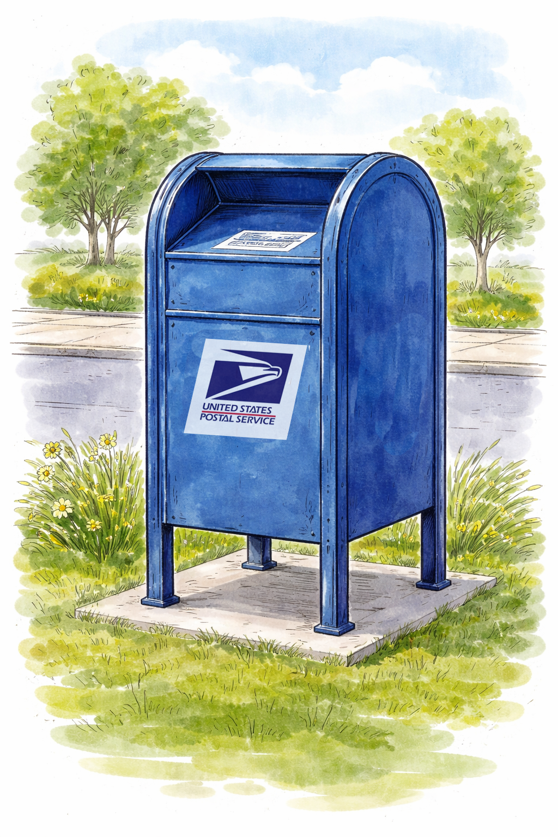
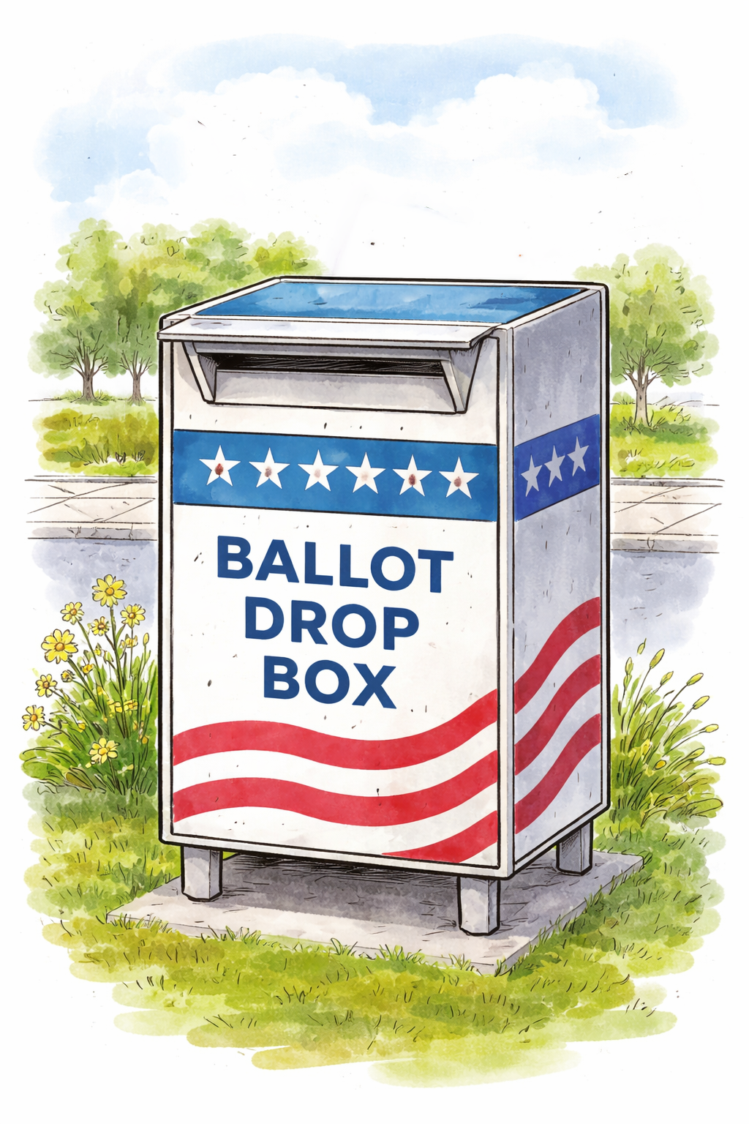
ADD ELECTION DATE
Election Day is [DATE]. Be sure your vote counts.
MONTH
ADD E-7 DATE
Before
00
Before printing:
Create a QR code linked to your web page or map showing drop box locations in your jurisdiction.
Add the election date for your primary or next election in the yellow area at the top. [BLUE ARROW]
Add E-7 dates. Type the date that is seven days before your primary or next election in two places: (1) “before” calendar icon, and (2) “after calendar icon. [RED ARROWS]
Replace the QR code placeholder box with the QR code.
Test the QR code to be sure it works as expected.
Replace the gray office seal or logo placeholder box with your seal or logo. This lets voters know this messaging is official.
Go to File > Download and select PDF. Print on 11x17-inch (tabloid) paper and display.
Vote early.
Late ballots don’t count.
ADD E-7 DATE
MONTH
After
Find the closest ballot drop box:
00
QR CODE
Return your ballot:
By mail
Using a drop box
In person
Return your ballot:
Using a drop box
In person
ADD YOUR OFFICE’S SEAL OR LOGO HERE
Vote early.
Late ballots don’t count.

