Slide 1
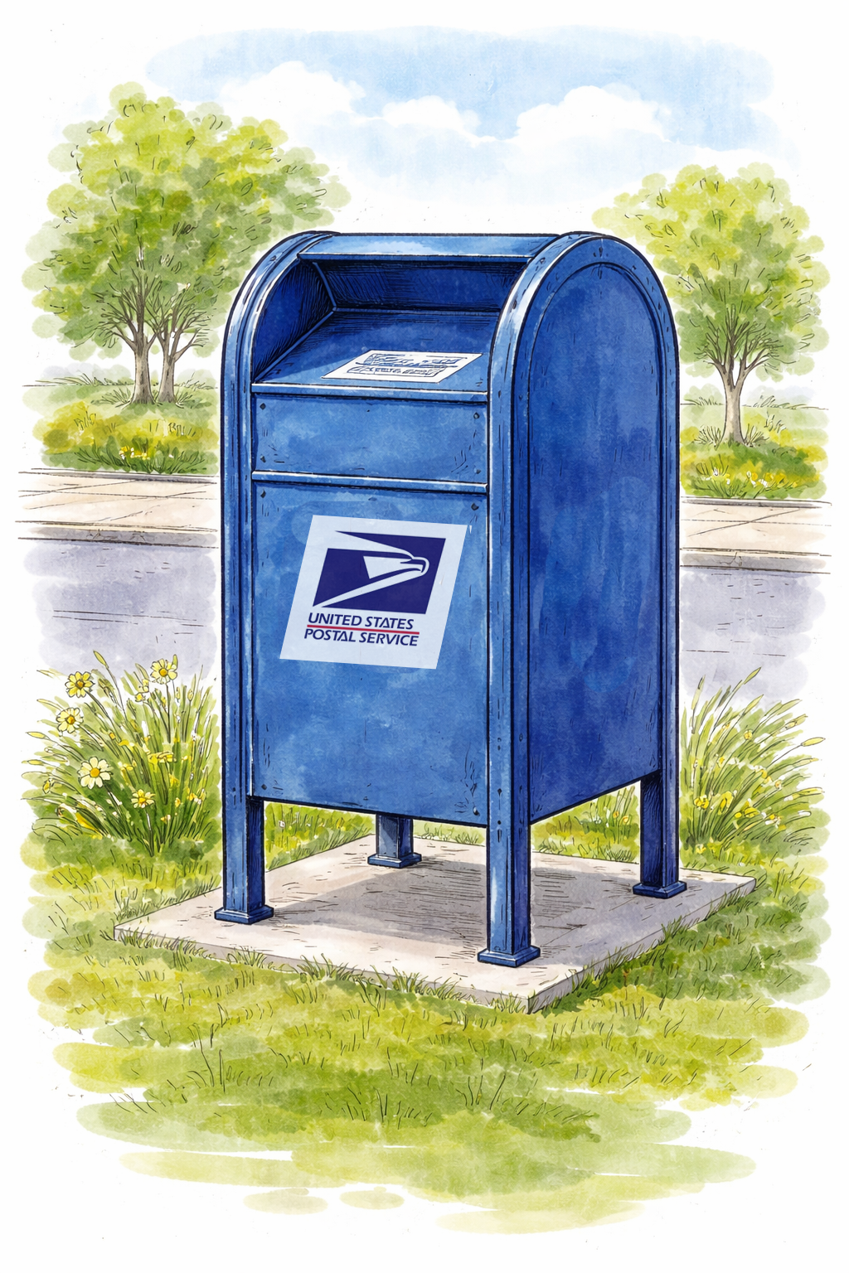

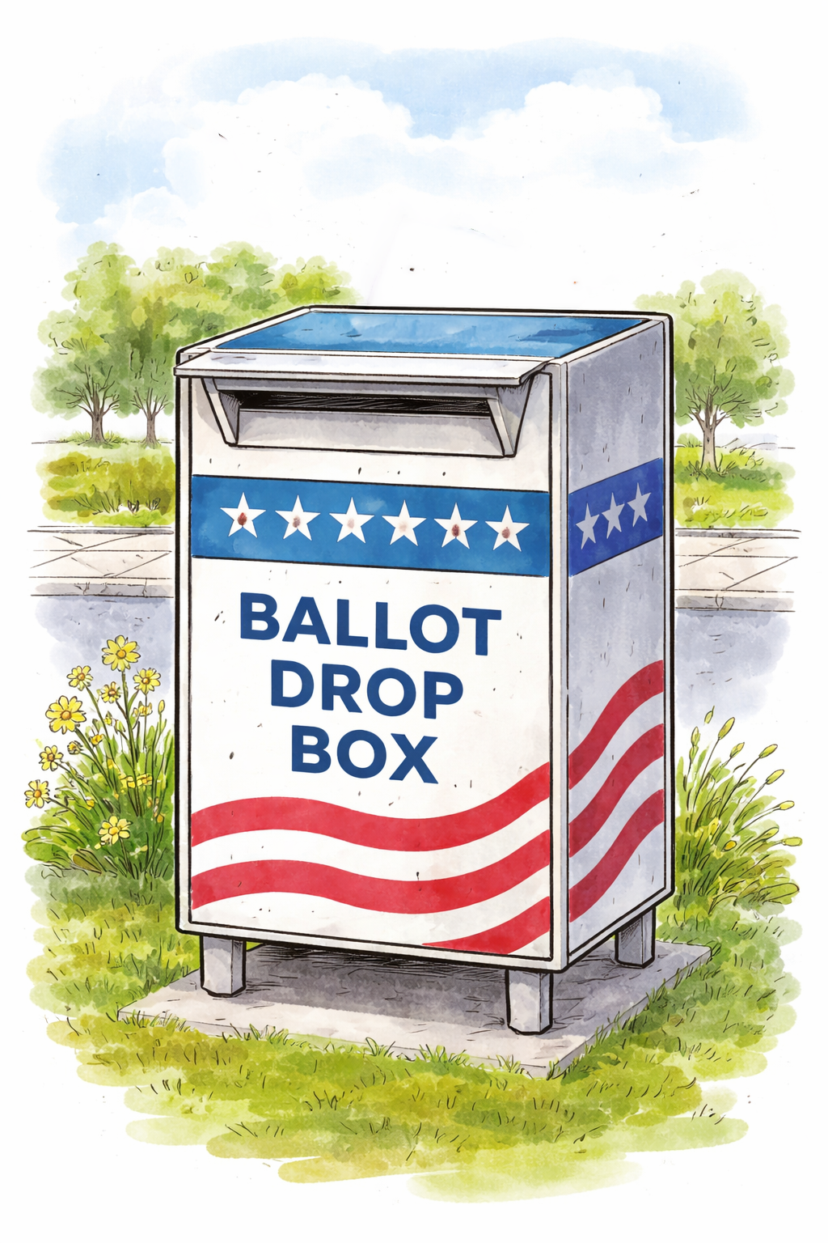
Election Day is [DATE].
ADD ELECTION DATE
Before printing:
Create a QR code linked to your web page or map showing drop box locations in your jurisdiction.
Add the election date for your primary or next election in yellow at top-right. [BLUE ARROW]
Add E-7 dates. Type the date that is seven days before your primary or next election in three places: (1) blue “before” text, (2) red, white and black calendar icon, and (3) red “after text. [RED ARROWS]
Replace the QR code placeholder box with the QR code.
Test the QR code to be sure it works as expected.
Replace the gray office seal or logo placeholder box with your seal or logo. This lets voters know this messaging is official.
Go to File > Download and select PDF. Print on 11x17-inch (tabloid) paper and display.
Be sure your
vote counts.
Before [DATE],
return your ballot:
By mail
Using a drop box
In person
ADD E-7 DATE
MONTH
Before
00
ADD E-7 DATE
After
ADD E-7 DATE
After [DATE],
return your ballot:
Using a drop box
In person
Find the closest ballot drop box:
QR CODE
ADD YOUR OFFICE’S SEAL OR LOGO HERE

Slide 2
Before printing:
Create a QR code linked to your web page or map showing drop box locations in your jurisdiction.
Add the election date for your primary or next election in the yellow area at the top. [BLUE ARROW]
Add E-7 dates. Type the date that is seven days before your primary or next election in two places: (1) “before” calendar icon, and (2) “after calendar icon. [RED ARROWS]
Replace the QR code placeholder box with the QR code.
Test the QR code to be sure it works as expected.
Replace the gray office seal or logo placeholder box with your seal or logo. This lets voters know this messaging is official.
Go to File > Download and select PDF. Print on 11x17-inch (tabloid) paper and display.
Note: In this layout, the yellow background color extends beyond the edge of the poster. The crop marks at the corners show the true edge. To ensure the poster prints to the edge, send the file to a print shop and request a “full bleed.”
Election Day is [DATE].
ADD ELECTION DATE
Be sure your vote counts.
MONTH
Before
00
ADD E-7 DATE
MONTH
ADD E-7 DATE
After
00
Return your ballot:
By mail
Using a drop box
In person
Return your ballot:
Using a drop box
In person
Find the closest ballot drop box:
QR CODE
ADD YOUR OFFICE’S SEAL OR LOGO HERE
Vote early.
Late ballots don’t count.

