Slide 1
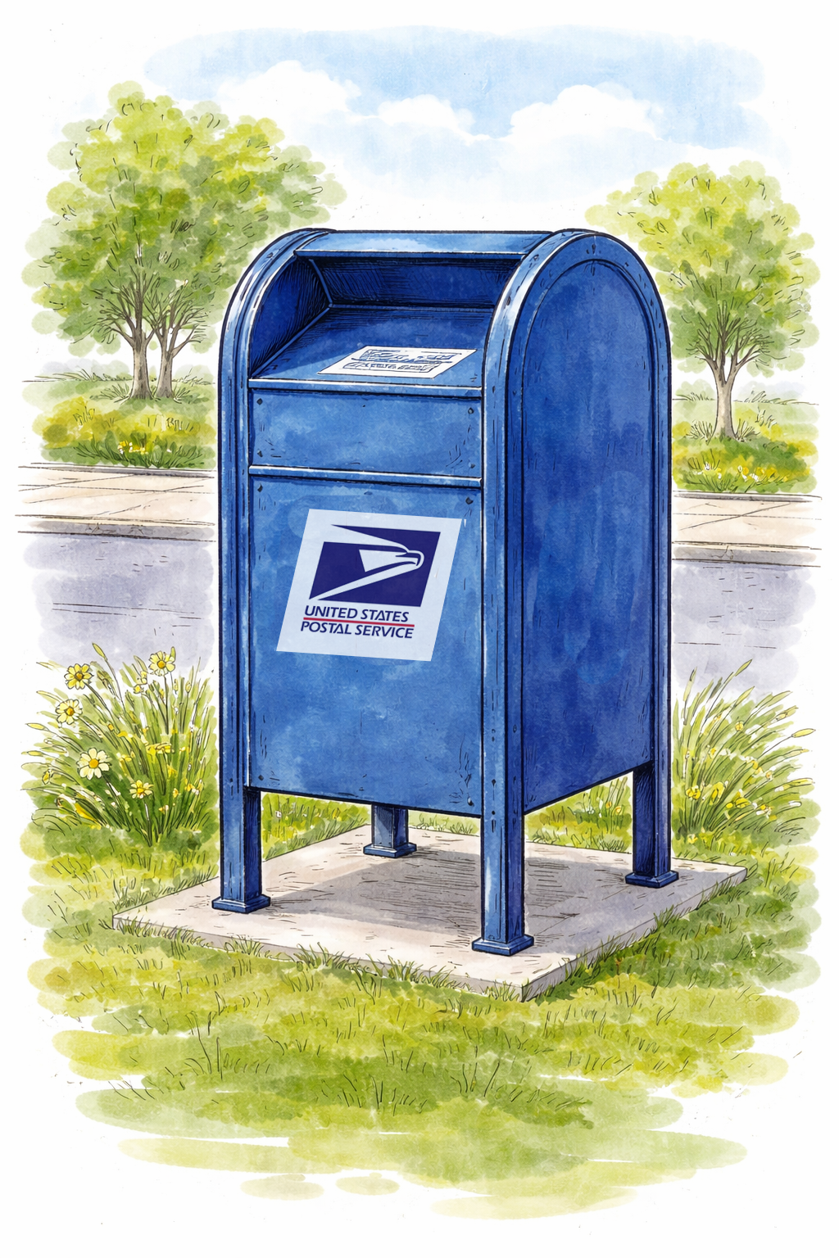
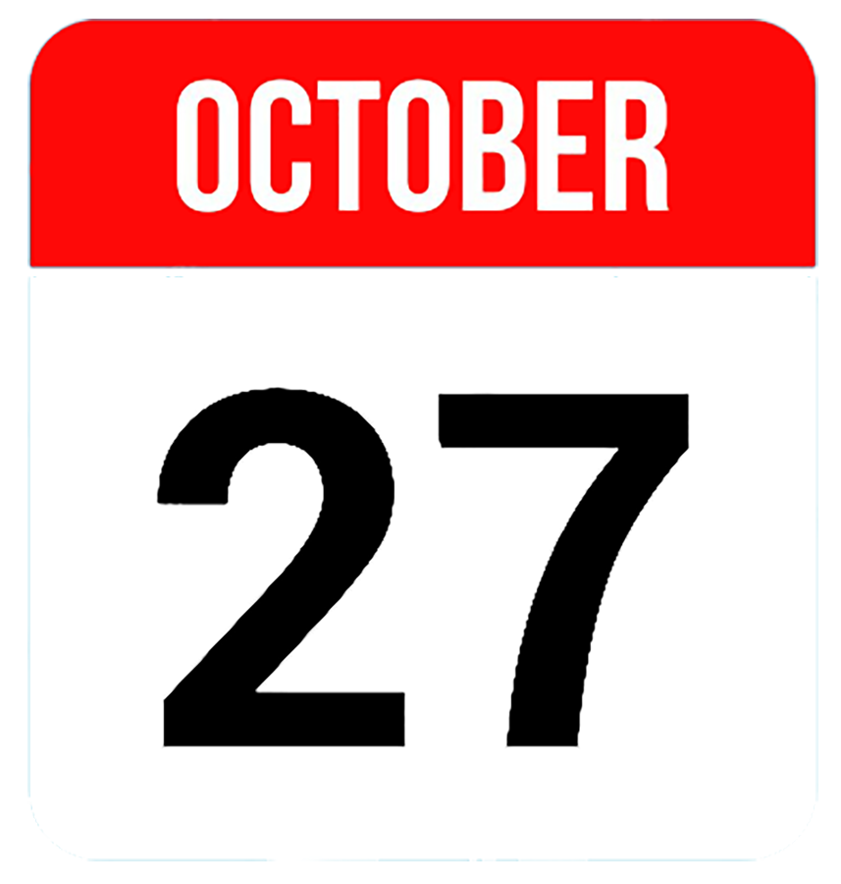
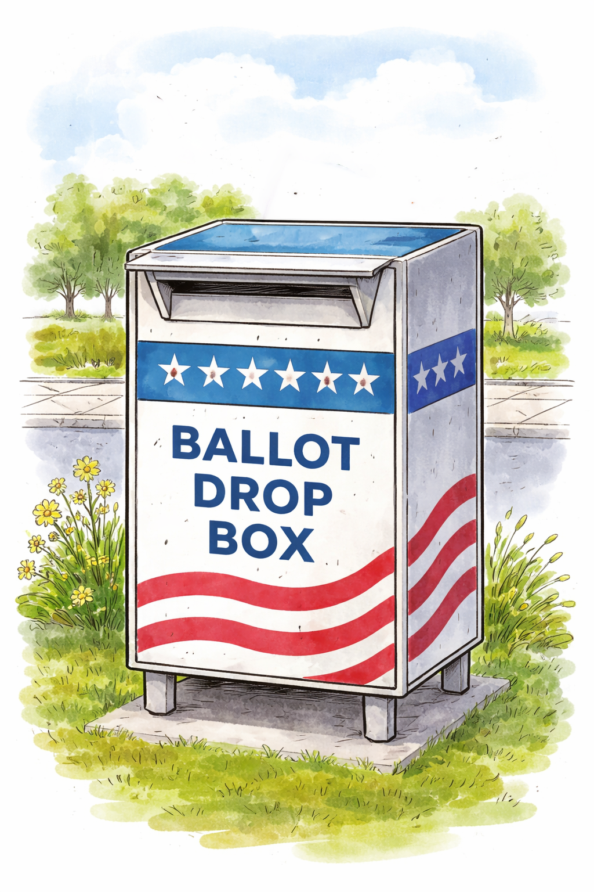
Election Day is November 3.
Before printing:
Create a QR code linked to your web page or map showing drop box locations in your jurisdiction.
Replace the QR code placeholder box with the QR code.
Test the QR code to be sure it works as expected.
Replace the gray office seal or logo placeholder box with your seal or logo. This lets voters know this messaging is official.
Go to File > Download and select PDF. Print on 11x17-inch (tabloid) paper and display.
Be sure your vote counts.
Before October 27, return your ballot:
By mail
Using a drop box
In person
Before
After
After October 27, return your ballot:
Using a drop box
In person
Find the closest ballot drop box:
QR CODE
ADD YOUR OFFICE’S SEAL OR LOGO HERE

Slide 2
Election Day is November 3.
Before printing:
Create a QR code linked to your web page or map showing drop box locations in your jurisdiction.
Replace the QR code placeholder box with the QR code.
Test the QR code to be sure it works as expected.
Replace the gray office seal or logo placeholder box with your seal or logo. This lets voters know this messaging is official.
Go to File > Download and select PDF. Print on 11x17-inch (tabloid) paper and display.
Note: In this layout, the yellow background color extends beyond the edge of the poster. The crop marks at the corners show the true edge. To ensure the poster prints to the edge, send the file to a print shop and request a “full bleed.”
Be sure your vote counts.
Before
After
Return your ballot:
By mail
Using a drop box
In person
Return your ballot:
Using a drop box
In person
Find the closest ballot drop box:
QR CODE
ADD YOUR OFFICE’S SEAL OR LOGO HERE
Vote early.
Late ballots don’t count.

