Slide 1
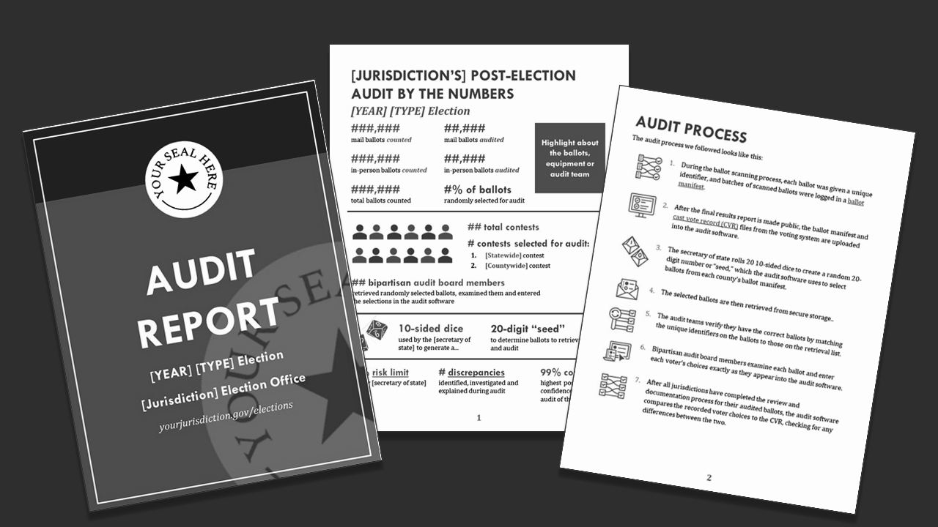
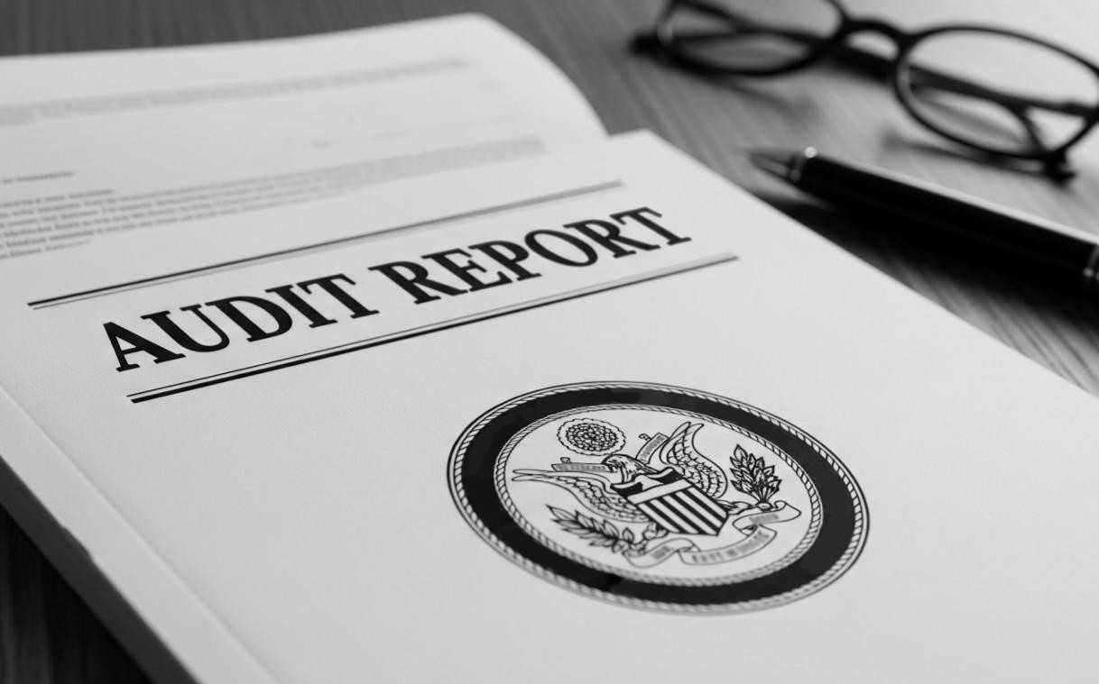
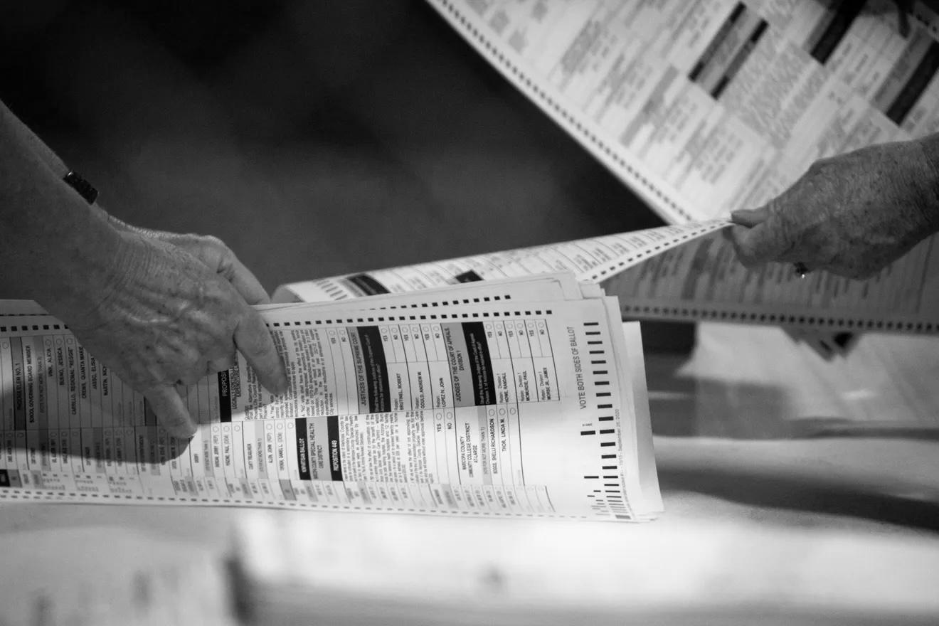

This is a template ready for customization. Replace text and images with your own, use the templated text and images with the modifications listed below, or combine templated content with your own.
BEFORE SHARING OR PRINTING:
1. Replace [State] on the cover with the name of your state.
2. Delete the placeholder box in the upper-right corner of the cover entirely or delete it and replace it with your organization’s logo. A white logo with no background works best.
3. On the back of the booklet, replace “Member of the public” with a person’s name and replace or update the quote.
4. On the back of the booklet, replace “Advocacy organization” with the name of an organization in your area and replace or update the quote.
If you will be printing your brochures professionally and want the cover image to extend to the edge of the page (full bleed):
1. Delete the outline near the edge of the page.
2. Replace the current cover image (grouped) on slide 1 with the image floating in the margin below, aligning the left edge of the replacement image with the center of the page (8.5 inches from the left edge of the sheet). The top, right and bottom of the image below will extend beyond the top, right and bottom margins to ensure full coverage.
“When I can read the audit report myself, in plain English, I feel more confident that the results are real.”
— Member of the public
DELETE OR REPLACE WITH YOUR LOGO
Clear audit reports boost election confidence.
[State] should require them.
"Election audits are intended to accomplish two things.
The first is to ensure that the election was properly conducted, that election technologies performed as expected, and that the correct winners were declared. The second is to convince the public of the first thing."
— Charles Stewart III and R. Michael Alvarez,
Introduction: Thoughts From the Election Audit Summit
“Audits only build trust when the public can understand them. A clear, accessible report is just as important as the audit itself.”
— Advocacy organization
BOOKLET BACK
BOOKLET FRONT
DELETE OR REPLACE WITH YOUR LOGO
Clear audit reports boost election confidence.
[State] should require them.

Slide 2





what?
goal:
What is a tabulation audit? Also known as a postelection audit, a tabulation audit is a check to ensure the voting equipment used during the election accurately counted votes.
Prepare and publish timely, plain
language, accessible postelection tabulation audit reports.
why?
Why do states conduct tabulation audits? They’re an efficient way to confirm that votes were correctly interpreted, recorded and counted, and to verify the results of the election.
audit reports
Election officials provide transparency through public reporting. Requiring audit reports to be published promptly, written in plain language and include procedures, findings, discrepancies and any corrective actions ensures voters, candidates and the media can understand and verify the audit process and results.
how?
How do audit reports fit in? Written in clear, plain language, they’re an efficient and effective tool for communicating to the public how your state’s audits work and if the audit detected any errors, increasing transparency and confidence in your elections.
Audit reports create transparency, increase trust
in our elections and help
head off potential problems:
Unknown audit processes
Explaining what was audited, how the audit worked, whether any issues surfaced and how they were resolved encourages public trust.
Hard-to-get information
Unavailable, delayed or overly technical audit reports do not support public understanding of how audits verify election results like accessible, timely, plain language reporting.
False rumors and disputes
Timely, plain language reports of audit findings help deter false rumors and baseless disputes
over winners.
No clear documentation to verify reliability of results
Audit reports backed by supporting data provide clear evidence that results were verified before winners were certified and, when compared against certified election results, serve as an important check for results reliability.
focus:
Timely audit reports, written in plain language, accessible to the public and published by a clear deadline, support
election accuracy and trust.
key facts:
Audit findings, when made available to the public, are essential for building and maintaining public confidence that election outcomes are accurate and legitimate.
MIT Election Data & Science Lab, Election Auditing: Key Issues and Perspectives (2018).
Clearly communicating all audit findings—as well as any steps taken to address found discrepancies—can help proactively dispel concerns about the voting process. Bipartisan Policy Center's Task Force on Elections, Bipartisan Principles for Election Audits (2021).
Plain-language election materials significantly improve voter understanding and trust in election results. Center for Civic Design, Plain Language (2019); U.S. EAC, Best Practices for Designing Effective Voter Education Materials (2024).
A survey of more than 6,000
Americans showed that learning
about a jurisdiction's audits
significantly increased trust in that jurisdiction's elections. Yankelovich Center for Social Science Research, Can
Visual Summaries of Post-Election Audits
Inrease Confidence in Elections? (2024).
Transparent, accessible reporting helps reduce misinformation with authoritative evidence directly from election officials. Aspen Institute Commission on Information
Disorder, Final Report (2021).
INSIDE LEFT
INSIDE RIGHT

