Slide 1
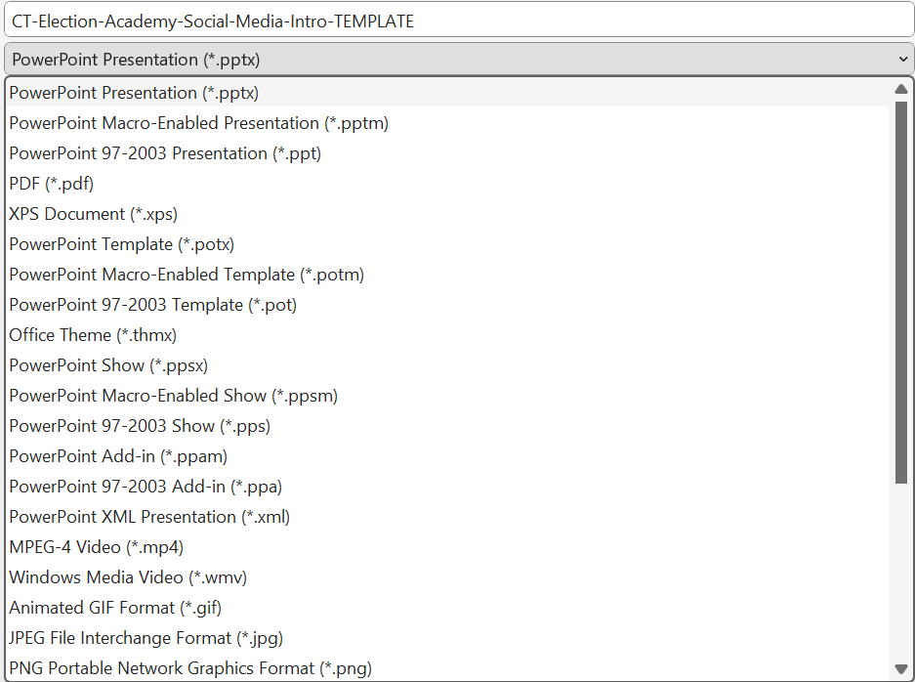
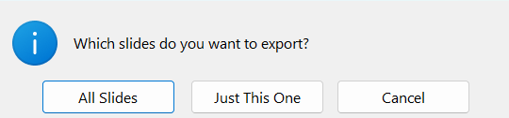
Instructions
Choose one of the slides in this presentation to use on your website.
Update the bracketed text for your jurisdiction and add the application deadline.
Update the instruction for more information or to apply.
With that slide open, go to File > Save as.
Choose where you would like to save your image, such as the Pictures folder or the folder you use for your Election Academy.
Give your image a name in the file name field.
Then, use the dropdown under the file name to select the type of image file you want to use. If you’re not sure, select PNG.
Click the Save button.
If you see a message asking if want to export All Slides or Just This One,
choose Just This One.
Note: If you updated all the slides with your information, you could choose All Slides to save them all as PNG files.
Next, locate the PNG file in the folder where you saved it. It’s ready to use on your website.

Slide 2
[Jurisdiction]
Election Academy
Apply by
[DATE]
Learn how election officials prepare for and run our elections.
For more information and to apply:
[ADD INSTRUCTION TO CALL/EMAIL/APPLY ONLINE]

Slide 3
NEW! [Jurisdiction]
Election Academy
Apply by
[DATE]
[Jurisdiction]’s first election education course!
Learn how election officials prepare for and run our elections.
yourJurisdiction.gov

Slide 4
[Jurisdiction]
Election Academy
Apply by
[DATE]
Classes start
on [DATE]!
Learn about elections from [Jurisdiction]’s experts.
yourJurisdiction.gov

