Slide 1
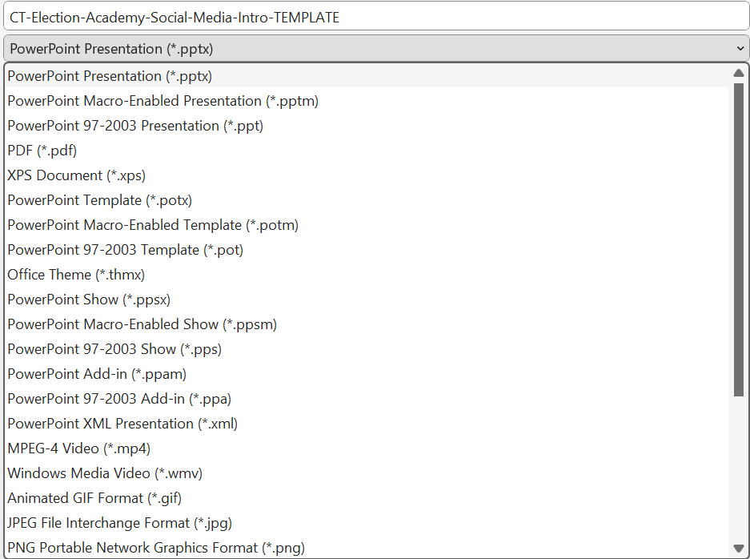
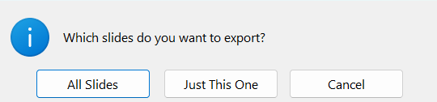
Instructions
Choose one of the slides in this presentation to use on social media or on your website.
Update the bracketed text for your jurisdiction.
Update the website URL to match your jurisdiction’s or your online application form for your Election Academy.
Delete the placeholder for a logo or seal and add your jurisdiction’s logo or seal.
With that slide open, go to File > Save as.
Choose where you would like to save your image, such as the Pictures folder or the folder you use for your Election Academy.
Give your image a name in the file name field.
Then, use the dropdown under the file name to select the type of image file you want to use. If you’re not sure, select PNG.
Click the Save button.
If you see a message asking if want to export All Slides or Just This One, choose Just This One. Note: If you updated all the slides with your information, you could choose All Slides to save them all as PNG files.
Next, locate the PNG file in the folder where you saved it. It’s ready to use on social media or on your website.

Slide 2


[Jurisdiction] Election Academy:
Learn all about elections in [Jurisdiction]
yourJurisdiction.gov
YOUR JURISDICTION’S LOGO OR SEAL

Slide 3
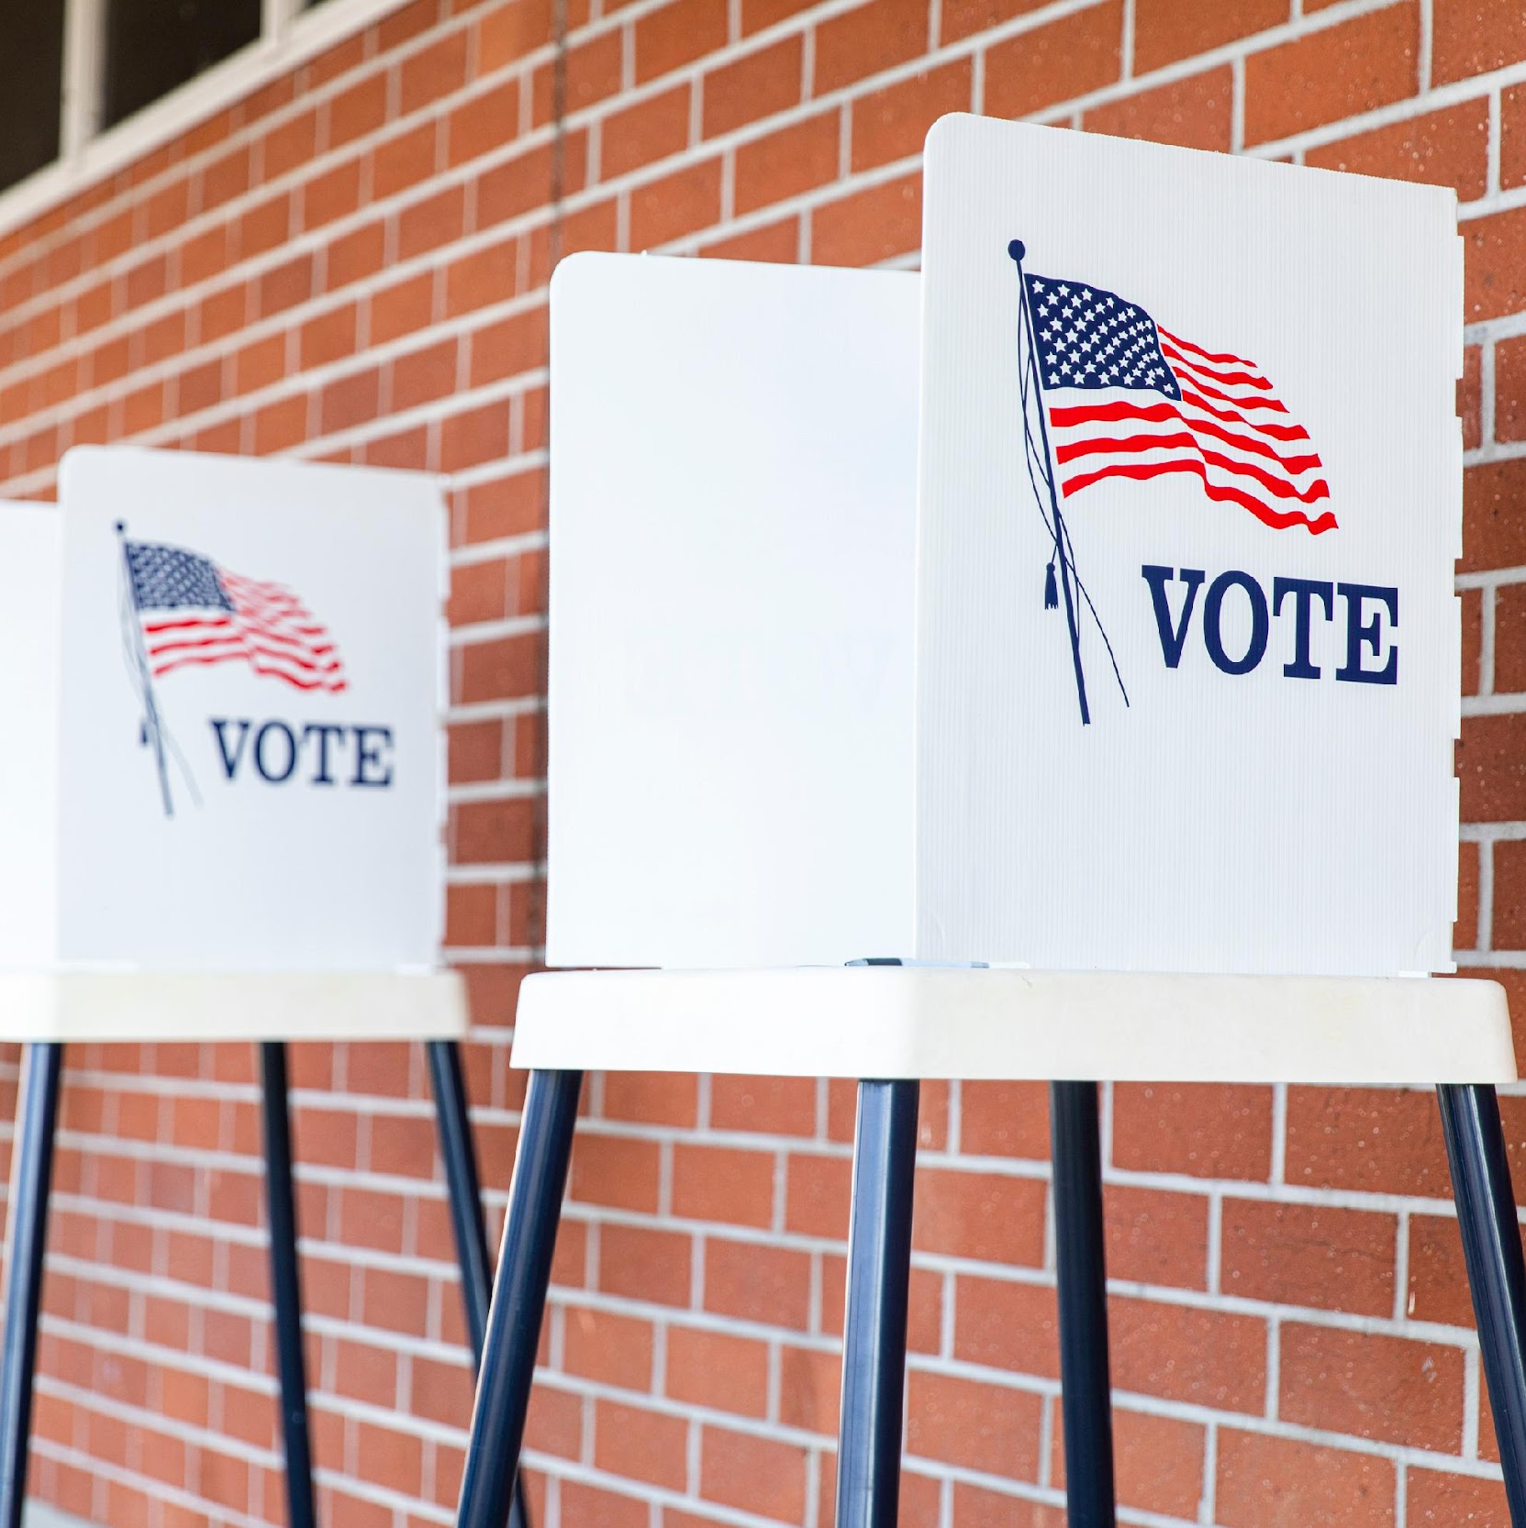
Find out how elections really work: [Jurisdiction] Election Academy
yourJurisdiction.gov
YOUR JURISDICTION’S LOGO OR SEAL

Slide 4

Learn about
elections from
[Jurisdiction’s] experts
YOUR JURISDICTION’S LOGO OR SEAL

Slide 5

New! [Jurisdiction] Election Academy:
No better way to learn about our elections
YOUR JURISDICTION’S LOGO OR SEAL
yourJurisdiction.gov

Slide 6
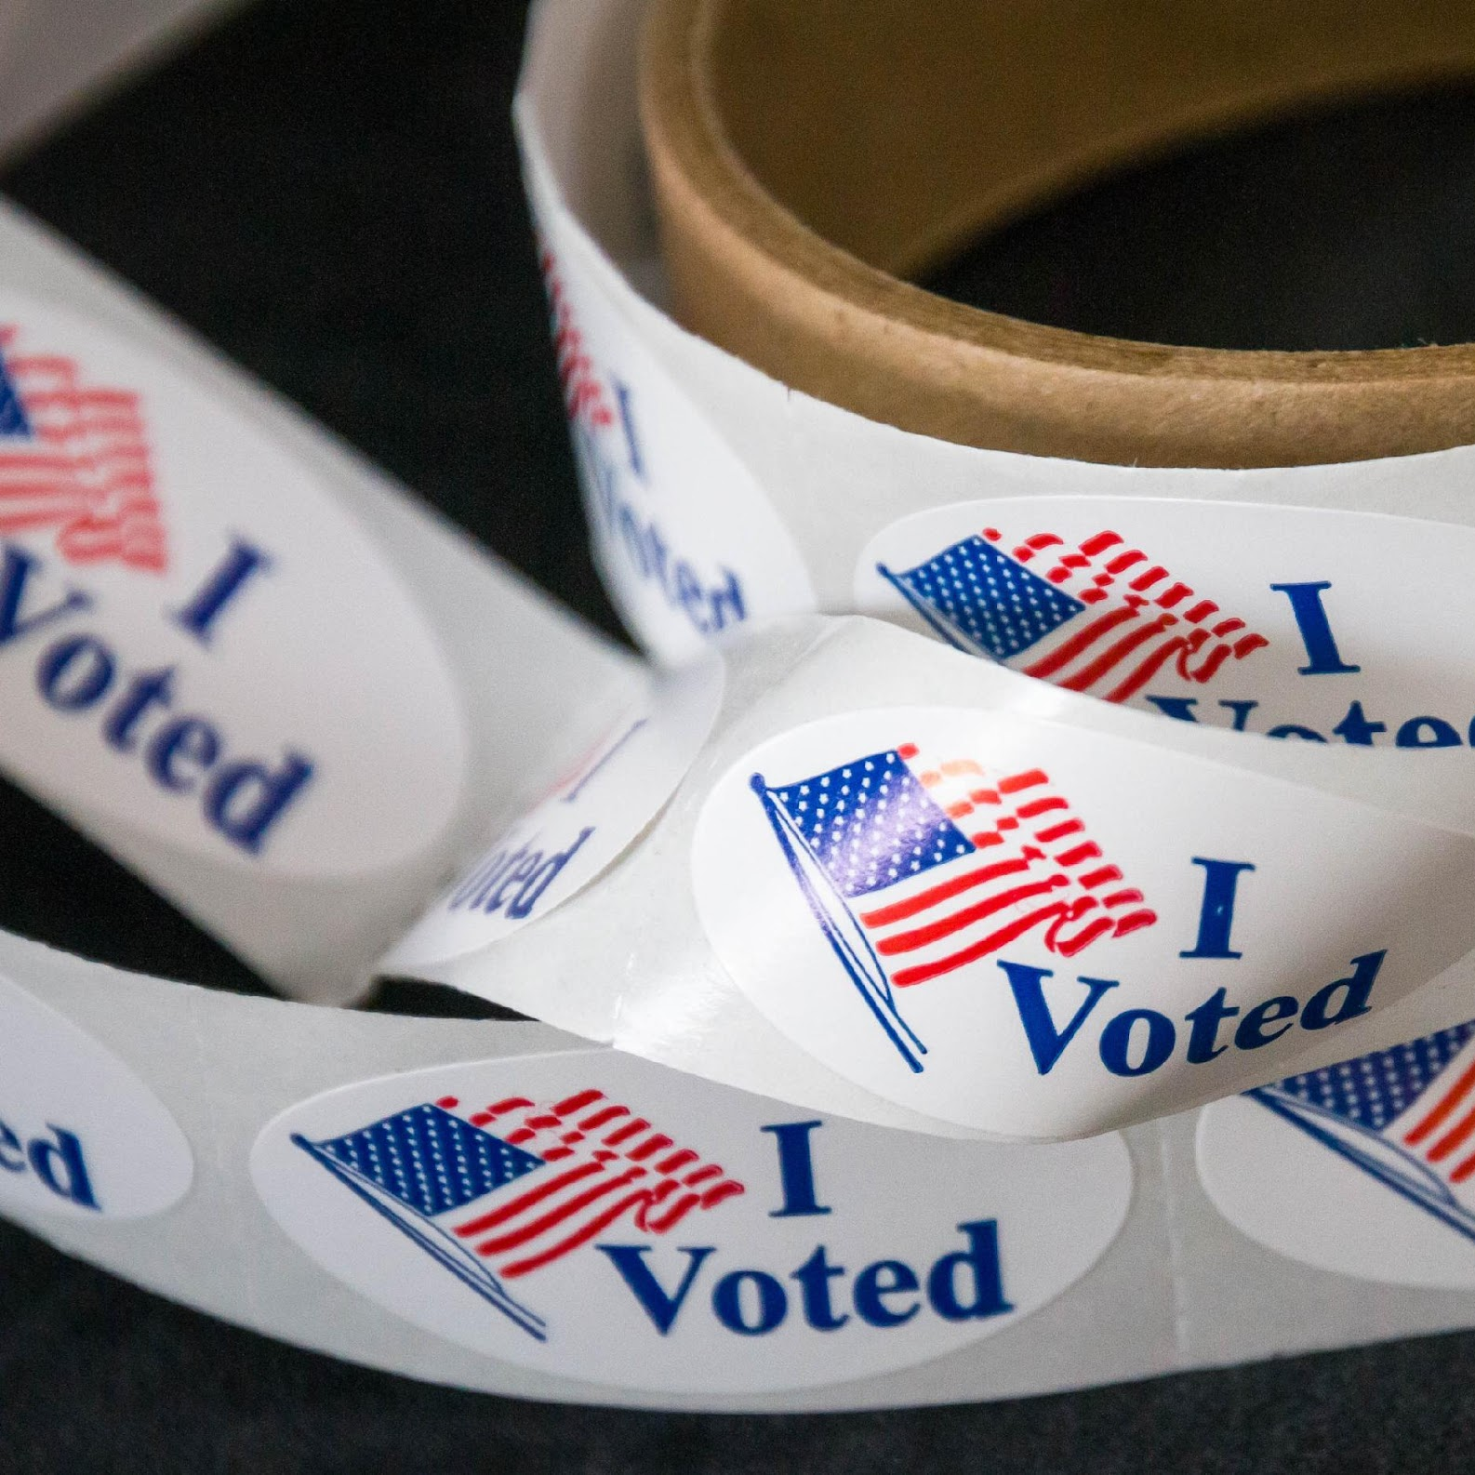
Learn more about our elections: [Jurisdiction] Election Academy
yourJurisdiction.gov
YOUR JURISDICTION’S LOGO OR SEAL

