Slide 1
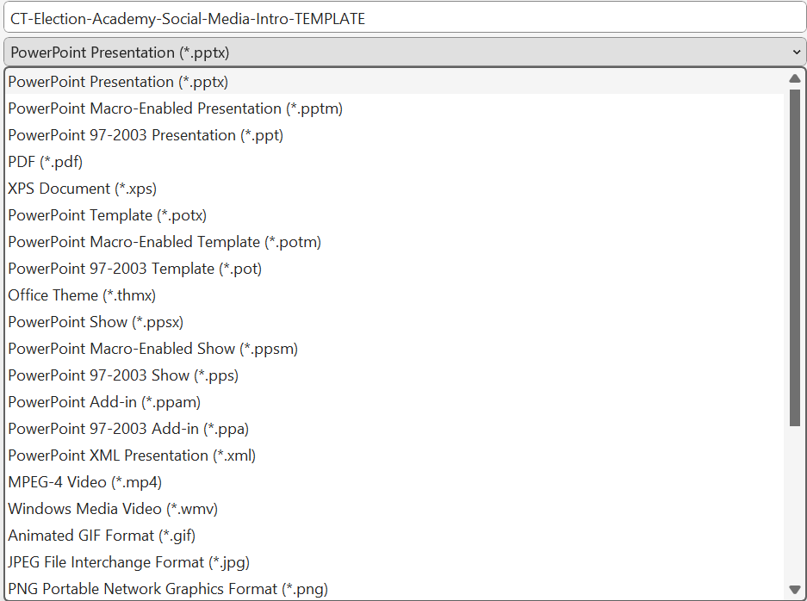
Instructions
Choose one of the slides in this presentation to use on social media or your website.
Adjust, add to and delete text as needed to fit your jurisdiction’s deadlines, rules and policies. .
With that slide open, go to File > Save as.
Choose where you would like to save your image, such as the Pictures folder or the folder you use for your Election Academy.
Give your image a name in the file name field.
Then, use the dropdown under the file name to select the type of image file you want to use. If you’re not sure, select PNG.
Click the Save button.
If you see a message asking if want to export All Slides or Just This One, choose Just This One. Note: If you updated all the slides with your information, you could choose All Slides to save them all as PNG files.
Next, locate the PNG file in the folder where you saved it. It’s ready to use on social media or your website.

Slide 2
Mail ballots must be postmarked by Nov. 5 and arrive by Nov. 12 to be accepted.
DON’T MISS YOUR CHANCE TO VOTE RETURN YOUR BALLOT RIGHT AWAY
YOURJURISDICTIONVOTES.GOV

Slide 3
Ballot counting doesn’t stop on Election Day.
Elections are often "called" before all ballots are counted. But all valid ballots are counted:
Mail ballots postmarked by Nov. 5 and received by Nov. 12
Military and overseas ballots and provisionals
Challenged ballots that are resolved
Results become official when the election is certified on <Date>.
YOURJURISDICTIONVOTES.GOV

Slide 4
What to know about mail ballots
In 2020, voting by mail overtook in-person Election Day voting as the most common voting method, with 43.1% of American voters casting ballots by mail.
It takes time to process mail ballots before they can be counted. In some states, election workers are prohibited from opening mail ballots before Election Day.
As more ballots are counted, results can and likely will change, which is normal and expected.
Military and overseas ballots are always counted after Election Day. In 2020, states sent 1.2 million ballots to overseas voters and 900,000 were returned.
On-time challenged mail ballots are counted once these voters provide election officials with missing information or correct an error as permitted under state law.
The deadline for mail ballots is Nov. 12. Any ballots postmarked by Nov. 5 and received by Nov. 12 are accepted.
YOURJURISDICTIONVOTES.GOV

Slide 5
Why election results change after election night
Results are not final on election night, and voters should be prepared for counts to change in the following days
As more ballots are counted, results can and likely will change, which is normal and expected.
Election results become official when the election is certified. This takes place at a certification meeting at <TIME> on <DATE>.
In particularly close elections, it may take days or even weeks before a winner can be declared.
Official vote counting periods — or the time between polls close on election night and certification — can last days or weeks, depending on state law. Delaware requires election certification two days after Election Day in contrast with Arkansas, which allows 45 days.
Military and overseas ballots are counted after Election Day.
Provisional and challenged ballots are counted once these voters provide election officials with missing information, ID or correct an error as permitted under state law.
Mail ballots postmarked by Nov. 5 and received by Nov. 12 are accepted. In some states, election workers are prohibited from opening mail ballots before Election Day. And it takes time to process mail ballots before they can be counted.
YOURJURISDICTIONVOTES.GOV

