Slide 1
Instructions
This template is ready for your ballot data, charts and terms.
Data: Enter your data in our Ballots Received & Ballot Status spreadsheet (Excel) to create charts. Follow the instructions on the first tab of the spreadsheet to save your carts as pictures, so you can add them to this slideshow. The same instructions explain how to save these slides as images for social media, your website, etc.
Text: Once you have your ballot totals and percentages, update the numbers in the text on each slide. Also replace <bracketed text> to personalize your slides. Be sure to update the <Today’s Date> field so viewers know that the data represented on your slides is current.
Glossary: The last slide has space for brief definitions that viewers may need. It is pre-filled with definitions for challenged, provisional and verified ballots. Adjust, add and delete definitions as needed to fit your processes and terminology.

Slide 2
<Your Jurisdiction>
Ballot Count & Ballot Status Update
<Today’s Date>

Slide 3
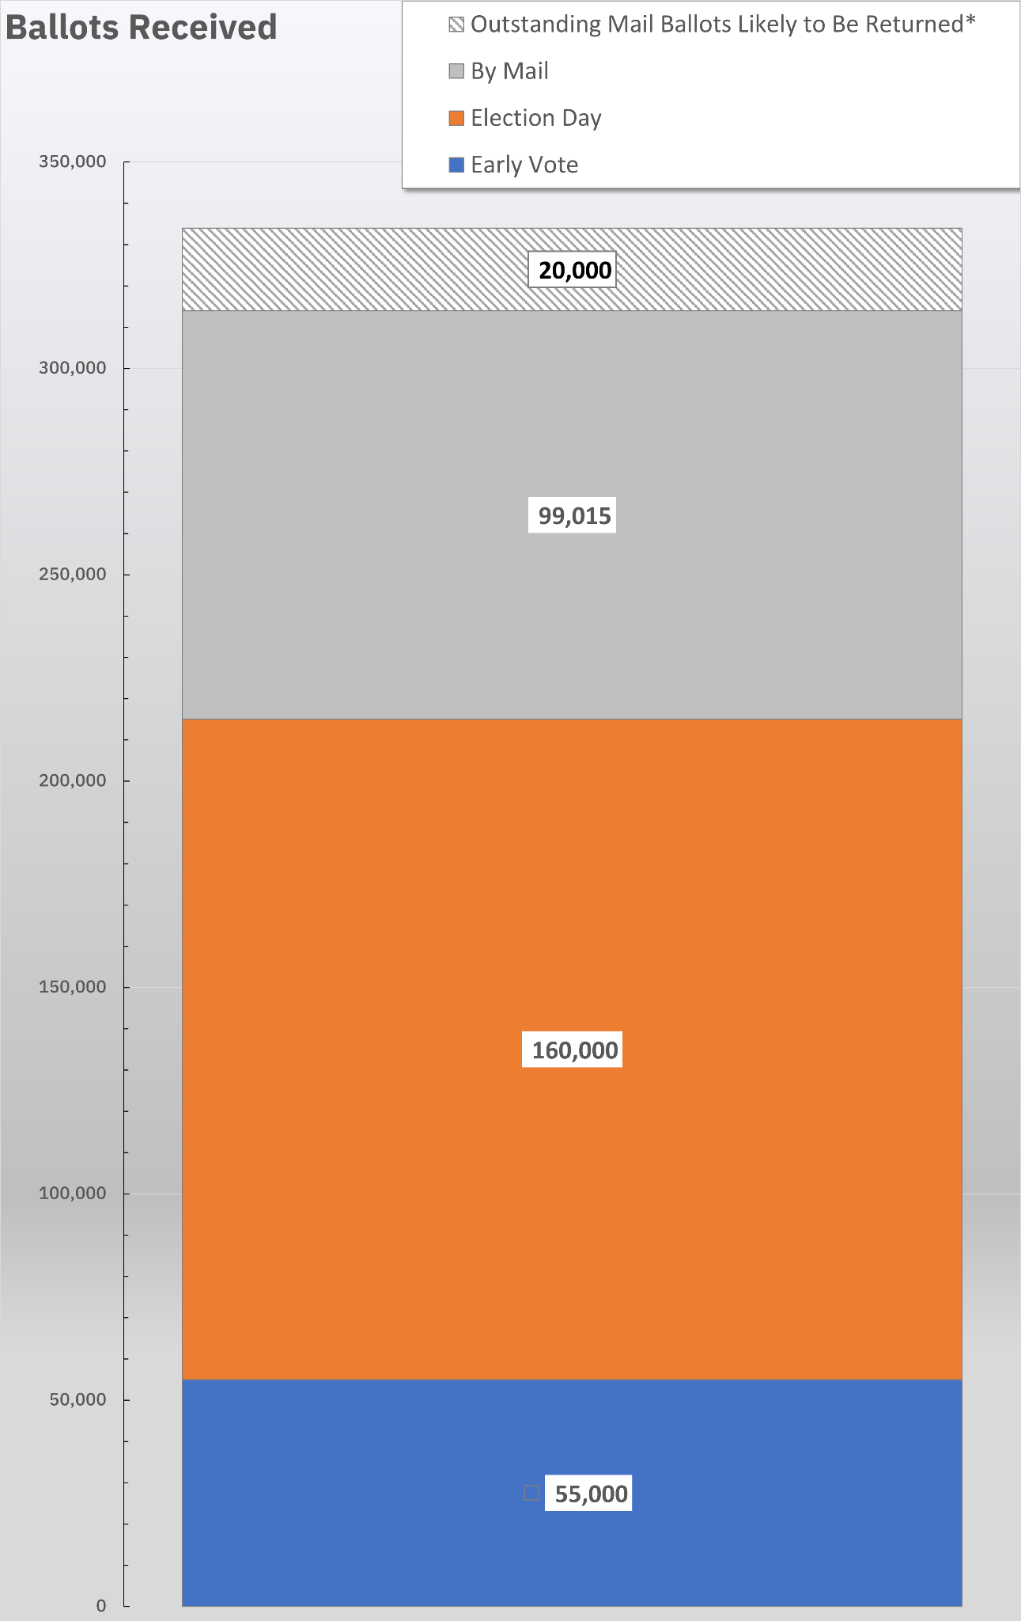
Ballots Received
As of <Date & Time>, <Jurisdiction> has received a total of 314,015 ballots
55,000 early voting
160,000 Election Day
99,015 mail ballots
Based on mail ballot return rates in 2020, we anticipate that approximately 20,000 of the outstanding mail ballots will be returned by the Nov. 12 deadline.*
Mail ballots must be postmarked on or before Election Day and arrive by Nov. 12 to be accepted.
<Today’s Date> • <Your Jurisdiction>

Slide 4
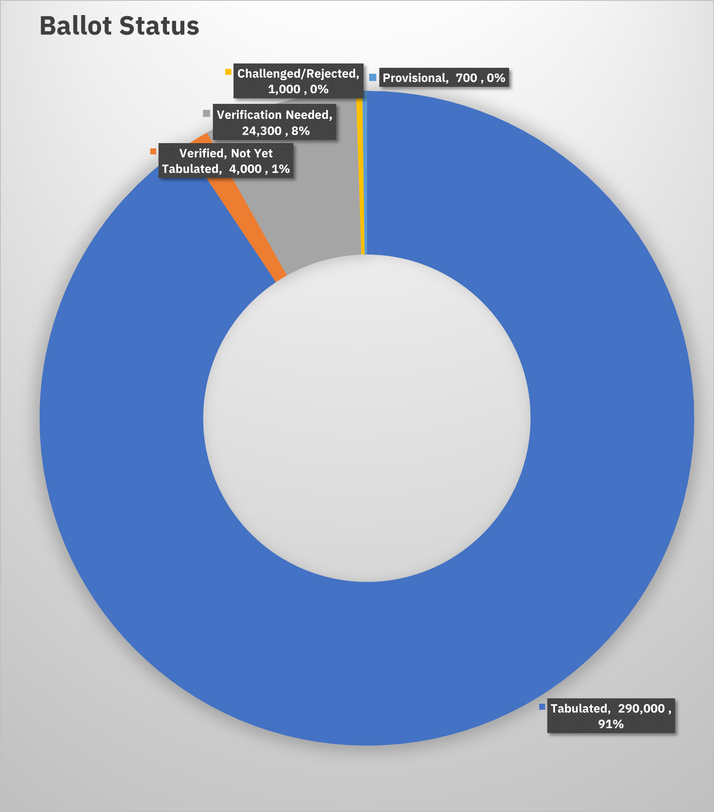
Ballot Status
As of <Date & Time>, <Jurisdiction> has received a total of 320,000 ballots.
91%: tabulated
1%: verified but not yet tabulated
8%: need verification
< .02%: provisionals
< .03%: challenged or rejected
Our plan is to finish tabulation by [TIME] on [DATE].
<Today’s Date> • <Your Jurisdiction>
<Today’s Date>

Slide 5
Glossary
Challenged Challenged ballots are mail ballots that cannot be verified for one of a variety of reasons. Voters can resolve the issue with their ballot until Nov. 12.
Provisionals Provisional ballots are marked by voters who have a registration issue during in-person voting. If the issue can be resolved, the provisional ballot is counted.
Verified Verified ballots are mail ballots that have been received and reviewed to ensure they meet requirements such as necessary signatures. They are ready to be tabulated.

