Slide 1
Mail ballots
have been sent
For the November 5, 2024 General Election

Slide 2
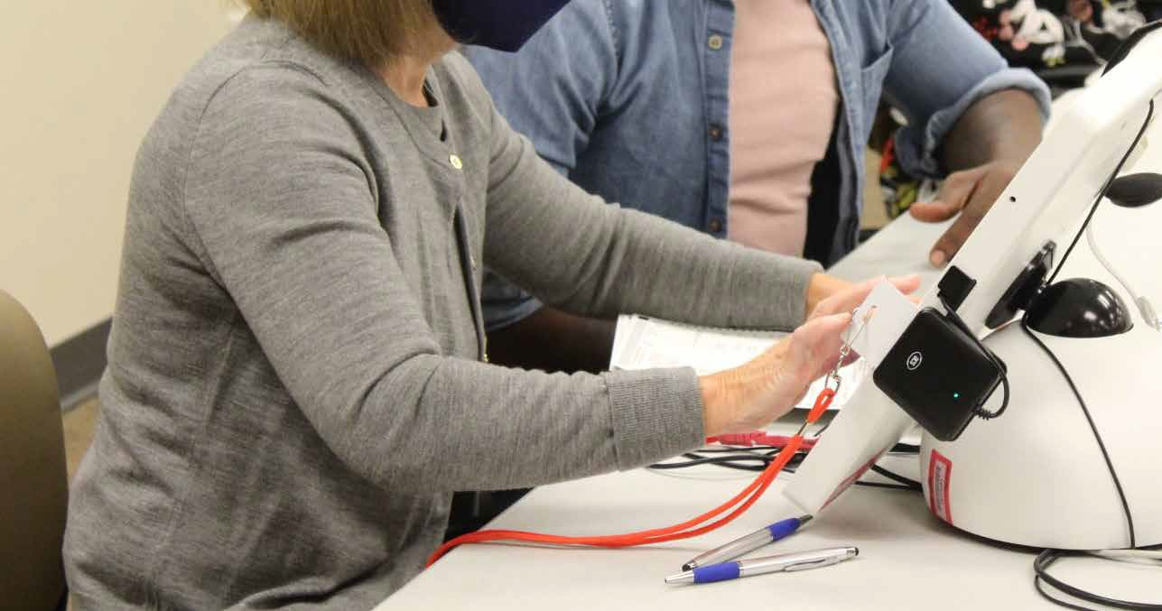
Did you know?
WE TEST VOTING
EQUIPMENT
BEFORE
EVERY ELECTION.

Slide 3
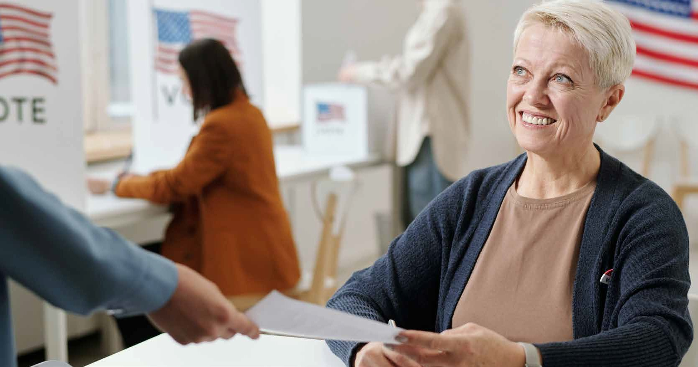
Sign up to be
a poll worker

Slide 4
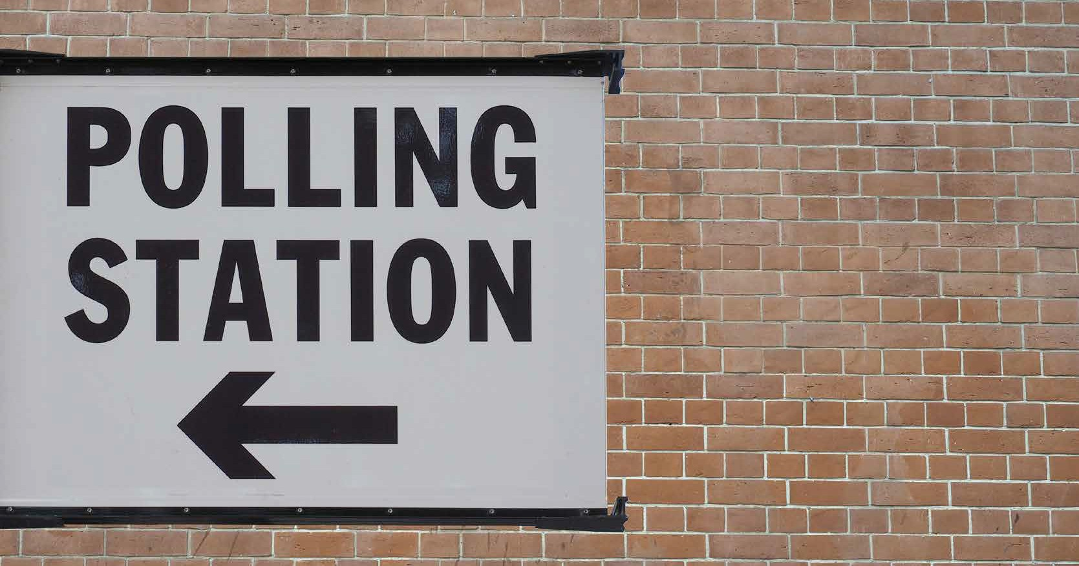
Did you know?
WE REQUIRE TRAINED, BIPARTISAN ELECTION WORKERS AT ALL
POLLING LOCATIONS.

Slide 5
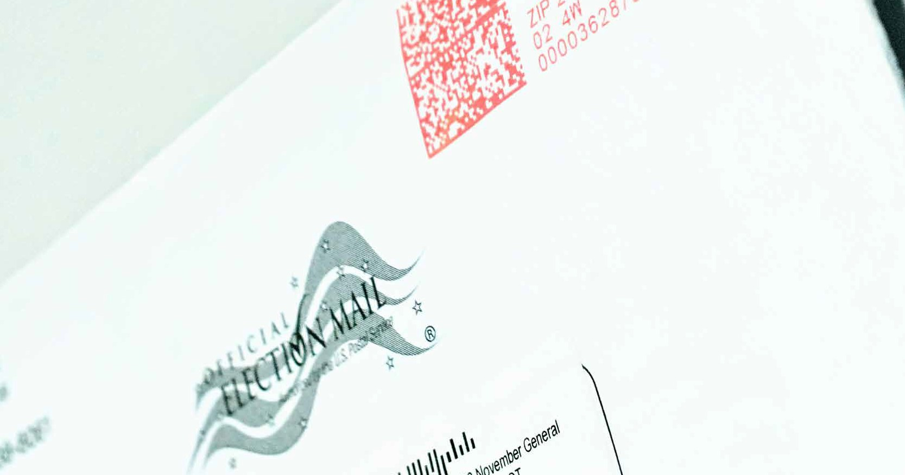
Did you know?
WE VERIFY VOTER
INFORMATION
WHEN ISSUING MAIL BALLOTS.

Slide 6
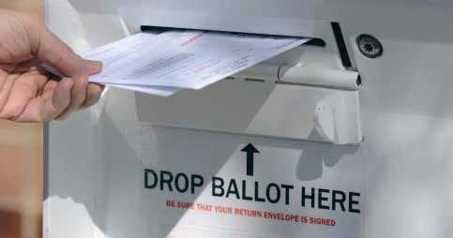
Did you know?
WE SECURE
EVERY BALLOT
DROP BOX
AND MAIL
BALLOT DEPOSITED.

Slide 7
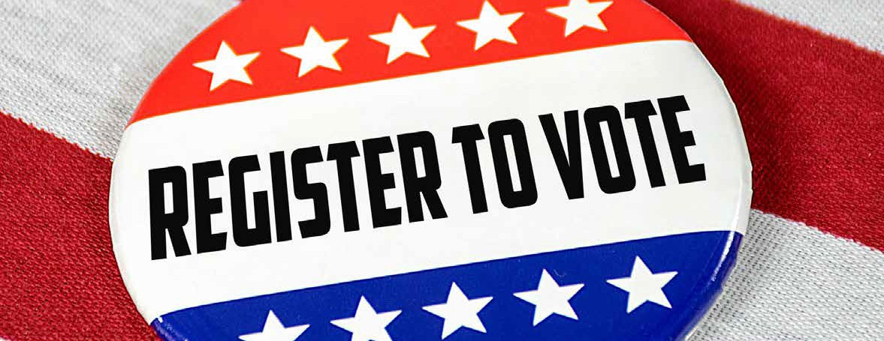

Slide 8
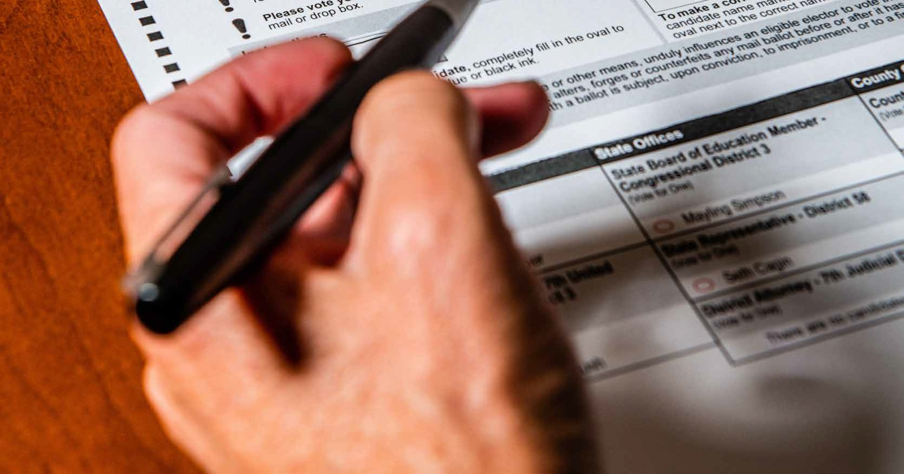
Did you know?
WE USE PAPER BALLOTS FOR EVERY VOTER.

Slide 9
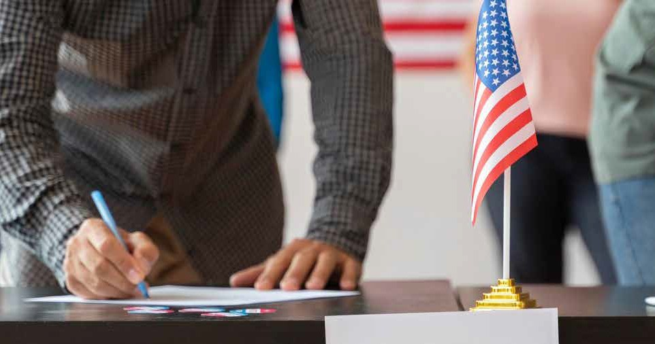
Did you know?
WE ONLY REGISTER U.S. CITIZENS WHO WILL BE 18 BY ELECTION DAY.

Slide 10
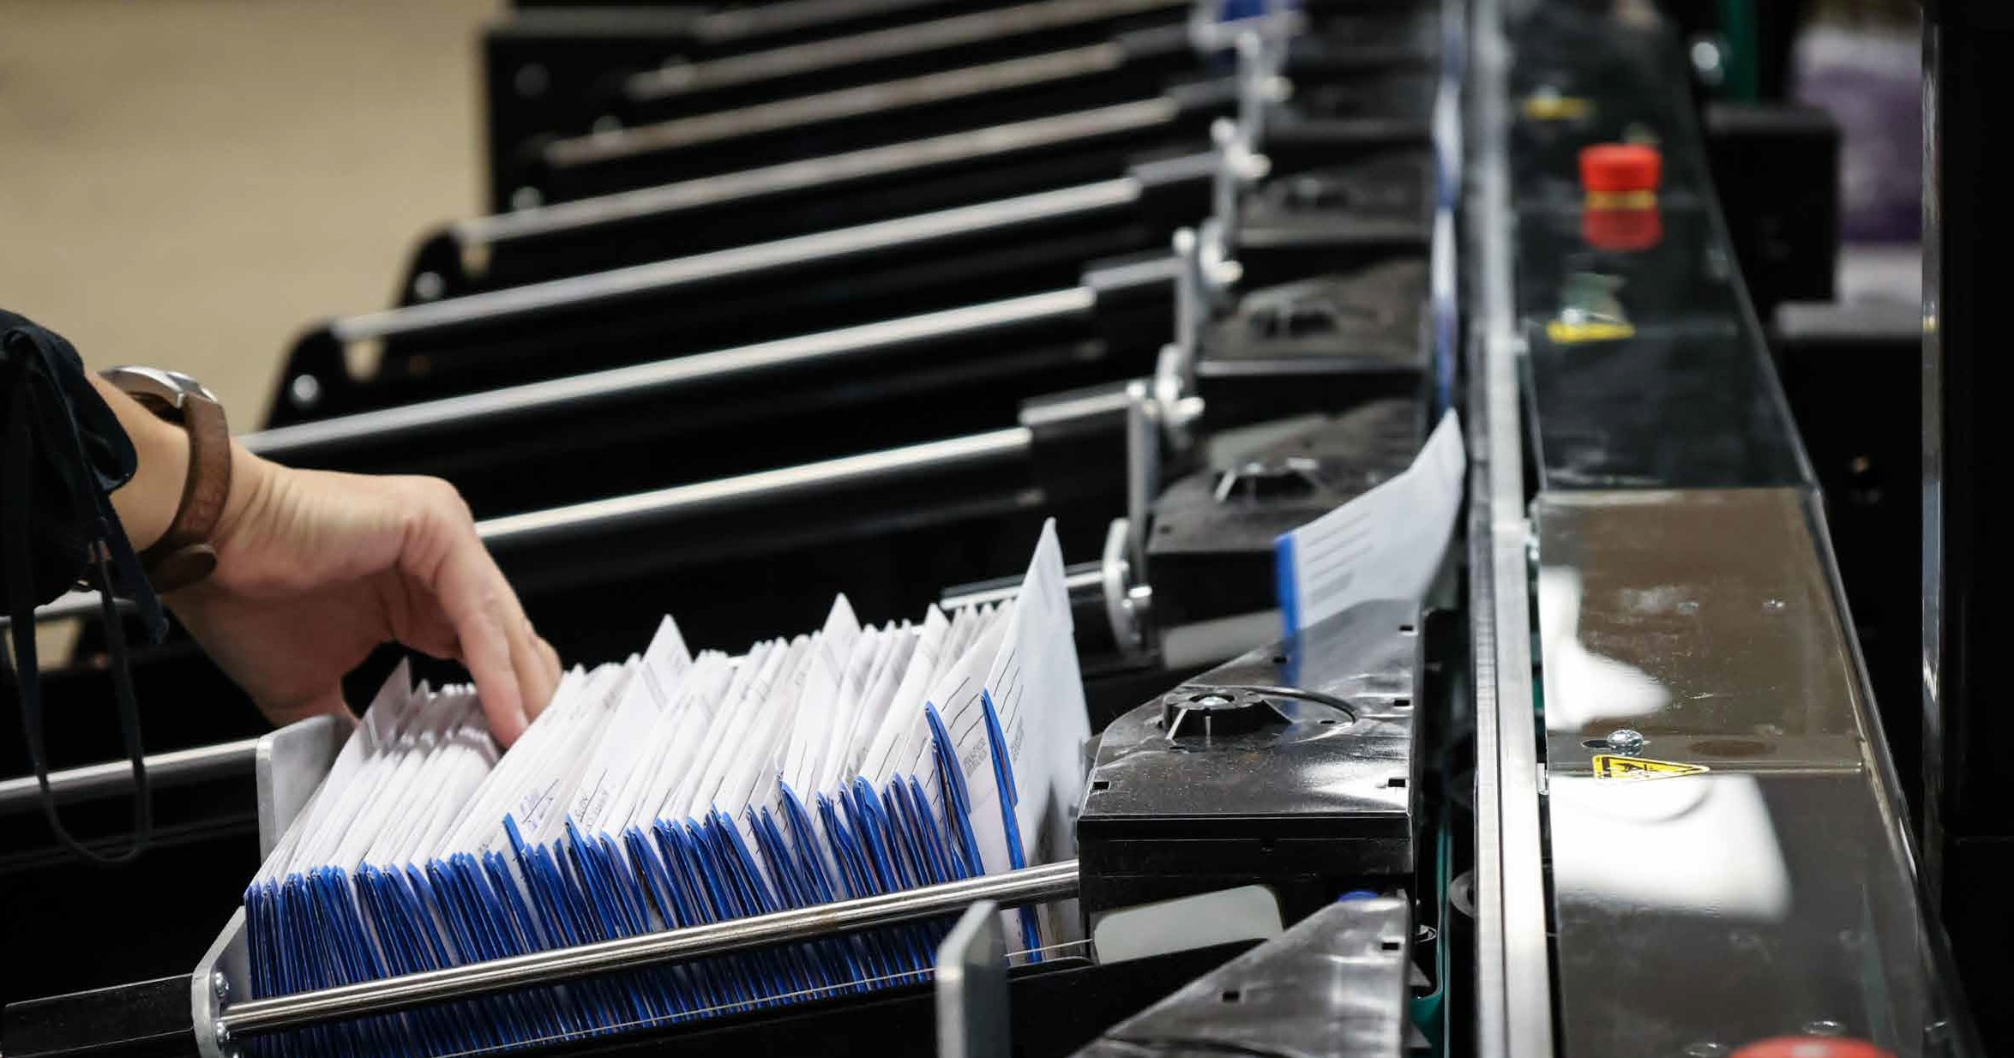
Did you know?
WE SUPPORT TRANSPARENCY WITH OBSERVATION OF
ELECTION PROCESSES.

Slide 11
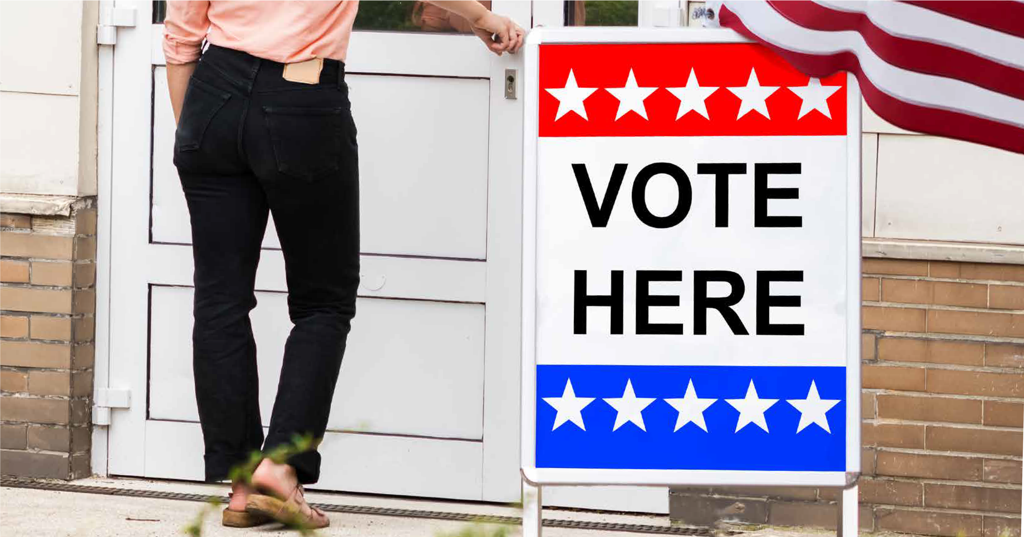
Make a plan to vote

Slide 12
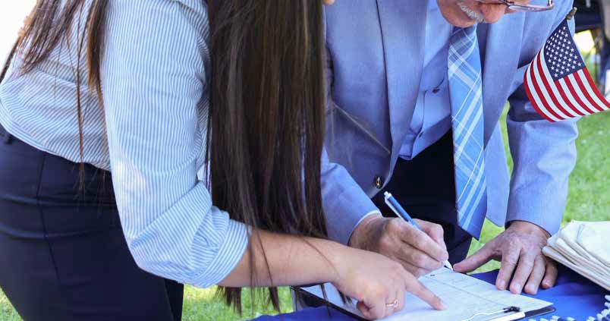
Did you know?
WE MAINTAIN
ACCURATE AND UP-
VOTER LISTS.
TO-DATE

Slide 13
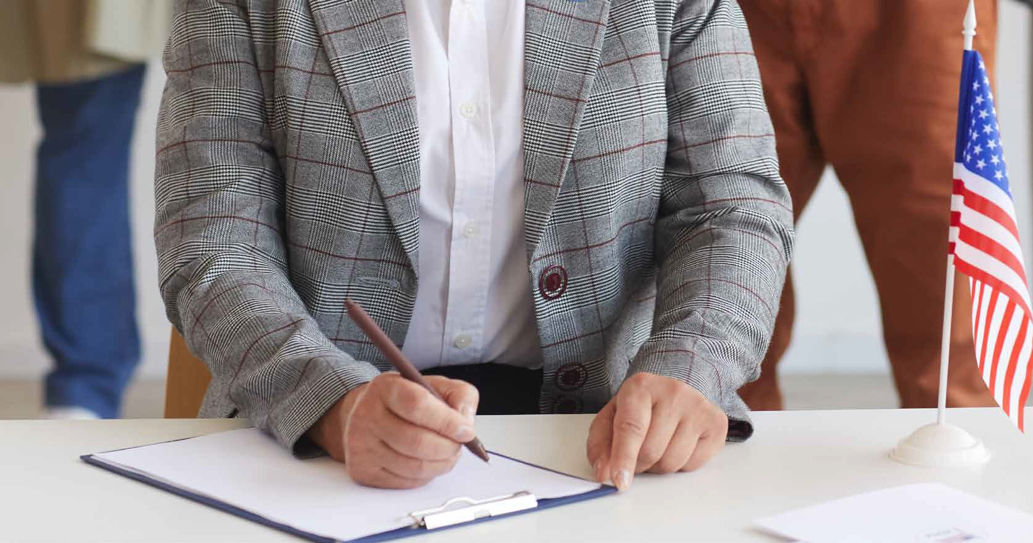
Register to vote
in person

Slide 14
Vote early
by mail or in person

Slide 15
One week to
Election Day

Slide 16
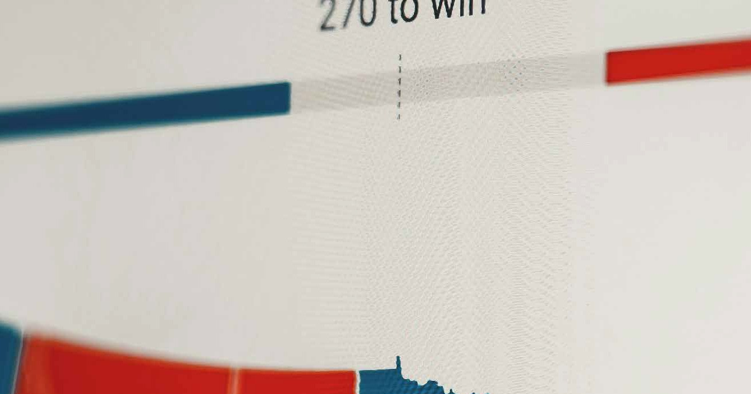
When to expect results

Slide 17
Did you know?
WE PERFORM AUDITS TO ENSURE ACCURATE RESULTS.

