Slide 1


Introduction to De-Escalation Techniques for Election Workers
Notes:
Hi folks! Welcome to our introductory course tailored specifically for election workers. In the often high-stress environment of elections administration, effective de-escalation techniques are essential for maintaining order, ensuring safety and upholding the integrity of the election process. Whether you’re a seasoned election official, full- or part-time staffer, or temporary election worker, this course introduces the necessary skills to handle tense situations calmly and professionally.
Drawing from common best practices in emergency management and security, we’ll touch on proven strategies and techniques for defusing conflicts, managing challenging behaviors and fostering a positive and respectful environment whether at a polling place, vote center or election office. By the end of the course, you’ll have a roadmap of practical skills and resources to more information to help you navigate potentially volatile situations with greater confidence and composure.

Slide 2
Introduction

Slide 3
Course Outline
Introduction
Defining De-Escalation
Key Principles of De-Escalation
De-Escalation Techniques
Self-Care and Support
Scenario-Based Training
Conclusion
Notes:
This course will look at de-escalation, what it is and the key principles. We’ll take a look at common techniques for de-escalating tense situations, while being mindful of our own wellbeing. We’ll then do some scenario-based training exercises before concluding the course and providing resources for additional information.

Slide 4
What You Will Learn
Learn and practice best practices of de-escalation
Foster a positive and respectful environment
Navigate future situations with confidence and composure
Notes:
In this course, we want you to learn and practice the best practices of de-escalation for preventing and defusing conflicts, become more knowledgeable about fostering a positive and respectful environment, and by the end of the course, we want you to feel more confident navigating future situations with confidence and composure - whether that’s handling the situation on your own, or escalating it to a supervisor.
We want you to feel confident owning your space as an election worker, but don’t feel that you need to manage everything that comes at you on Election Day. You are part of a team and your election office is here to support you and your job duties. We want you to feel comfortable de-escalating situations, but also knowing when to direct the voter to the elections office for them to handle.

Slide 5
Defining De-Escalation
Notes:
So what exactly is de-escalation?

Slide 6
What and Why of De-Escalation
What is it?
U.S. Department of Homeland Security Policy Statement 044-05
Using communication (both verbal and non-verbal) to shift the energy in a tense situation.
Why is it important?
Prevention
Safety
Notes:
According to the Cybersecurity and Infrastructure Security Agency, or CISA, de-escalation is the use of communication or other techniques during an encounter to stabilize, slow or reduce the intensity of a potentially violent situation without using physical force, or with a reduction in force. So in basic terms, using communication to prevent calm down a tense situation.
It’s important to de-escalate situation to prevent it from becoming a bigger, crisis situation. Election workers should do their best to anticipate situations of potential escalation in order to maintain the safety of themselves and others.

Slide 7

Common Drivers
Long wait times
Confusion about voting procedures
Disputes over eligibility
Conflict between voters or observers
General distrust regarding elections
Mis/dis-information
Mutual distrust/worry of hostility from the other person
Notes:
Working in elections, we’ve all experienced tough situations dealing with the public. Whether on the phone or in-person, we see and hear everyone’s shared values of fair and free elections. Emotions can be heightened for many reasons such as long wait times, confusion or misunderstanding about voting procedures, disputes over registration or voting eligibility, conflict between voters or observers, general distrust regarding elections including the rise of mis and dis-information, or even just a mutual distrust or worry of hostility from the other person.

Slide 8
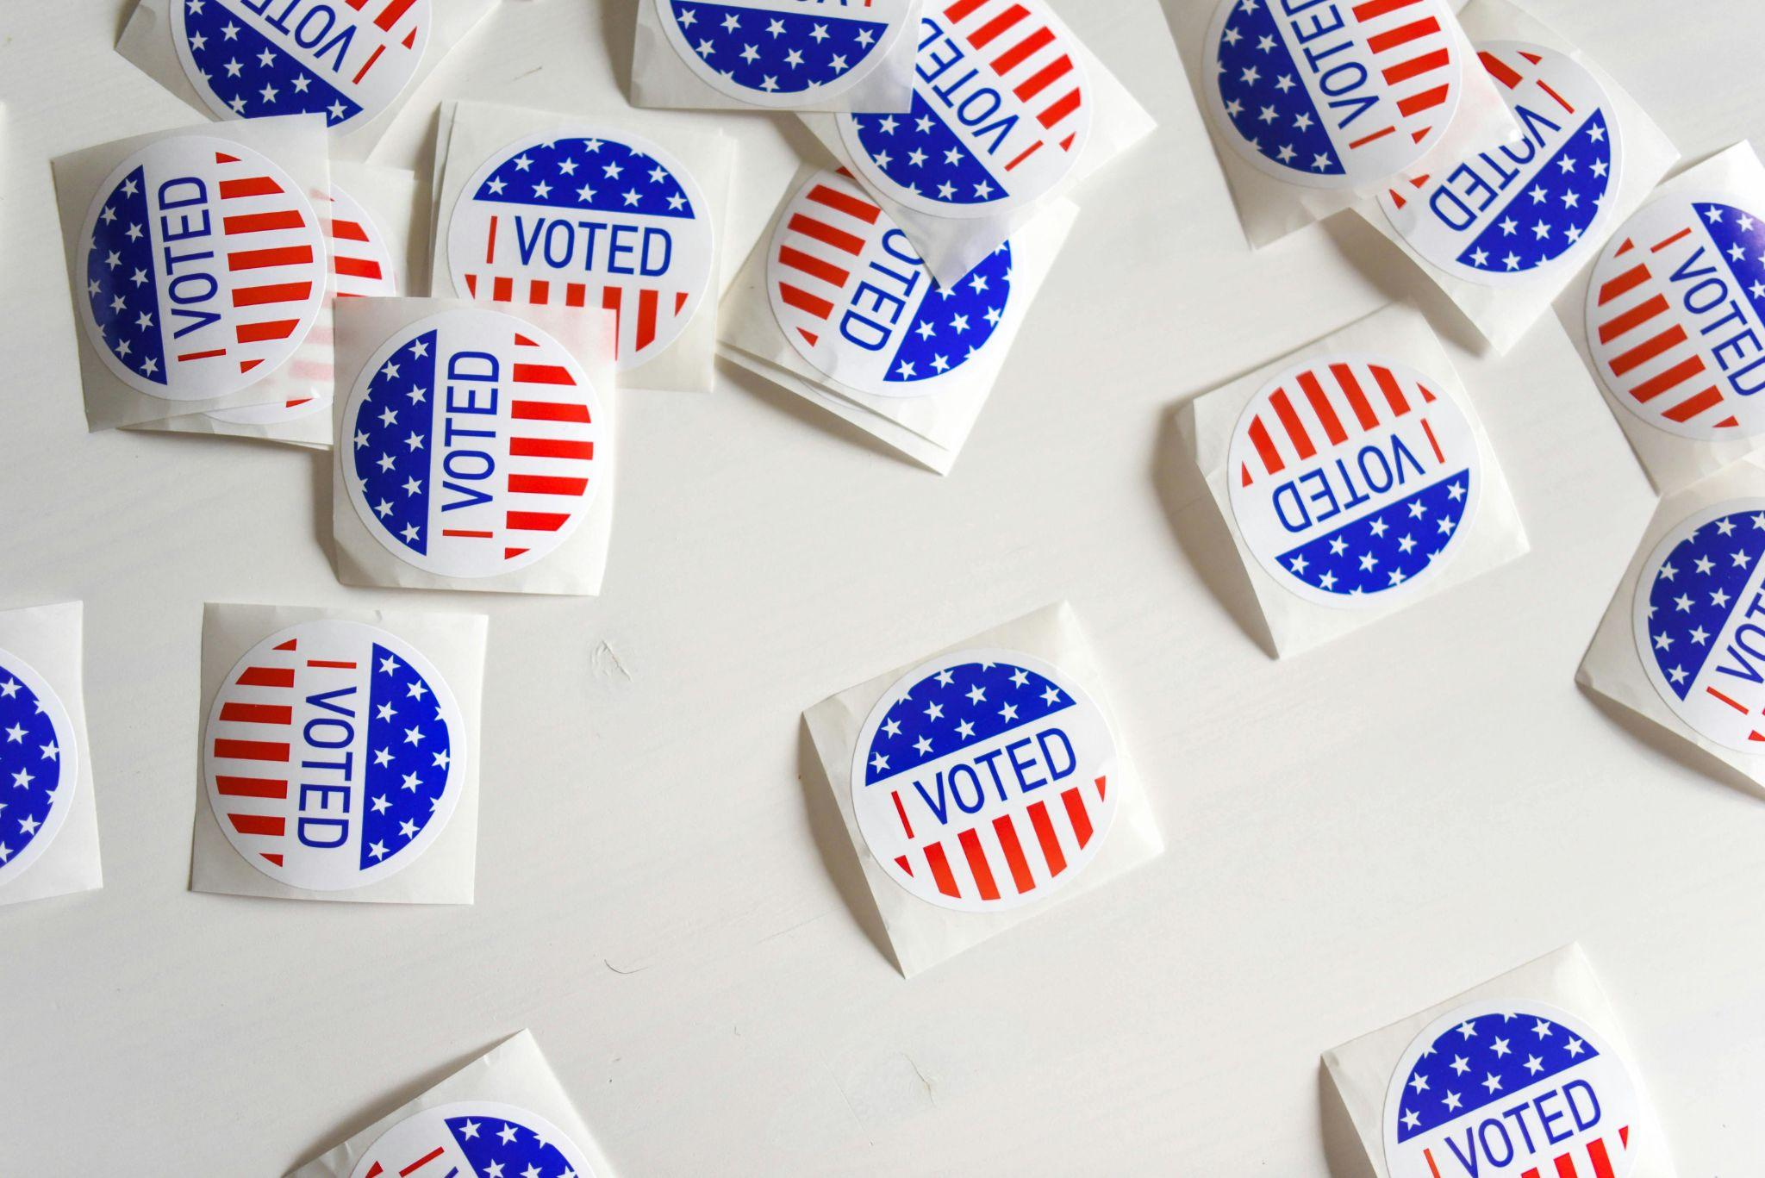
Your Role in De-Escalation
According to the Cybersecurity and Infrastructure Security Agency
Recognize
Assess
De-escalate
Report
Notes:
CISA emphasizes the critical role of election workers in maintaining order and ensuring a positive voting experience for all. Their de-escalation series looks at four tenets: recognize, assess, de-escalate and report.
However, remember that your role as a poll worker is just that - you are just one part of the election. You don’t need to be an expert on the entire election process. Answer the questions from voters that you can and that relate to your job duties. Anything else should be directed to the head poll worker or the elections office.

Slide 9

Recognize
Change in baseline behavior or mood
Pacing, agitated gestures
Staring through you
Blocking others’ movements
Finger pointing
Distracted or inability to focus
Notes:
When a person is triggered into a heightened state of mind, there are numerous signs to recognize. These signs can include changes in a person’s behavior or mood; pacing, ruminating or using agitated gestures; staring through you rather than looking directly at you; blocking other’s movements; finger pointing; or being distracted or having an inability to focus. These are all signs to be prepared for a tense situation and watch for further escalation.
However, also recognize the situation and surroundings at your polling place and communicate to voters and your election office as much as possible to prevent escalation. For example, this could be monitoring how long voters have to wait in line to cast their ballots, and communicating to the voters in line and to your election office. This can look like saying to the voters in line, “we are moving voters through the polling place as quickly as possible but want to ensure that every voter has the time they need to properly vote and cast their ballot.” Many times, communicating in advance alleviates any concerns people may have.

Slide 10
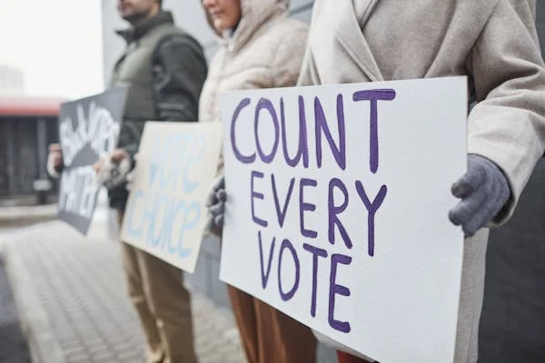
Assess
The situation
Be aware of any internal biases
Yourself
Are you in the right state to handle the situation?
Notes:
Once you recognize a tense situation, you can then assess the situation The assessment process determines if de-escalation is needed, if you may need further assistance with the situation, or if an emergency response is needed. It involves being aware of your own internal or cultural biases. Take a moment before engaging to think about those biases to prevent from ‘wrongfully’ engaging. A useful resource for taking a look at implicit or explicit bias is included here.
It also involves assessing yourself. Are you in the right frame of mind to be handling the situation? Are you stressed from a previous encounter? Or are you feeling confident in this current situation?

Slide 11

De-Escalate
Prevention
Safety
Yourself
Others
Limits
Help
Notes:
As we have learned, de-escalation is a method to prevent a situation that could get out of hand. It’s important to use purposeful actions, verbal communications, and body language to defuse a potentially disruptive situation. Your safety and the safety of others is of utmost importance. Remember to maintain a safe distance and avoid being alone with the individual who is disruptive. If you feel there is a risk of imminent violence, remove yourself and others from the situation and find safety. However, during the de-escalation process, it’s important to know your own vulnerabilities and mental state. Sometimes the best intervention is knowing when to seek additional help. Getting additional help can come from a colleague, supervisor, or the elections office, or in more extreme cases, security staff or local law enforcement.

Slide 12

Report
Reporting is critical to the prevention of workplace and community violence. Threats that are not known cannot be managed.
Internal reporting structure
After-action report
Notes:
The reporting process is a critical final step in conflict management. This is typically done through reporting the incident to your elections office or jurisdiction. When making the report, the goal is not to be punitive, to get someone in trouble, send someone to jail, to cost someone their job, or to damage someone’s reputation. Rather, the goals of the report are to document what took place and to determine if the situation could have been handled differently for future prevention. There are many templates that can be used for internal reporting - such as from CISA or other emergency management organizations. Your jurisdiction may already have an effective reporting tool.

Slide 13
Key Principles of De-Escalation
Notes:
Now that we’ve taken a look at what de-escalation is, let’s take a deep dive into the key principles of de-escalation.

Slide 14

Key Principles of De-Escalation
Empathy
Active Listening
Respect
Attentive Communication

Slide 15

Empathy
The ability to understand and share the feelings of another.
Listen to understand
Find common ground
Find common solutions
Notes:
Empathy and active listening are key for de-escalation. These attributes can reduce the negative emotions and reactions that often fuel conflict. When people feel heard, understood and valued, they are more likely to calm down, trust and cooperate.They are also more likely to listen to your perspective and to consider alternative opinions and options. Active listening and empathy can also help you to identify the underlying causes and interests of the conflict, and to address them in a constructive and respectful way.
Empathy is the ability to put yourself in the other person's shoes, and imagine how they feel and think in a given situation. It is not the same as sympathy, which is feeling sorry or pity for someone. Empathy is more about understanding and sharing their emotions, and showing compassion and support. Empathy helps you to connect with the other person on a human level, and to recognize their needs and values. It also helps you to avoid judging, blaming, or criticizing them, and to focus on finding common ground and solutions.

Slide 16
Active Listening
Give the speaker your full attention and try to understand the entire message they are trying to convey. Be mindful of:
Verbal and non-verbal cues
Asking open-ended questions
Summarizing key points
Acknowledging their feelings and concerns
Notes:
Active listening is a way of paying attention to what the other person is saying, not only with your ears, but also with your eyes, body, and mind. It involves listening to the content, tone, and emotion of their message, and reflecting back what you heard and understood. Active listening also means asking open-ended questions, summarizing key points, and acknowledging their feelings and concerns. By doing so, you demonstrate that you are interested, curious, and respectful of their point of view, and that you want to learn more.

Slide 17
Respect
Remain respectful and courteous. Use “please” and “thank you.”
Respect personal space.
Avoid changing the subject or interrupting the other person.
Notes:
Respect is a big part of de-escalation and maintaining a calm, professional atmosphere. While it may seem simple, saying please and thank you can go a long way in showing respect and calming the situation. Being mindful of yours and the other person’s personal space is also key. Maintain a safe distance from the person and avoid touching them. And finally, avoid changing the subject or interrupting the other person. No one likes to be interrupted when they’re talking, so do your best to avoid this.

Slide 18
Attentive Communication
Demonstrate calmness and composure.
Give your full attention - nod and ask questions.
Present genuine concern and willingness to understand.
Remain politically impartial.
Maintain a neutral and attentive facial expression.
Use slow, deliberate movements and a relaxed stance.
Change the setting, if possible.
Know your limits and seek additional help when needed.

Slide 19
Learning Check

Slide 20
De-Escalation Techniques

Slide 21
Verbal Strategies
Tone: Speak calmly to demonstrate empathy
Volume: Be aware of your volume and avoid raising your voice
Rate of speech: Slower can be more soothing
Inflection: Be aware of emphasizing words or syllables that could have a negative effect

Slide 22
Non-Verbal Strategies
Posture: Keep a relaxed yet alert stance to the side of the person
Hand motions: Keep hands down, open and visible
Movements: Use slow, deliberate movements
Facial expressions: Maintain a neutral, attentive facial expression

Slide 23
Time and Space Management
Personal space: Maintain a safe distance—avoid touching the person
Buddy system: Avoid being alone with the person
Location: Change the setting, if possible
Self-awareness: Know your limits
You’re not alone: Seek additional help when needed

Slide 24
C.L.A.R.A. Method
Center, Listen, Affirm/Acknowledge, Respond, Assess
Notes:
The CLARA Method is used to address anyone who is verbally attacking others, or behaving unruly, or when a difficult conversation is needed. The CLARA Method helps you model compassionate, kind, empathic listening and communication to help de-escalate a situation and bring harmony. It is used by many organizations including the Nonviolent Peaceforce's Unarmed Civilian Protection forces stationed in conflict zones around the world to protect civilians. This method allows for a lot of flexibility and freedom to adapt to whatever situation is unfolding. These techniques are not meant to be used in order, you can use this in any order throughout the process of de-escalation. The effectiveness of it comes from centering the dignity, safety, needs, and feelings of the person who is behaving unskillfully, as well as all other stakeholders.

Slide 25

Center
Be fully present in the situation
Be aware of your reactions
Bring yourself into a place of understanding and empathy
Set aside any judgmental thoughts
Notes:
You first want to start out by being fully present in the situation. Recognize your reactions and bring yourself into a place of understanding and empathy. Set aside any judgemental thoughts.

Slide 26

Listen
Actively listen
Eyes
Body
Mind
Feelings
Needs not being met
Universal values or principles
Notes:
Then you want to actively listen to the other person. Pay attention to what the other person is saying, not only with your ears, but also with your eyes, body, and mind. Listen to the content, tone, and emotion of their message. Take note of the feelings they are experiencing, what needs of theirs are not being met, what universal values or principles are at play, and what behaviors they are concerned about. By actively listening to them, you help them feel heard, respected, and valued, and this helps to calm them and de-escalate the situation.

Slide 27

Acknowledge/Affirm
Reflect back
Ask for confirmation
Notes:
Affirm their dignity, worth, belonging, and safety verbally and nonverbally. This can be achieved by reflecting back what you heard from them and asking them to confirm if you understand them. This way, your words remain focused on them and their needs. This helps them feel your empathy, understanding, and respect, and will help calm them and de-escalate the situation.

Slide 28

Respond
Ask
Open-ended questions
Summarize key points
Acknowledge their feelings and concerns
Share
Your feelings
Your needs
Respond
Brainstorm positive, concrete actions
Offer ideas that help them reframe
Notes:
Ask open-ended questions, summarize key points, and acknowledge their feelings and concerns. By doing so, you demonstrate that you are interested, curious, and respectful of their point of view, and that you want to learn more. You can also respond by sharing your feelings and needs, or that of the people you are protecting, to help them connect with their humanity and compassion. Respond by brainstorming positive, concrete actions that you are able to do that might address their concerns. You can offer ideas that help them reframe the situation according to the values, needs, and principles that are shared.

Slide 29
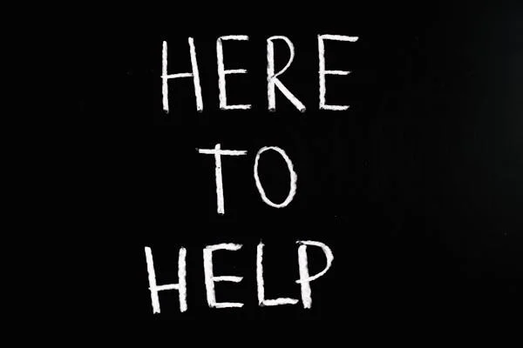
Assess
Chain of command
When to bring in help
Know you’re not alone
Notes:
Assess the situation and think about when you may need to bring in some additional help. You’re not on an island and expected to do all of this yourself. Know your chain of command or skills of your teammates and bring then in when you feel overwhelmed. As we mentioned at the beginning, your job as a poll worker is just one part of the election process and you are not expected to know everything from start to finish. Answer the questions from voters that you can and that relate to your job duties. Anything else should be directed to the head poll worker or the elections office. You can also always direct the voter to additional information such as the local or state election office websites or phone lines.

Slide 30
Learning Check

Slide 31
Self Care and Support

Slide 32
Recognize Stress and Burnout
Stress
Palpitations
Dry mouth
Accelerated speech
Feelings of overwhelm
Burnout
Exhaustion
Decreased motivation
Lowered performance
Negative attitudes
Notes:
According to the American Psychological Association, stress is the physiological or psychological response to internal or external pressure. Stress affects nearly every system of the body, influencing how people feel and behave. Not all stress is bad, a healthy amount of stress motivates us to return phone calls, check our emails, and check off items on our to-do list.
For example, stress may be manifested by palpitations, sweating, dry mouth, shortness of breath, fidgeting, accelerated speech, augmentation of negative emotions (if already being experienced), and longer duration of stress fatigue. Stress can turn into chronic stress where one experiences a prolonged internal or external stressful event. This stressor may not remain physically present to have lasting effects; even memories of it can sustain chronic stress.
The APA defines burnout as physical, emotional, or mental exhaustion accompanied by decreased motivation, lowered performance, and negative attitudes toward oneself and others. It results from performing at a high level until stress and tension, especially from extreme and prolonged physical or mental exertion or an overburdening workload, take their toll.
Job burnout can result from various factors, including: Having a heavy workload and working long hours, struggling with work-life balance, working in a profession that serves people, or feeling like you have little or no control over your work.
Ignored or unaddressed job burnout can have significant consequences, including: Excessive stress; Fatigue; Insomnia; Sadness, anger or irritability; Alcohol or substance misuse; Heart disease; High blood pressure; Type 2 diabetes; or Vulnerability to illnesses

Slide 33
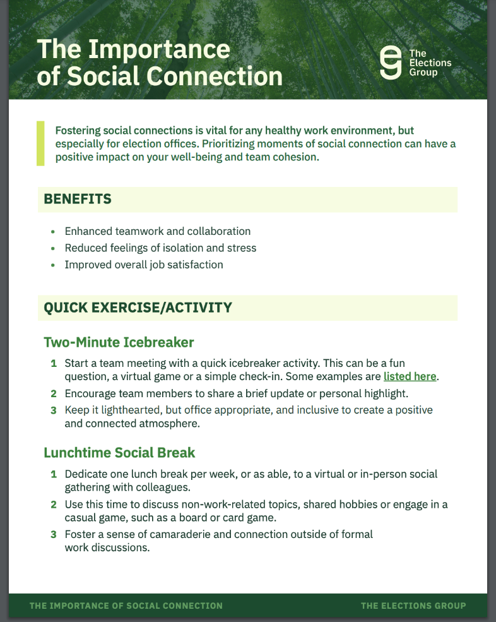
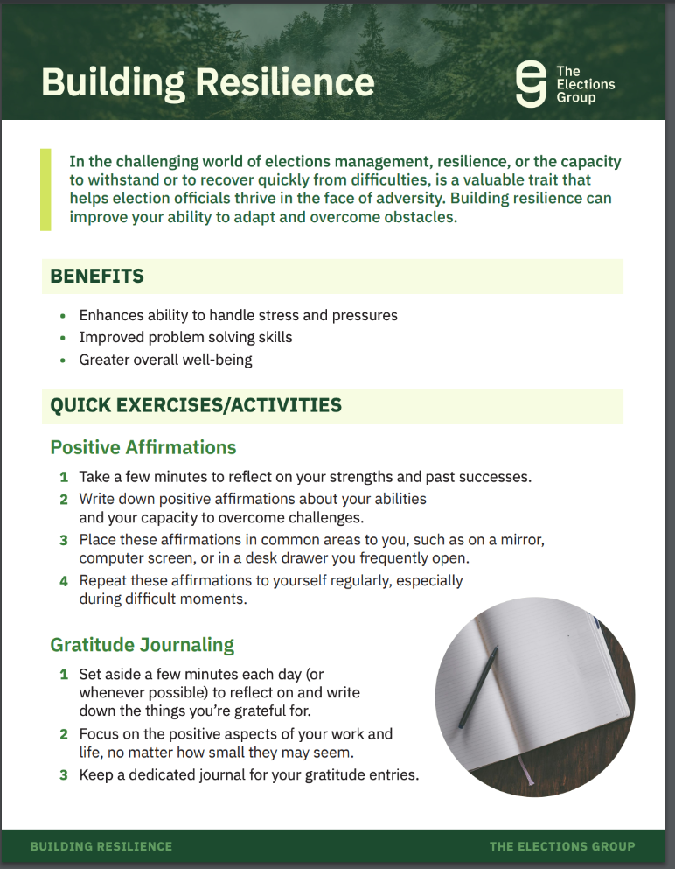
Techniques for Management
Deep breathing exercises
Using your senses
Stretching
Meditation
Mindfulness
Notes:
Know when you might not be in the right frame of mind for a tough interaction. Tag out with another co-worker or, if you must confront the situation, use mindfulness techniques such as deep breathing or sense identification to help calm yourself down (reign in a bad mood). Having yourself already in a bad mood may further escalate a situation.

Slide 34



Create a Trusted Support System
Friends
Family
Colleagues
Notes:
Share your worries, fears, and feelings with the people you trust. Talking about things that are stressing you out may help you unburden yourself and feel less overwhelmed. Providing friends and family with support also has benefits. It’s essential to make sure that you and those around you give and receive support. One-sided relationships can end up causing you more stress than relief.
Nobody understands the stress of the job like a fellow election official. Consider creating a “support” group of fellow colleagues - maybe people you work with here or other folks you’ve connected with throughout [state]. Create a place where you feel safe talking about what you are struggling with. Most likely, they are too. Commit to encouraging each other - you all understand what each other are going through.

Slide 35
Learning Check

Slide 36
Scenario-Based Training

Slide 37

Scenario 1

Slide 38
Scenario 1: Provisional Ballot
Characters
Election Worker (EW)
Voter (V)
Supervisor (S)
Setting
Polling place check-in area

Slide 39
Scenario 1: Provisional Ballot
Script
EW: Good morning! May I have your name, please?
V: Sure, it's John Doe.
EW: Thank you, John. It looks like you're not on the voter roll for this precinct. Are you sure this is your correct polling place?
V: Yes, I’ve been voting here for years! There must be some mistake.
EW: I understand. Sometimes errors do occur. We can issue you a provisional ballot so your vote can still be counted once your eligibility is confirmed.
V: (frustrated) A provisional ballot? Why can’t I just vote like everyone else?
EW: I’m really sorry for the inconvenience, John. I assure you, this process is in place to ensure everyone's vote counts.
V: (raising voice) This is unfair! I feel like my vote isn’t going to count if it's provisional!
EW: (calmly) I understand your frustration. Let me call my supervisor to explain the process in more detail.
(EW signals to Supervisor to come over.)
S: Hi, I’m the supervisor. How can I help?
V: (Angrily) I’m being told I have to use a provisional ballot, but I’ve always voted here! This makes no sense!
[Decision Point]

Slide 40
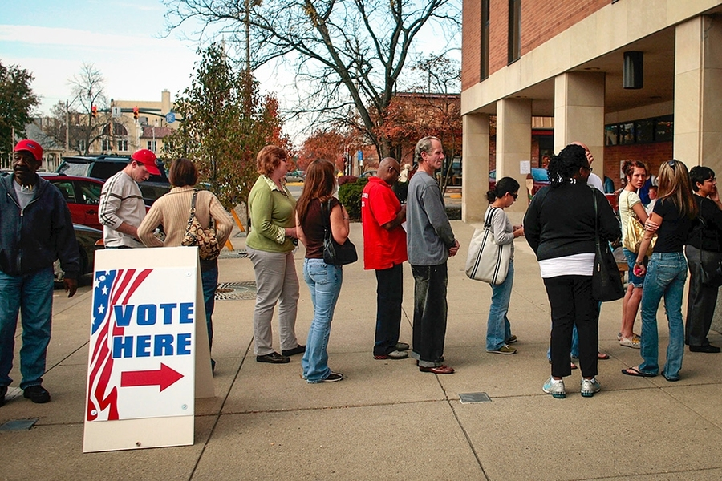
Scenario 2

Slide 41
Scenario 2: Long Lines
Characters:
Election Worker (EW)
Voter 1 (V1)
Voter 2 (V2)
Crowd of Voters (C)
Setting
Polling place with a long line of waiting voters.
Notes:
Anticipate and communicate. Stem emotions before people get upset

Slide 42
Scenario 2: Long Lines
Script
V1: (to EW) This line is taking forever! I’ve been here for 30 minutes!
EW: I’m really sorry for the wait. We’re doing everything we can to get everyone through as quickly as possible.
V2: (joining in) I have to get back to work. What’s the holdup?
EW: I understand how frustrating this is. We’re working to ensure everyone can vote, and we appreciate your patience.
V1: (angry) This is unacceptable! Can’t you open more stations or something?
C: (murmurs of agreement and frustration from the crowd)
[Decision Point]
Notes:
Anticipate and communicate. Stem emotions before people get upset

Slide 43
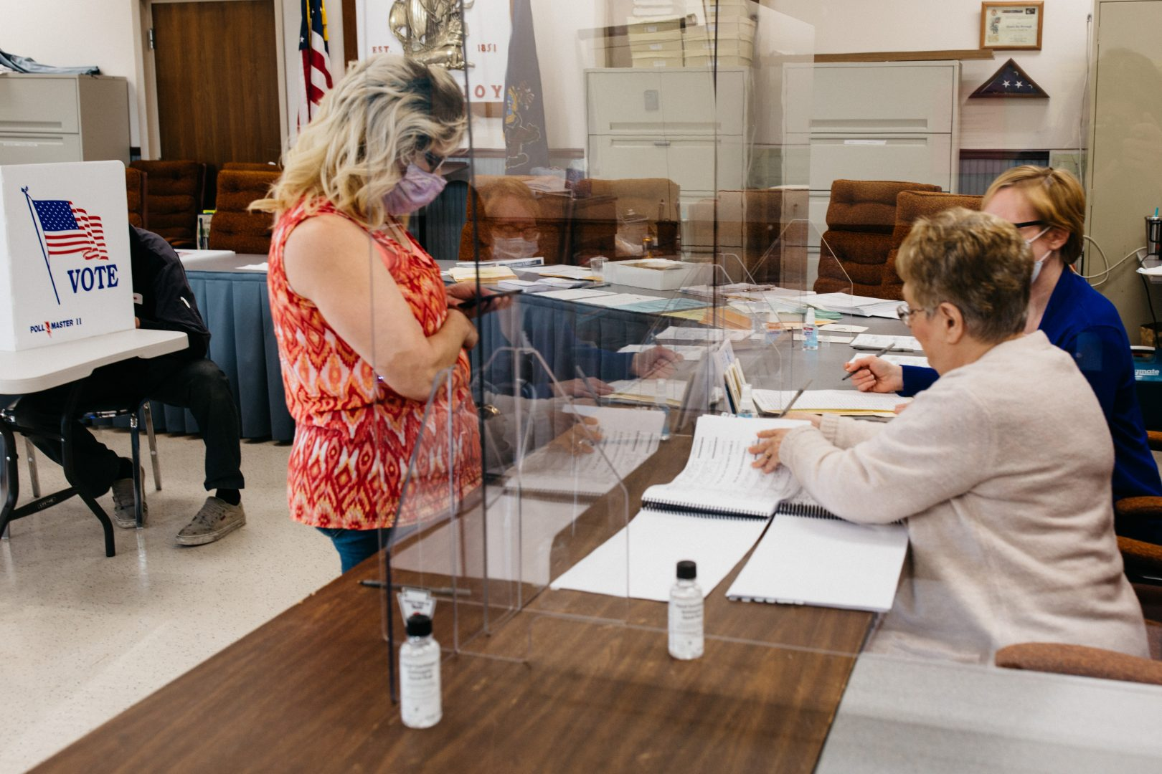
Scenario 3

Slide 44
Scenario 3: Distrust of Vote Being Counted
Characters
Election Worker (EW)
Voter (V)
Setting
Polling place after a voter has cast their ballot.

Slide 45
Scenario 3: Distrust of Vote Being Counted
Script
V: (approaching EW after voting) How can I be sure my vote will be counted?
EW: Your vote will definitely be counted. Our processes are designed to ensure every vote is secure and included in the final tally.
V: (skeptical) But how do I know for sure? I’ve heard so many stories about votes being lost or tampered with.
EW: I understand your concerns. We have multiple safeguards in place to protect your vote. Each step of the process is monitored and verified.
V: (agitated) That’s what they always say, but I don’t trust the system. What proof do I have?
EW: Your ballot has been securely processed. Here is a handout that explains our processes.
V: (raising voice) I don’t want explanations, I want guarantees! This is my vote we’re talking about!
[Decision Point]

Slide 46
Conclusion

Slide 47
What We Learned
Learned and practiced best practices of de-escalation
Identified how to foster a positive and respectful environment
Instilled greater confidence navigating future situations with confidence and composure

Slide 48
Additional Resources
Observer Relations Training
De-Escalation Resources
De-Escalation Posters
CISA De-Escalation Series
Wellness and Resilience In-A-Box
BDI Directory

Slide 49
Additional Resources
Veterans Hotline- 1-877-424-3838
Trevor Project Suicide/Crisis Hotline - 1-866-488-7376
SAMHSA - 1-800-662-HELP
Notes:
Some other hotlines that may be useful while working elections include:
Veterans National Homeless Hotline 24/7 Hotline connecting callers to free services in their area 1 (877) 424-3838
Trevor Project Suicide and crisis hotline for LGBTQ+ youth. 1 (866) 488-7386 (24/7) Text START to 678-678
SAMHSA’s National Helpline A confidential, free, 24/7 information service for individuals and family members facing mental health and/or substance use disorders. Provides referrals to local treatment facilities, support groups, and community-based organizations. Callers can also order free publications and other information. 1 (800) 662-HELP (4357) (24/7) TTY: 1 (800) 487-4889 https://www.samhsa.gov/find-help/national-helpline

