Slide 1
Thank you, election heroes!

Slide 2
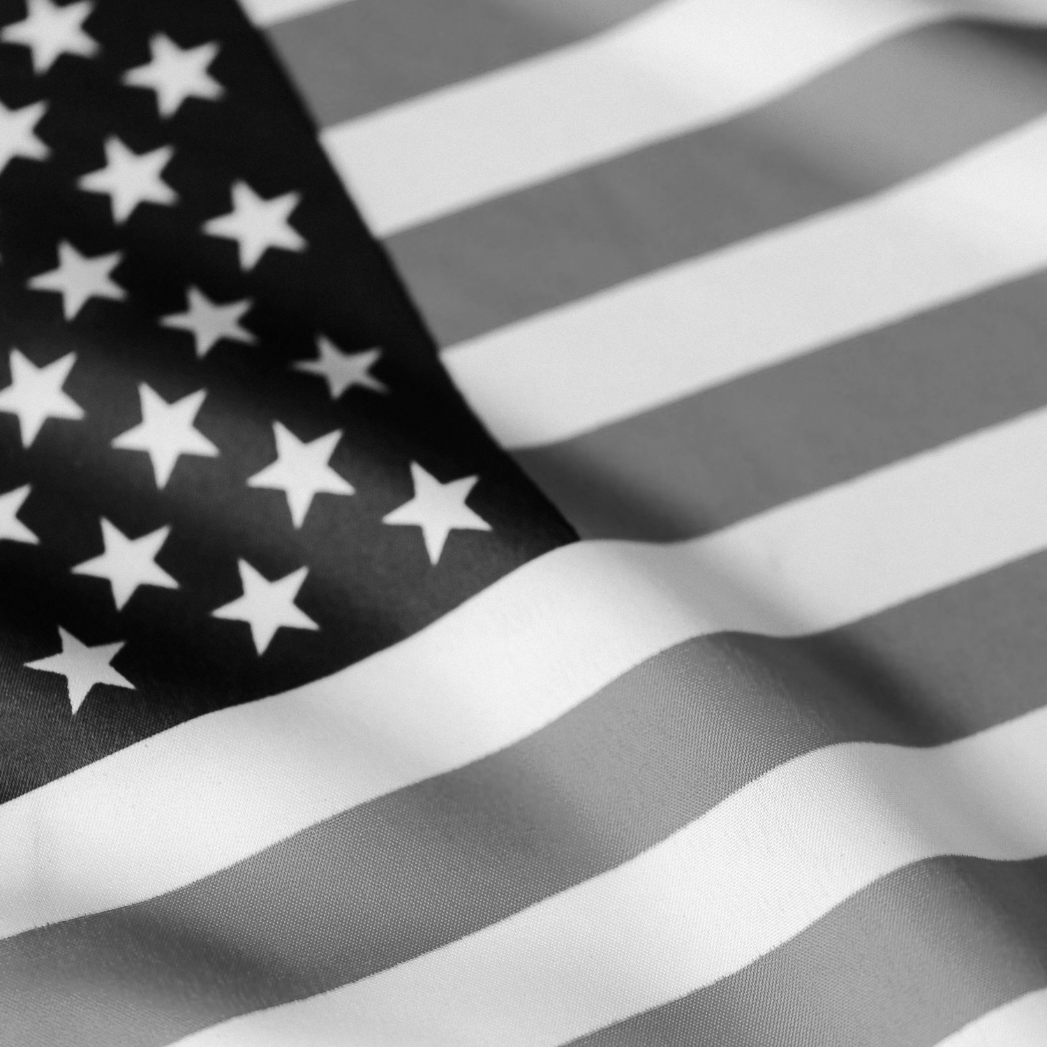
Unofficial Results have been updated

Slide 3
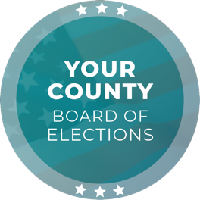
Our office is closed on Thursday, November 28

Slide 4
Unofficial Results have been updated

Slide 5
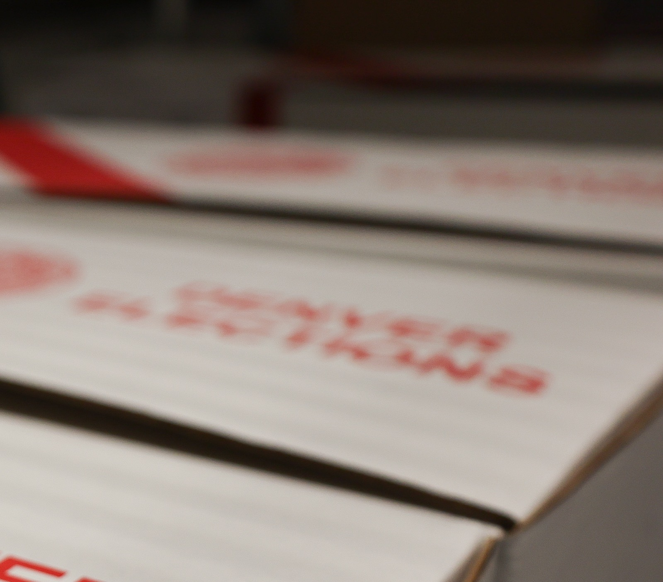
Post-election audits have been completed

Slide 6
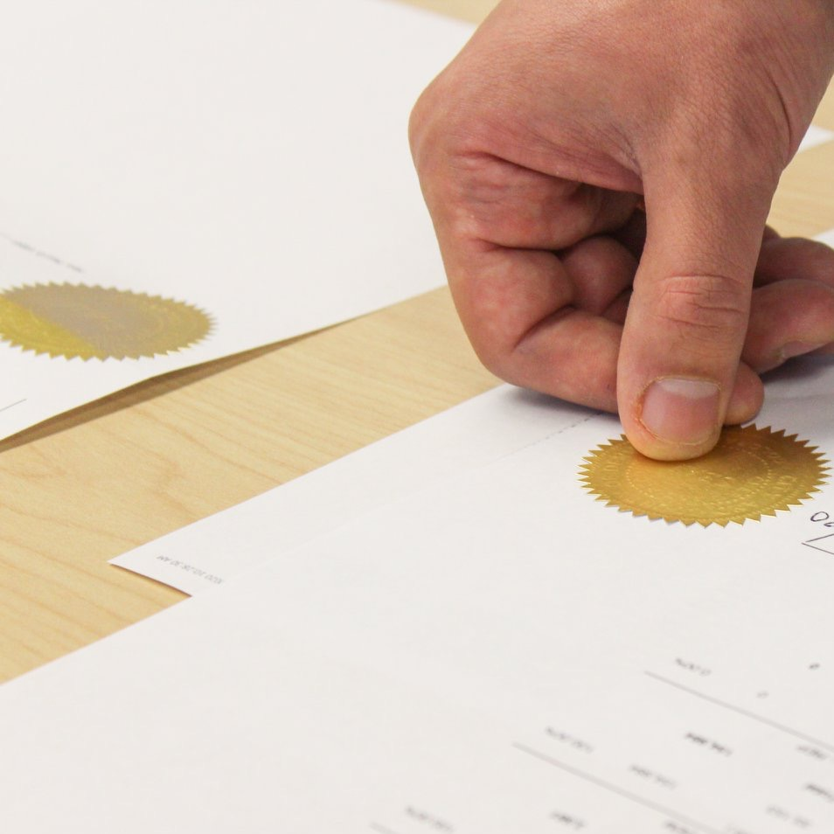
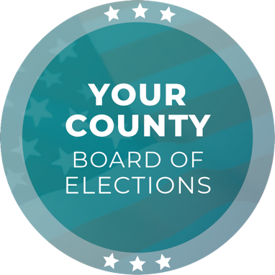
The 2024 General Election has been certified!
The 2024 General Election has been certified!

