Slide 1

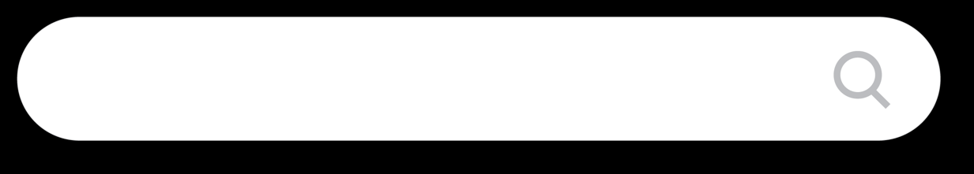

Update
your voter registration today
yourcountyvotes.gov

Slide 2



Slide 3
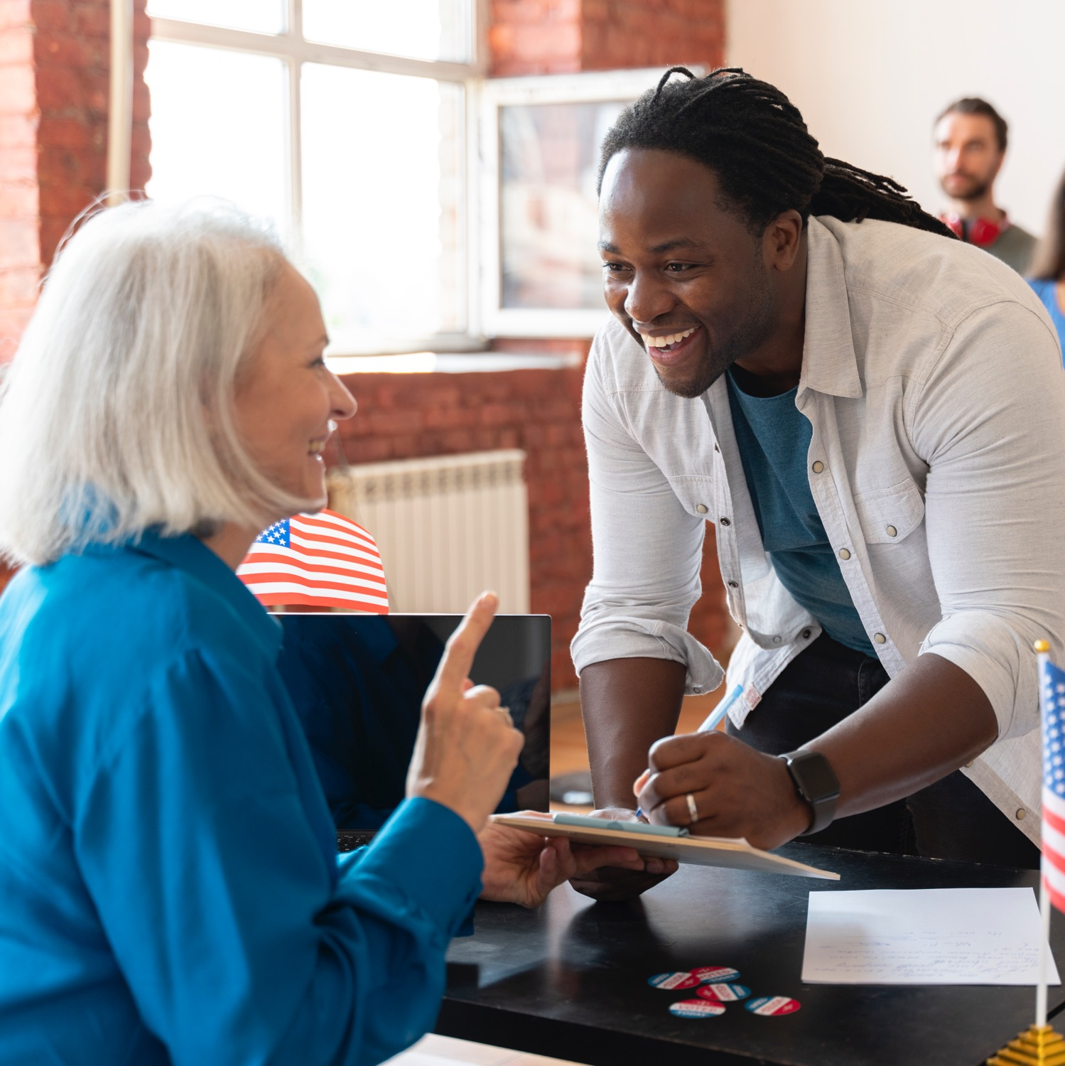

Become a poll worker

Slide 4
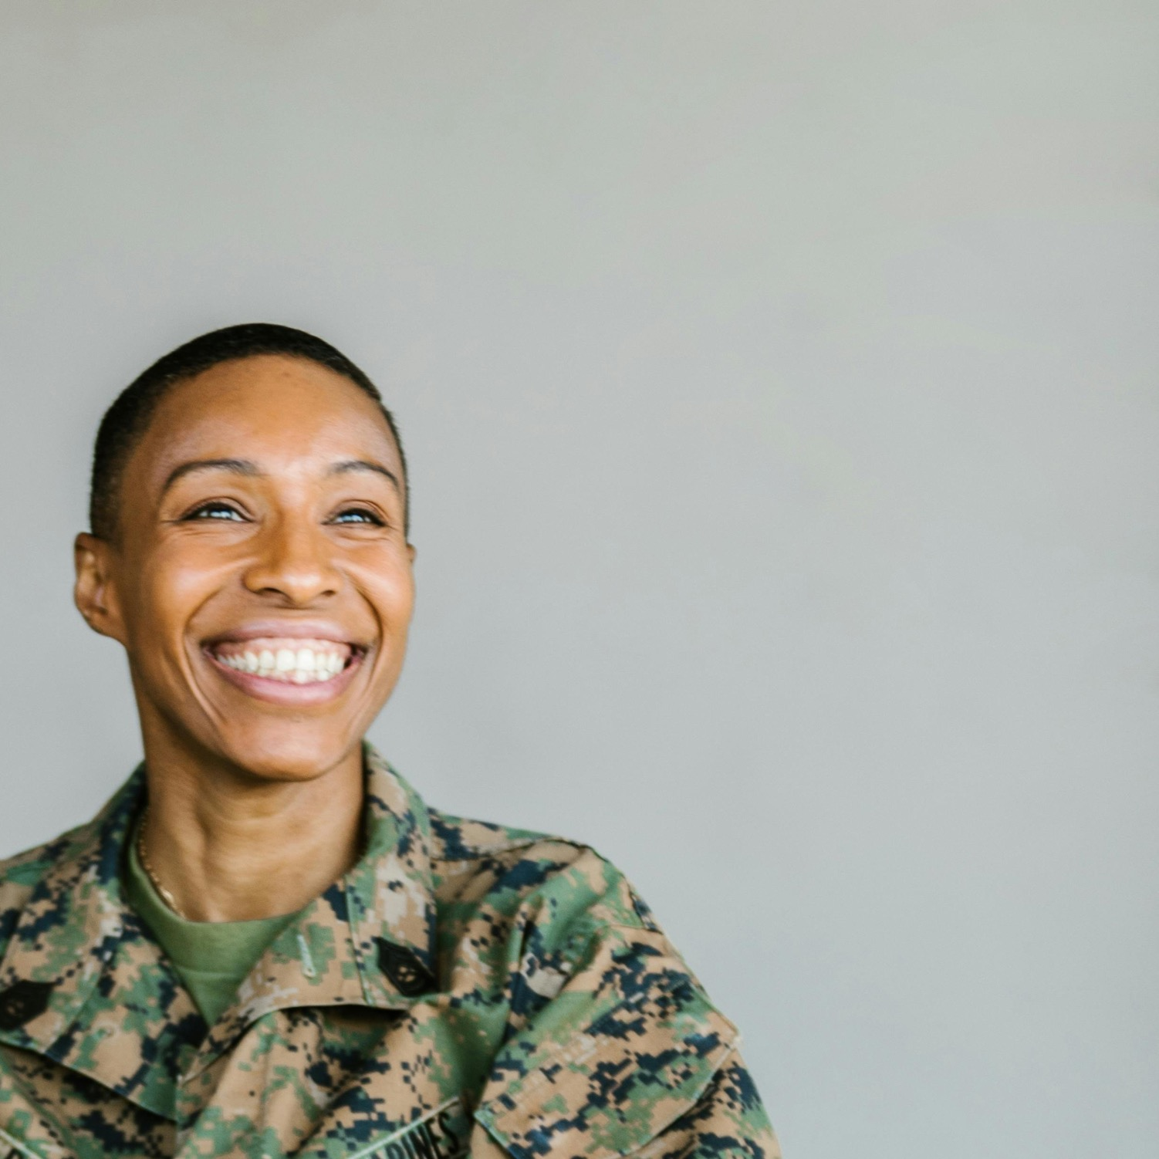
Military and overseas voters
It’s time to update your registration!
yourcountyvotes.gov

Slide 5

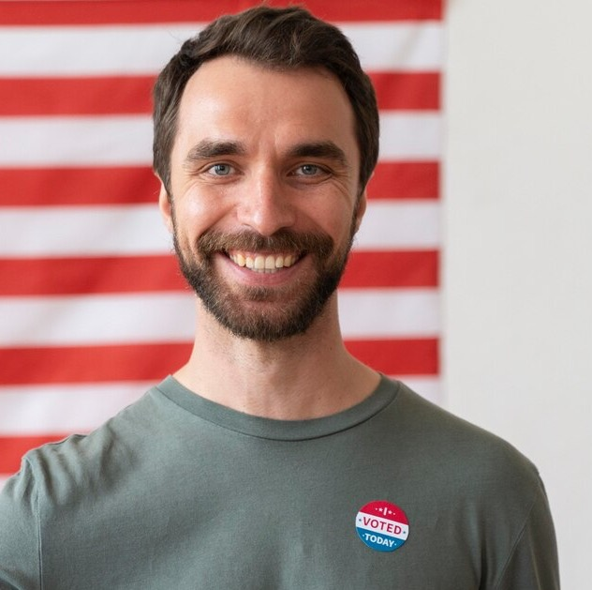

Team Spotlight
Firstname

Slide 7

Team Spotlight
Firstname

Slide 8
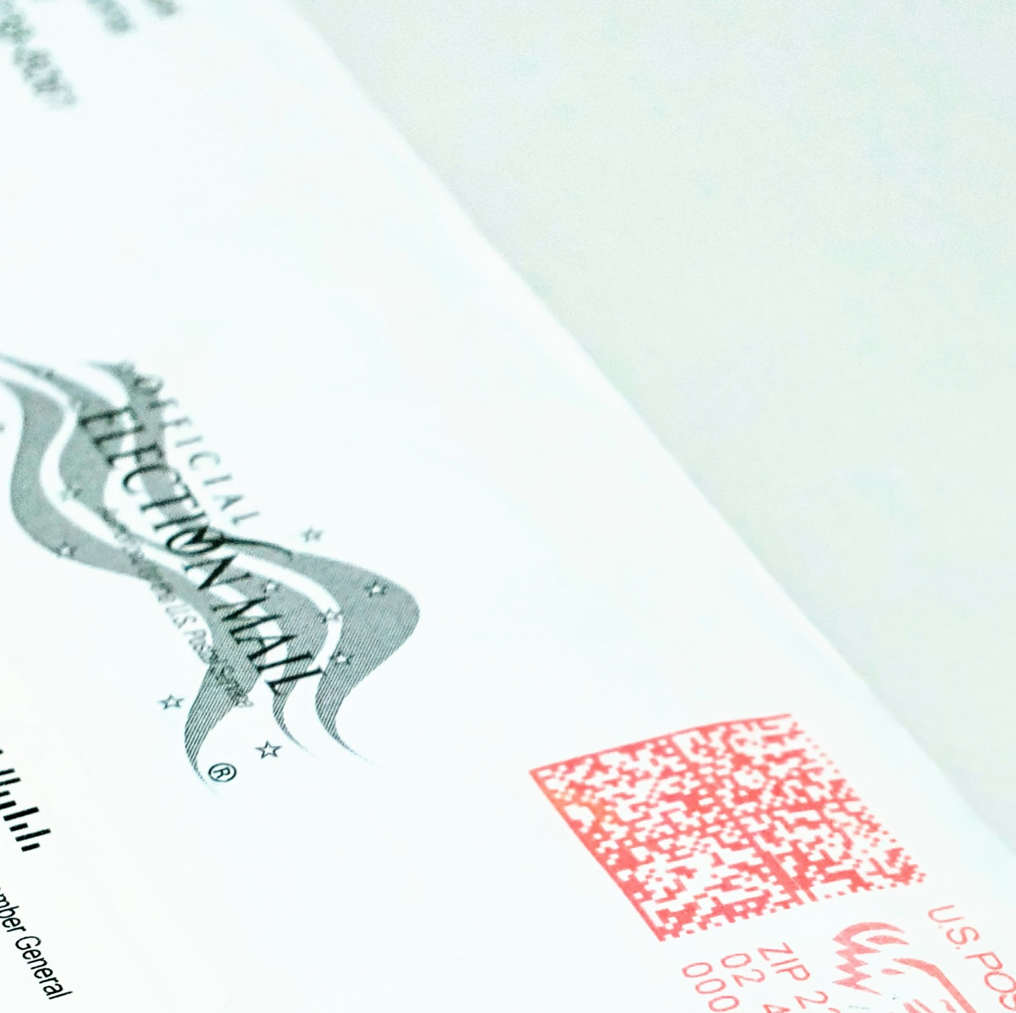

Ballots have been sent
to military and overseas voters!

Slide 9
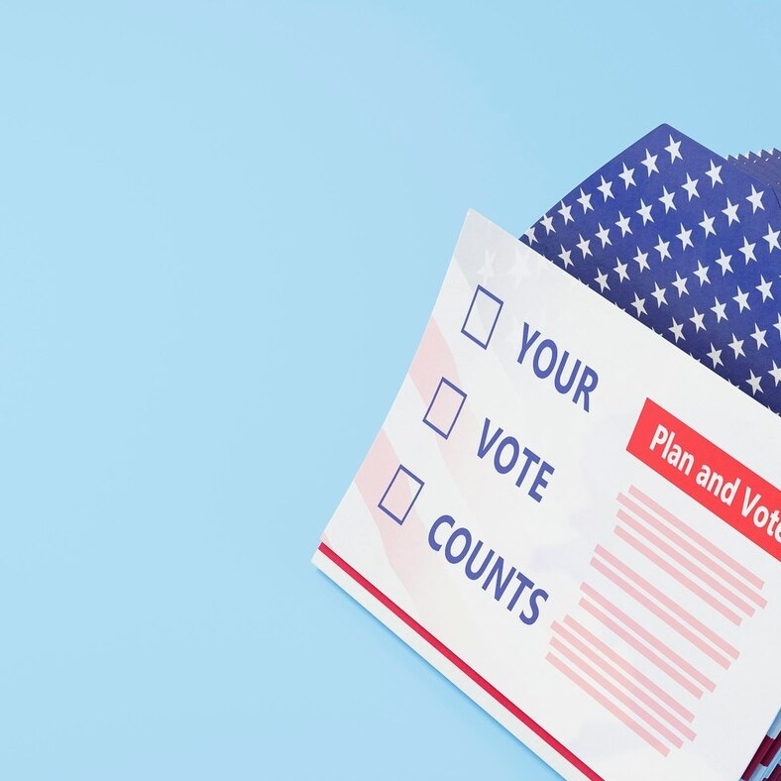
Voter info guides are in the mail!

Slide 10
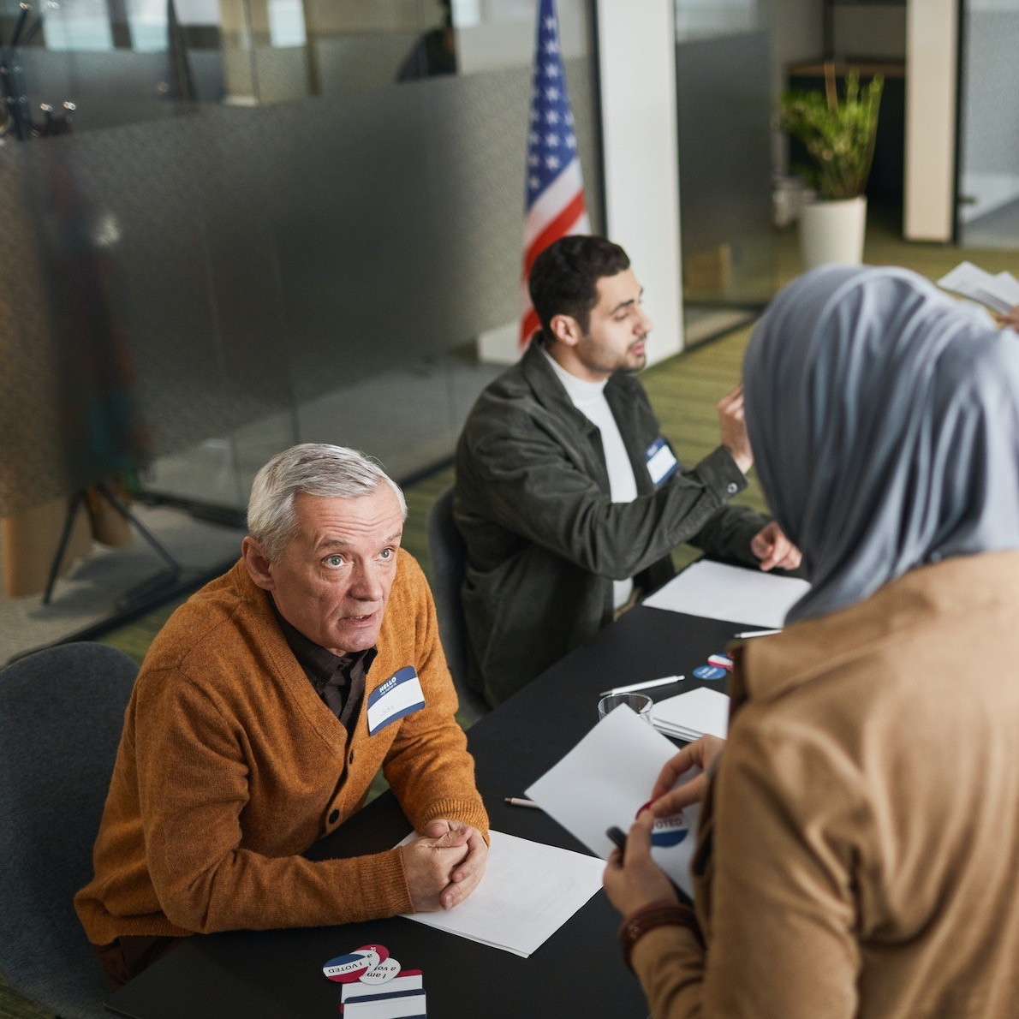

Become a poll worker

Slide 11
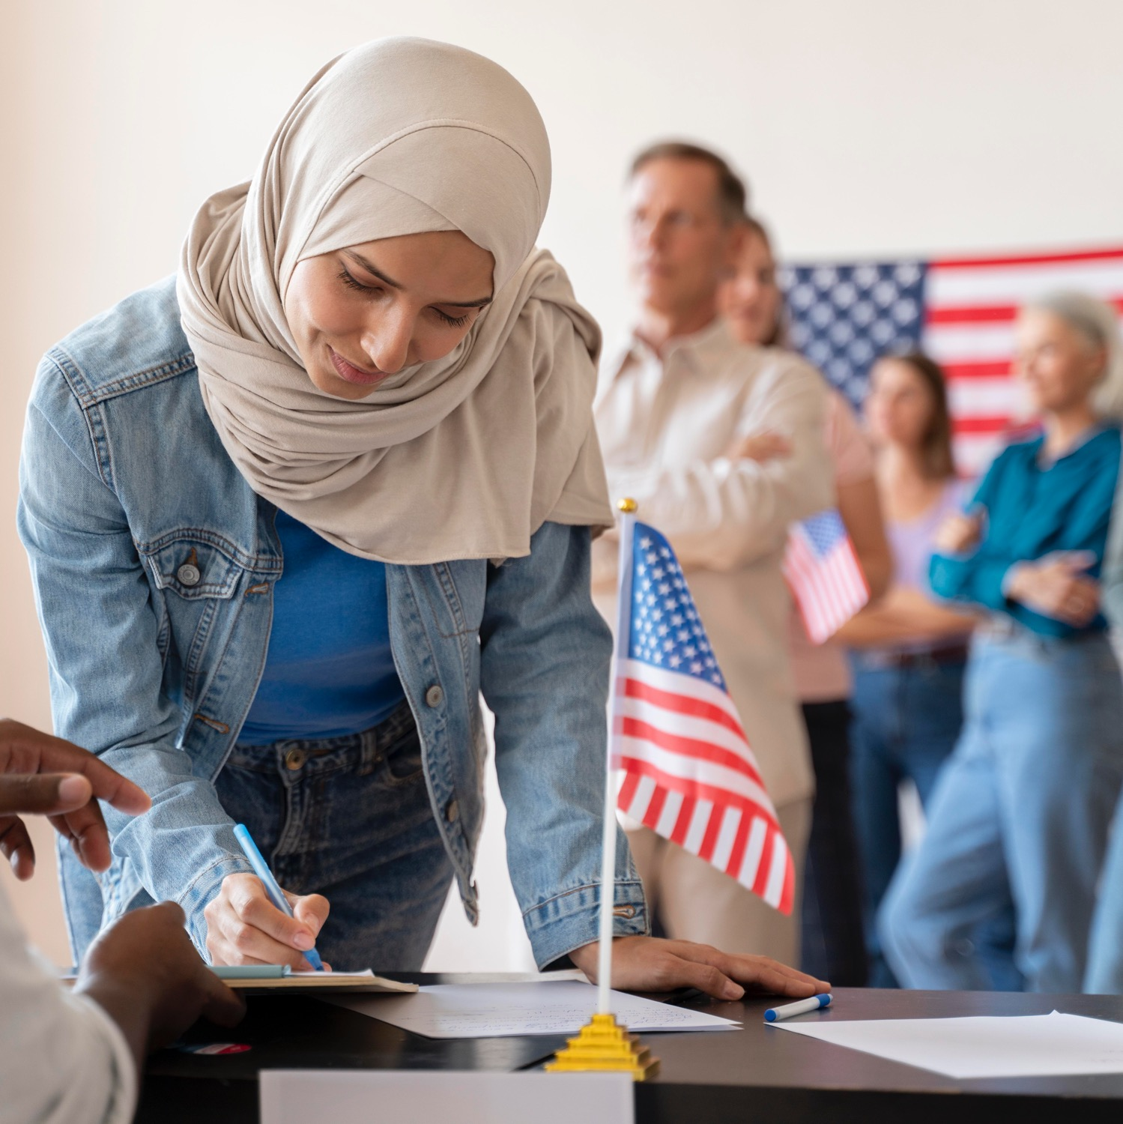

Deadline upcoming!
Register to vote today

Slide 12
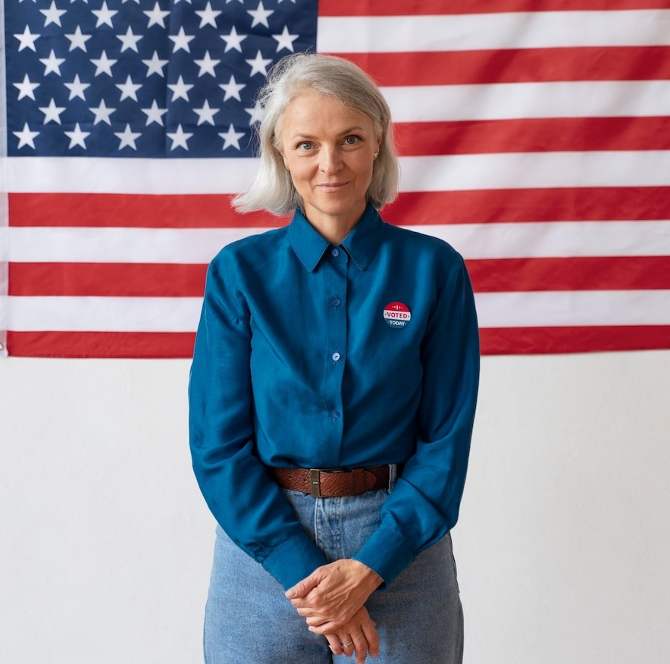
Team Spotlight
Firstname

Slide 13
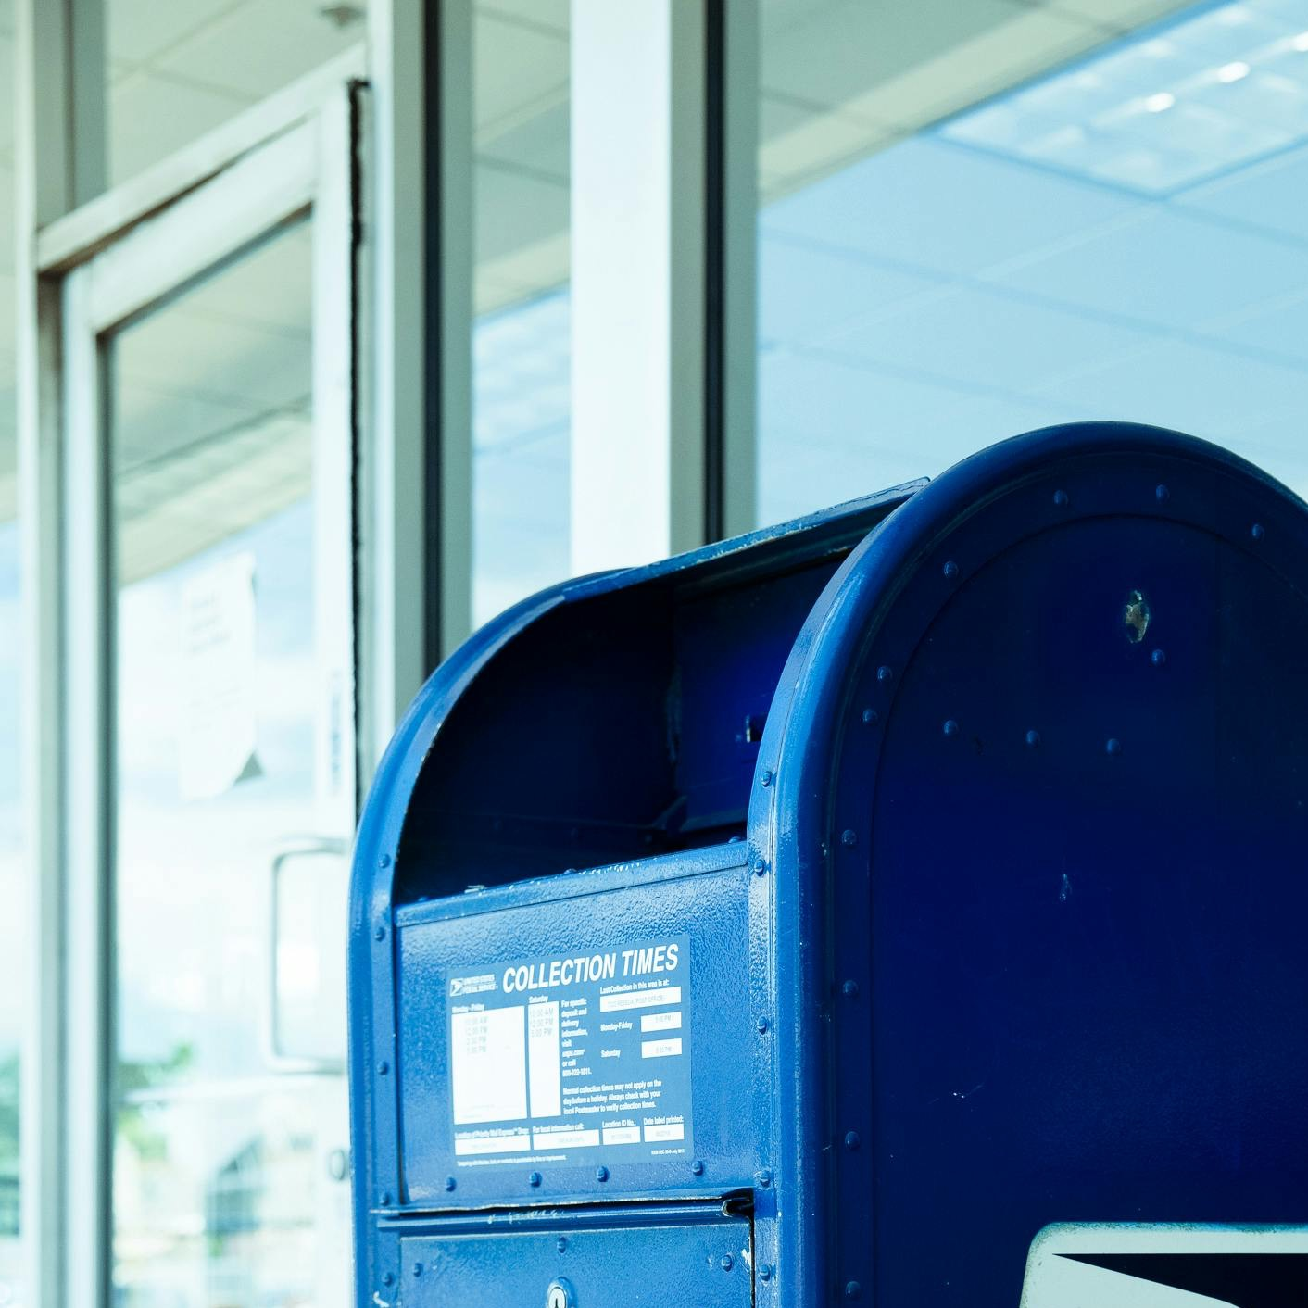

You have options
Vote early
Vote by mail
Vote on Election Day

