Slide 1
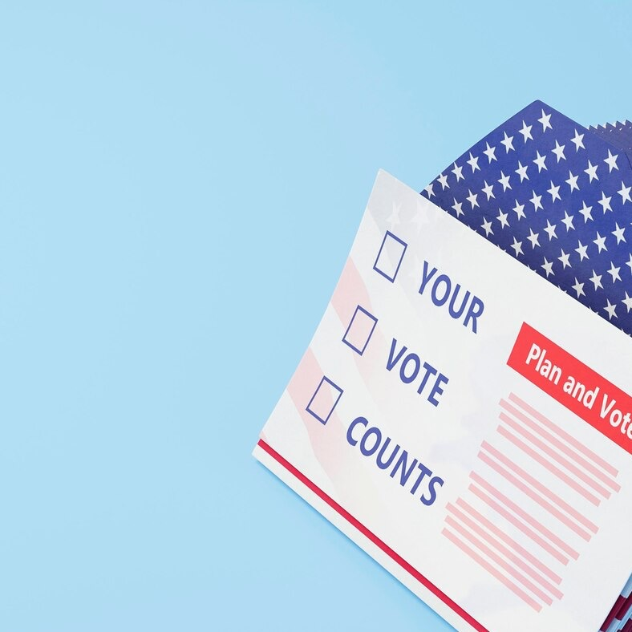
Ballots are in the mail!

Slide 2
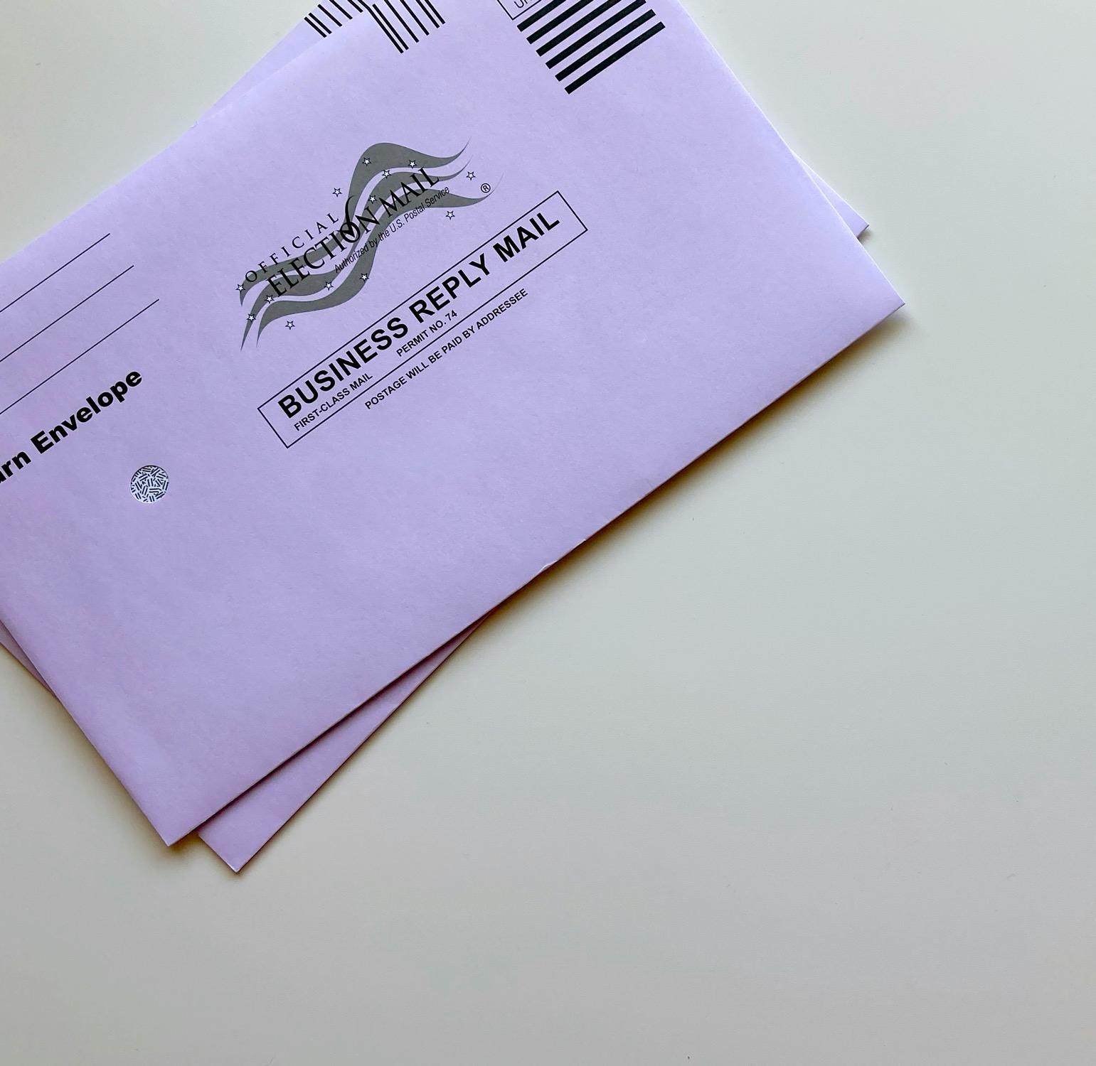
Now open
Find your nearest ballot drop box at yourcountyvotes.gov

Slide 3
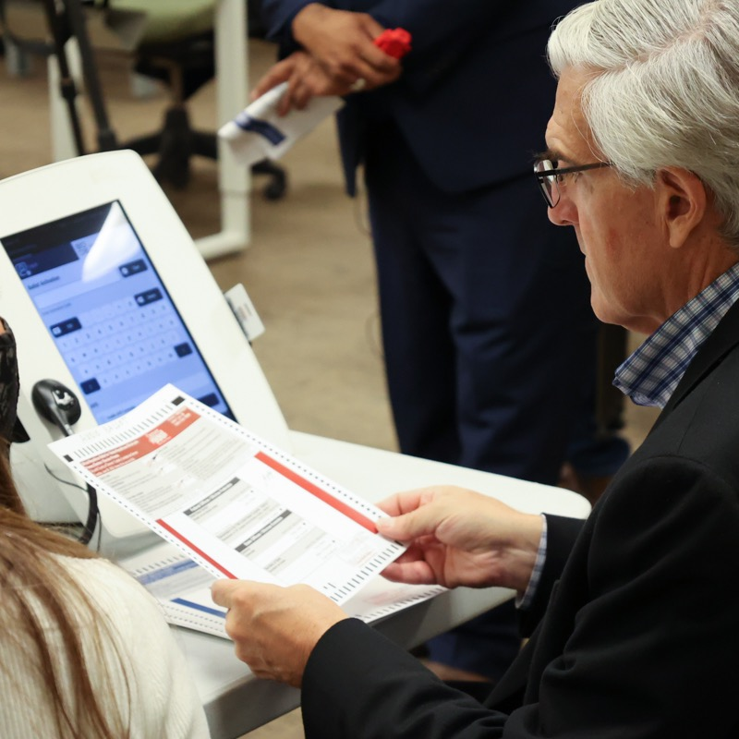
Join us
for our Logic and Accuracy Test

Slide 4
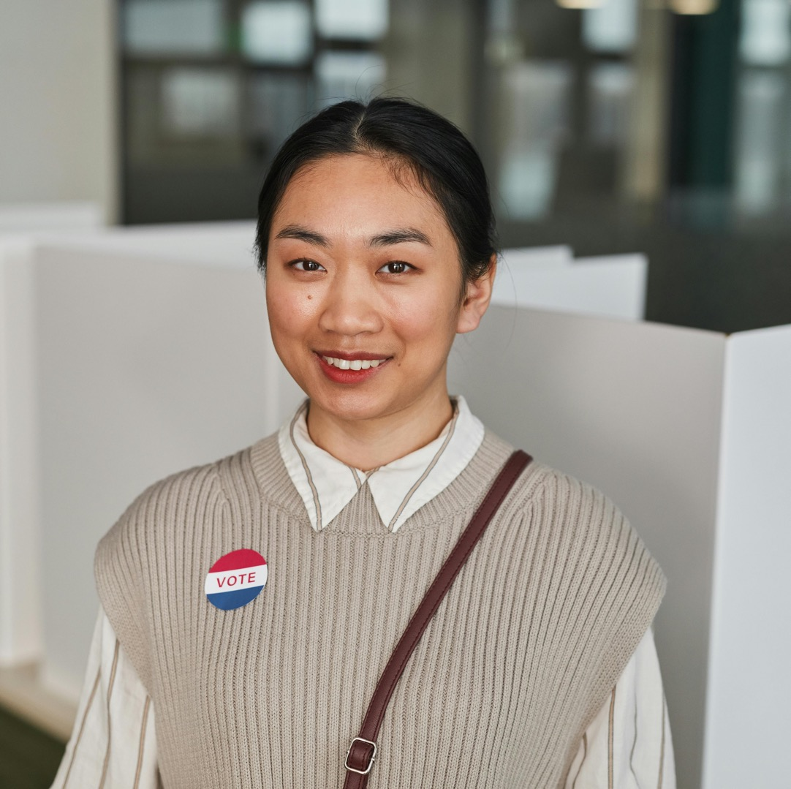
Team Spotlight
Firstname

Slide 5
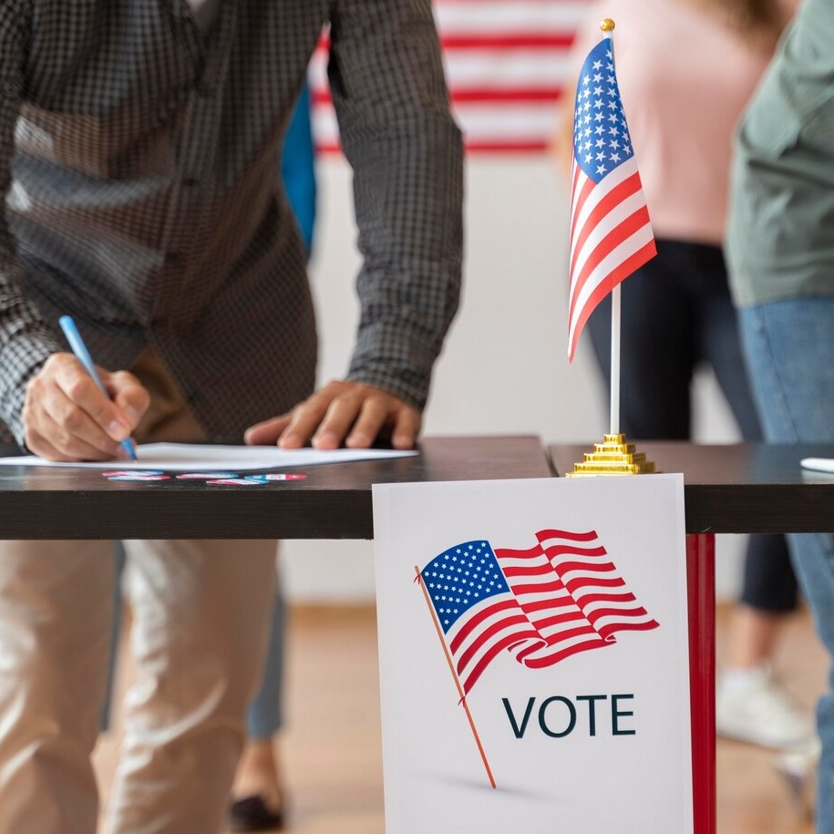
Military and overseas voters
It’s time to update your registration!
Voting in person?
1. Bring acceptable form of ID
2. Check in at your polling place
3. Vote!

Slide 6
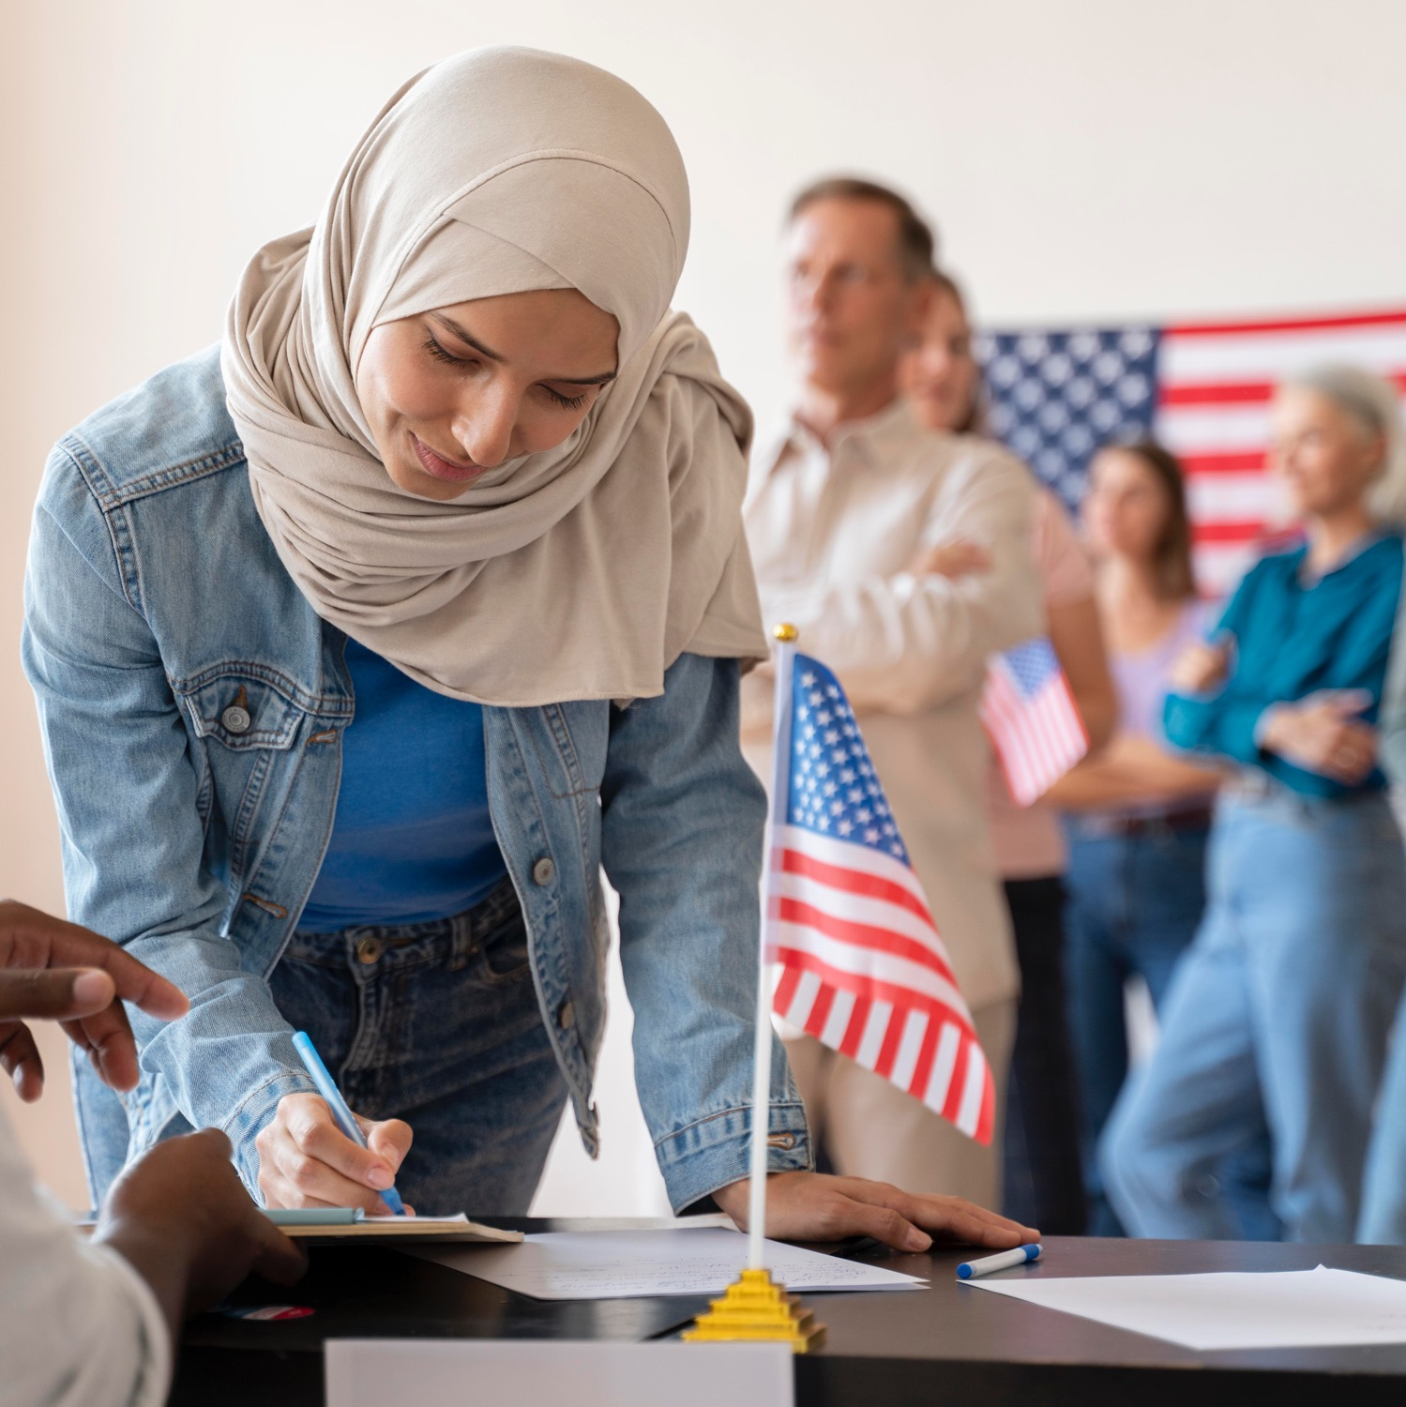
Deadline upcoming!
Register to vote today

Slide 7
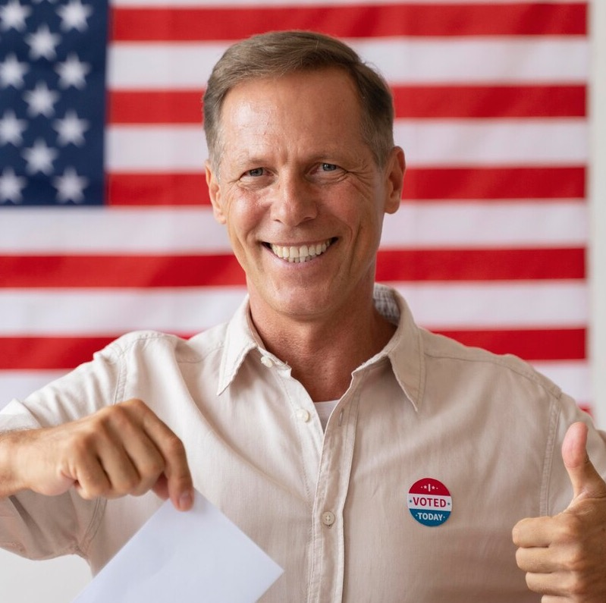
Team Spotlight
Firstname

Slide 8
Last day to register to vote

Slide 9
Team Spotlight
Firstname

Slide 10
10 days to Election Day

Slide 11
9 days to Election Day

Slide 12
8 days to Election Day

Slide 13
Don’t be spooked!
Voting is easy as 1, 2, 3
1. Bring acceptable form of ID
2. Check in at your polling place
3. Vote!

Slide 14
7 days to Election Day

Slide 15
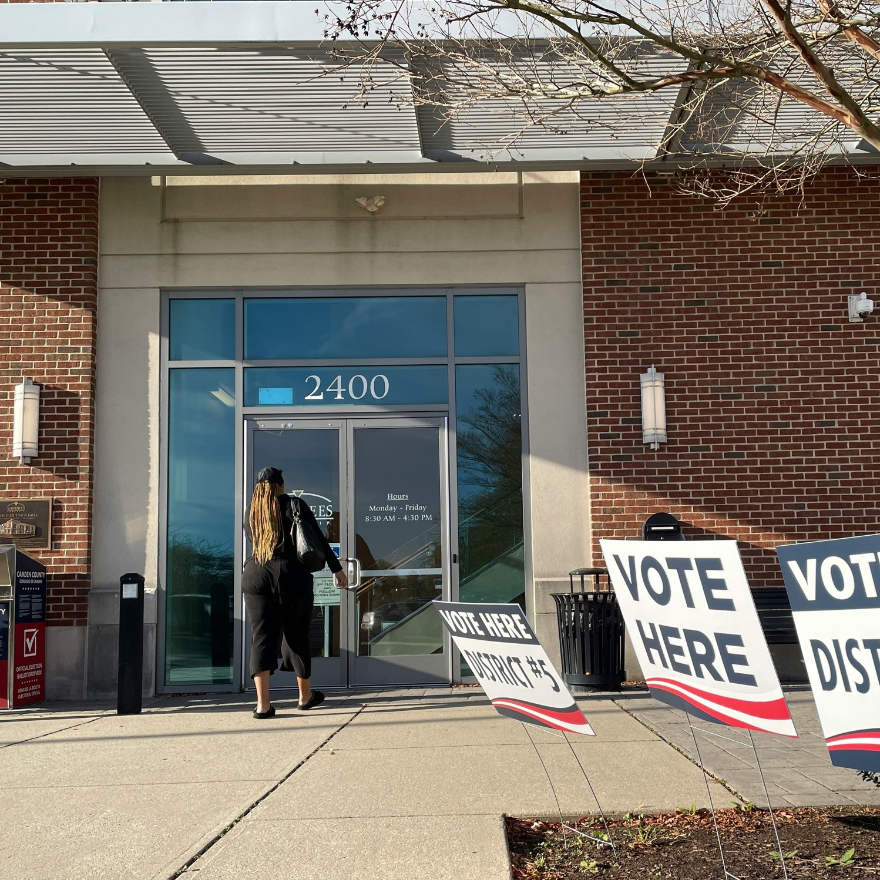
Vote centers are open!

Slide 16
6 days to Election Day

Slide 17
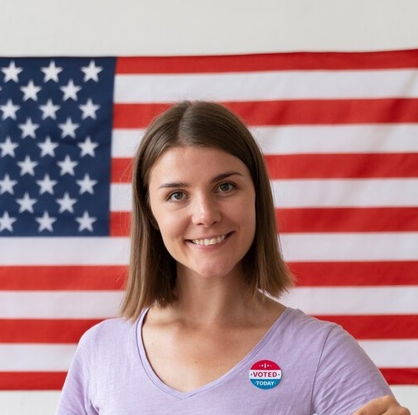
Team Spotlight
Firstname

Slide 18
5 days to Election Day

Slide 19
Planning your weekend?
Pencil us in!

Slide 20
4 days to Election Day

Slide 21
3 days to Election Day

Slide 22
2 days to Election Day

Slide 23
Set your clocks back
Daylight Saving Time ends today
2 days to Election Day

Slide 24
1 day to Election Day

Slide 25
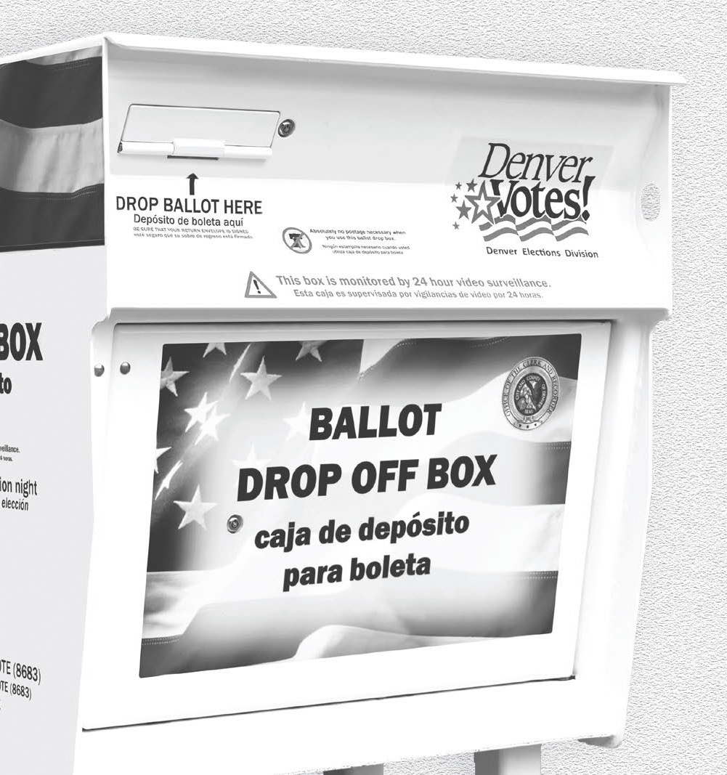
Happy Election Day!
Polls and drop boxes close at 7 p.m.

Slide 26
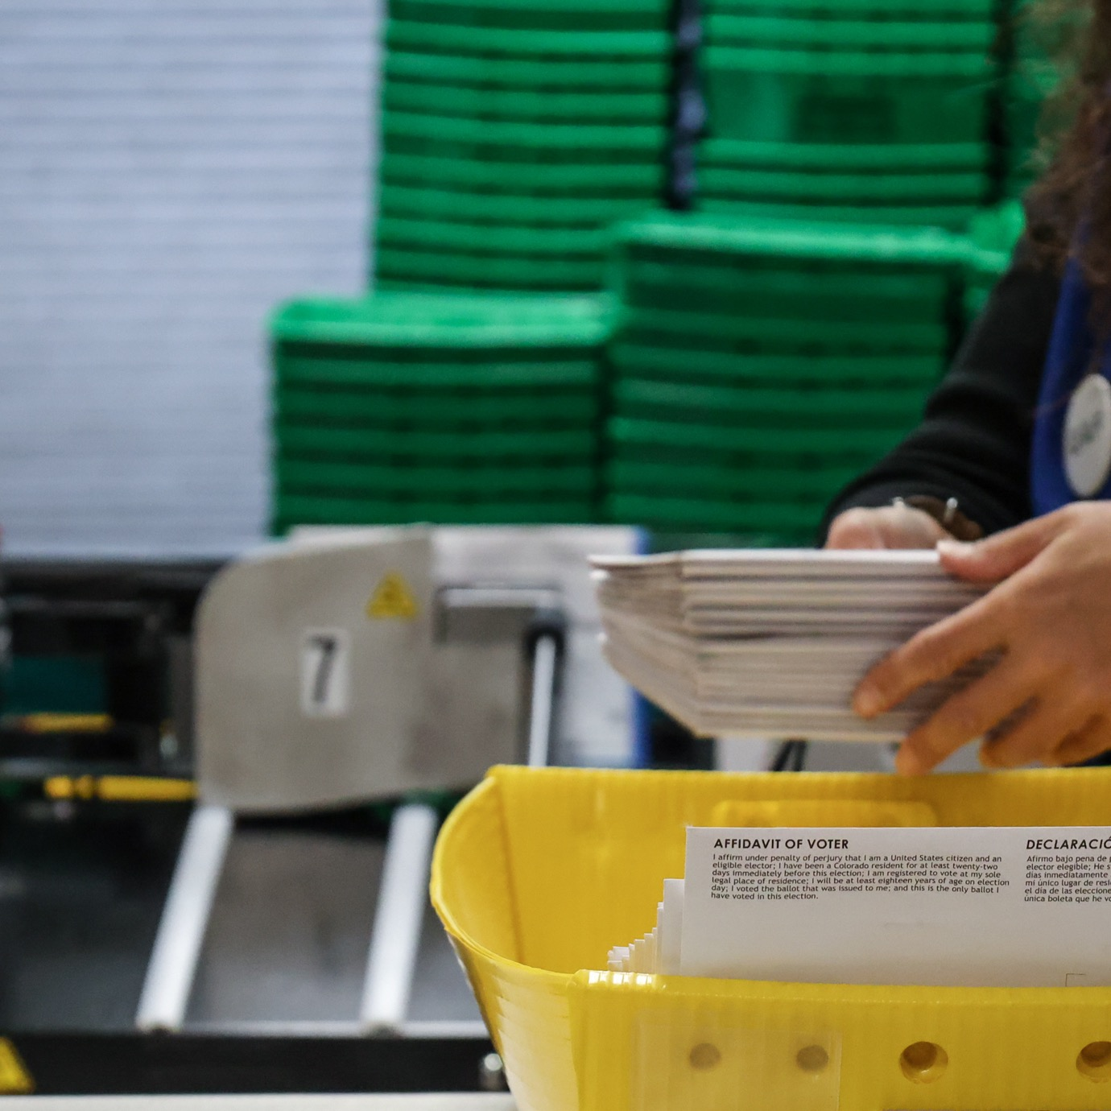
Thank you, voters!

Slide 27
Team Spotlight
Firstname

Slide 28
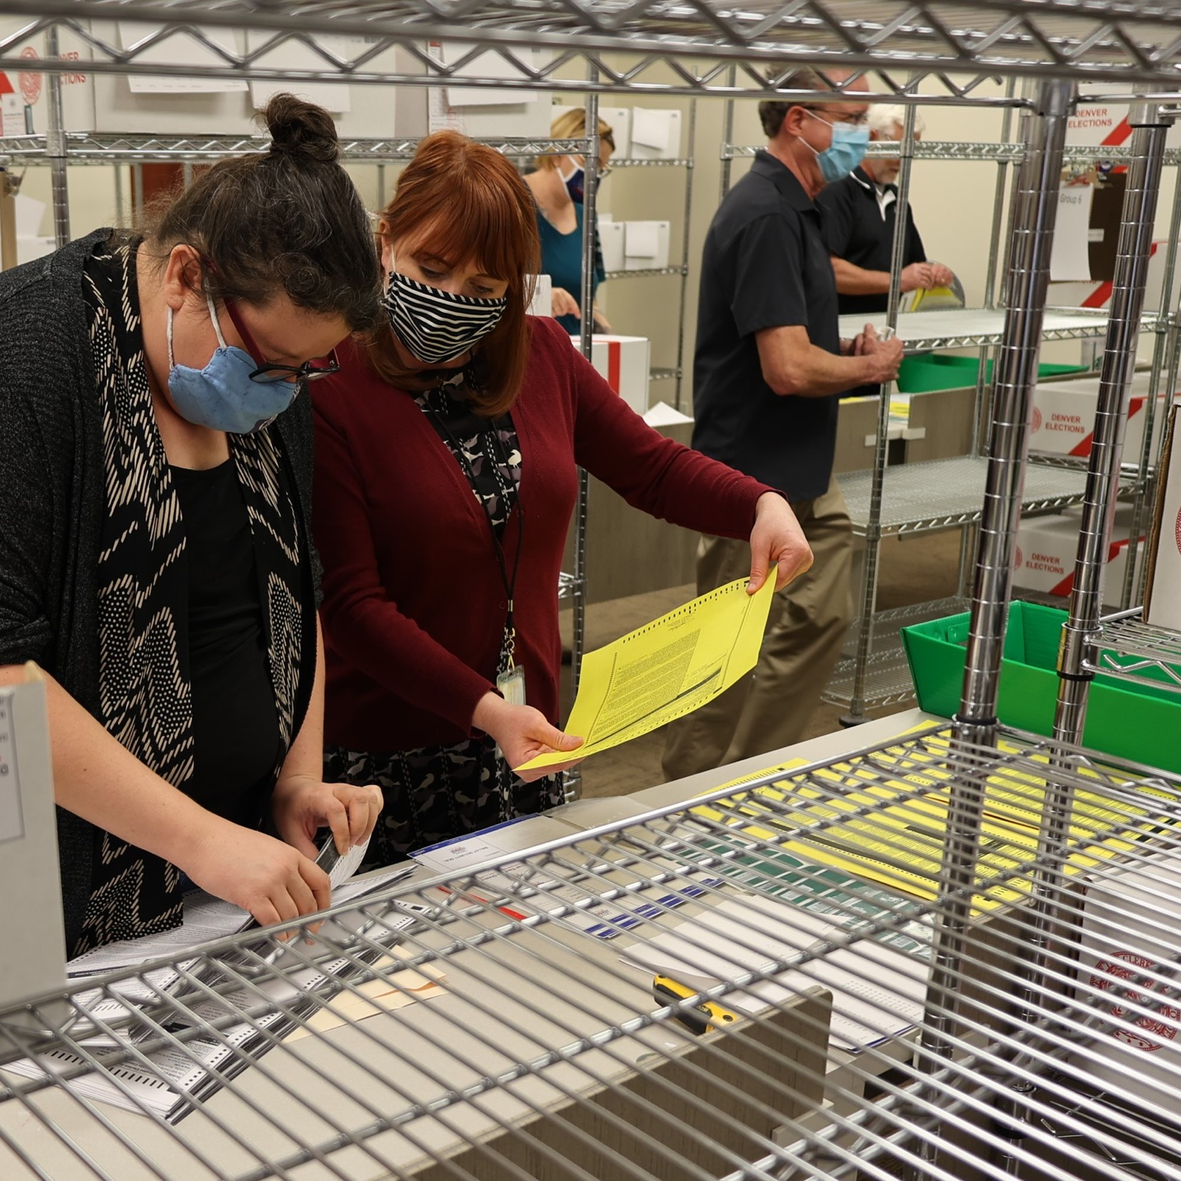
Post-election audits have begun

