Slide 1
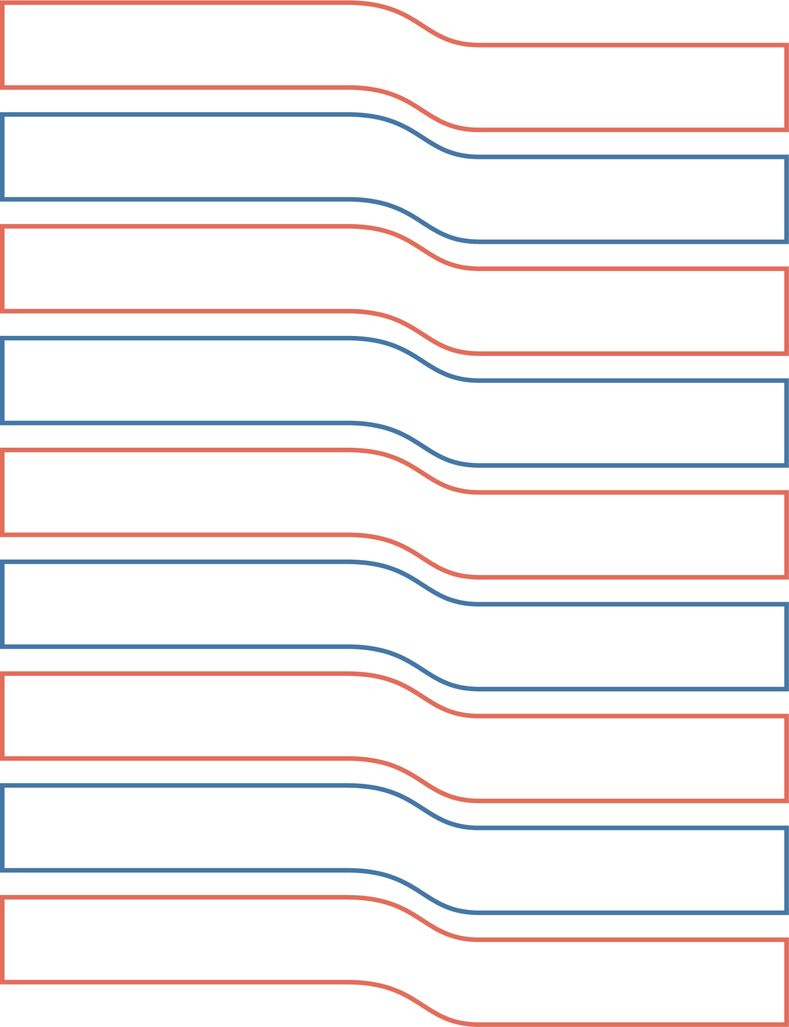
Voter Registration & Voter List Updates
HOW IT WORKS SERIES
Note: This general information resource may not represent the policies and practices in every state. Election offices can adjust and add content to describe their specific voter registration and voter list update policies and practices.
HOW IT WORKS SERIES
Notes:
Welcome! Let’s talk about how voter registration and voter list updates work

Slide 2
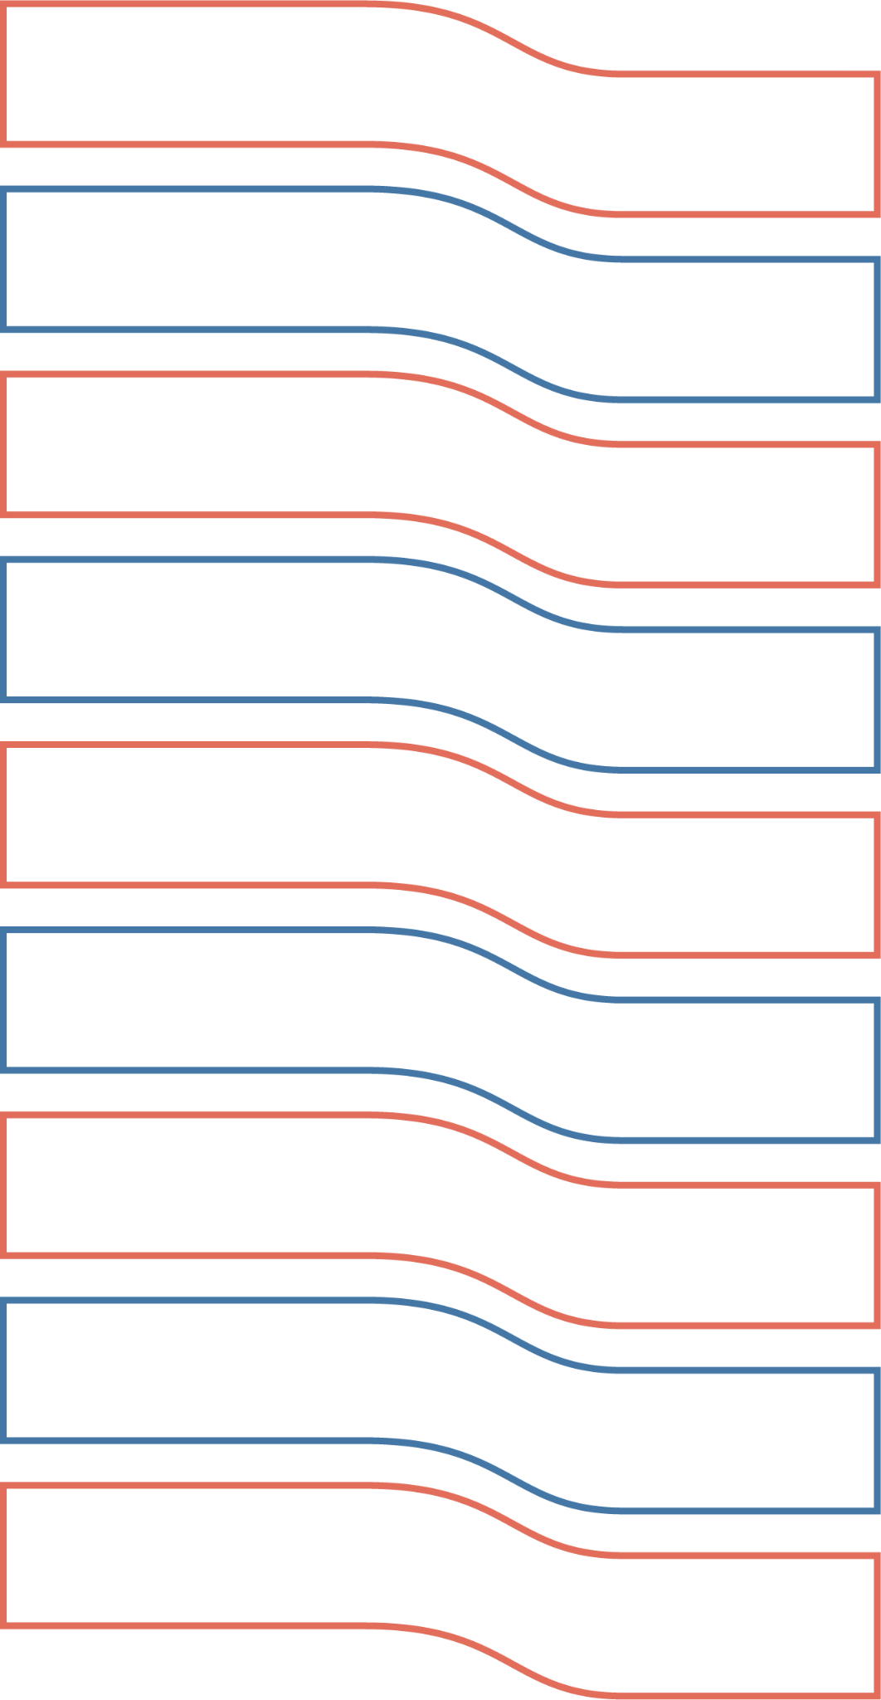
Elections officials are the experts
Not the candidates. Not reporters.
Election officials are the experts on how voter registration and voter list updates work. They know the rules, regulations and procedures involved.
It’s what they do.
And election officials helped create this presentation.
Notes:
With so many rumors floating around about voter registration and who can vote, we’re here to give you the facts from the election experts: election officials.
Yes, election officials are the experts on how voter registration and voter list updates work. Not the candidates. Not reporters. And election officials created this presentation.
If you have a question about something you hear related to voting or elections, reach out to the experts. Reach out to your local election office.

Slide 3
How Voter Registration Works:
.Voter Edition.
Notes:
Let’s begin with voter registration from the voter’s point of view.

Slide 4
Who is a .qualified resident?.
A U.S. citizen
Who meets their state’s residency requirements
Will be at least 18 years old on Election Day
Any state-specific requirements, such as no felony convictions or incapacity
Notes:
Voter registration is open to all “qualified residents.” You’ll hear this phrase a lot today, so who are qualified residents?
Qualified residents are people who meet the requirements to vote in the United States.
To register to vote in state and federal elections, you must be a:
U.S. citizen,
Who meets the state’s residency requirements, and
Will be at least 18 years old on Election Day.
These three requirements apply across the country, and some states have additional requirements, such as no felony convictions or incapacity. If you meet your state’s requirements, you are a qualified resident. You are eligible to vote.

Slide 5
Registering to vote
Paper voter registration application
Online voter registration application
Voter registration opportunity at motor vehicles
Phone apps
Same-day voter registration
Notes:
In all but one state – North Dakota – qualified residents need to register before they can vote.
And in most places, there are several ways to register. No matter how you register, you will likely need to provide your name, address, date of birth, driver’s license or Social Security number, and signature.
Some qualified residents complete a paper voter registration application and return it by mail or in person to their local election office. Others complete and submit an online voter registration application. Applications typically require a signature to affirm U.S. citizenship and other qualifications, and information, such as a driver’s license or Social Security number, as proof of identity.
When the National Voter Registration Act – also called the NVRA or the “motor voter law” – became federal law in 1993, it mandated another option: registering to vote or updating a voter registration while conducting a driver’s license transaction with motor vehicles. States covered by the NVRA must also make voter registration available for people interacting with agencies that provide public assistance or services to individuals with disabilities or people interacting with armed forces recruitment offices.
Qualified residents can also register using their phone. There are phone apps and online voter registration forms hosted by voter engagement groups that make voter registration quick and easy. These systems usually build on a state’s online voter registration system.
For qualified residents who miss their state’s voter registration deadline or decide to vote at close to the last minute, same-day registration may be an option. It’s available in about half the states, and in those locations, qualified residents can register to vote and then cast a ballot on the same day at a polling location.
No matter how someone registers to vote, election offices perform multiple checks to ensure that only qualified residents who meet the state’s requirements are added to the state’s list of registered voters. If you’d like to know more about the registration process in your state, check with the experts in your local election office.

Slide 6
Preparation is key!
Not yet registered to vote?
Voter registration deadlines typically fall between eight and 30 days before the election.
Already registered to vote?
Check your voter registration status at least four weeks before an election to ensure a smooth process on Election Day.
Notes:
Preparation is key if you want to vote in this election.
If you’re not yet registered to vote, keep in mind that voter registration deadlines typically fall between eight and 30 days before the election. Also keep in mind that qualified residents who do not provide proof of identity when registering (or whose proof of identity cannot be verified) will be asked to do so the first time they vote.
If you’re already registered to vote, check your voter registration status at least four weeks before an election to ensure a smooth process on Election Day.

Slide 7
How Voter Registration Works:
.Election Office Edition.
Notes:
So we’ve talked about voter registration from the voter’s point of view. What happens in the election office?

Slide 8
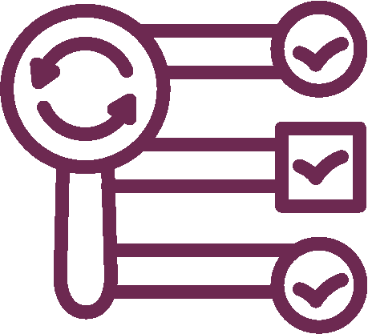
Processing voter registration applications
Application
Information & signature check
New voter registration record
Confirmation mailing
Notes:
As soon as the election office receives your registration, staff will confirm this information and check that you’ve signed your application to affirm that you meet your state’s eligibility requirements. The election office will also check the driver’s license number or social security number you provided on the application against state and federal databases to verify your identity. If the election office cannot confirm this information or it’s missing on the application, someone will reach out for additional proof of identity, such as photo or non-photo ID. A person generally must provide this additional proof of identity before voting.
After confirming your registration information, the election office will create a voter record for you in the voter registration database. Then, the office will mail you a voter registration card or a letter to confirm your registration.

Slide 9
The National Voter Registration Act (NVRA):
Makes voter registration available at places like the Department of Motor Vehicles.
Outlines requirements to keep voter registration lists accurate and current.
Each state determines how they maintain accurate and current voter lists using uniform, non-discriminatory practices.
Requirements for list updates help safeguard voters and ensure accuracy in 44 states + D.C.
Notes:
Earlier, we talked about voter registration and the National Voter Registration Act or NVRA. It applies to 44 states and the District of Columbia and does much more than require voter registration at motor vehicles. It also outlines ways to keep voter registration lists accurate and current.
While the NVRA has certain requirements, it gives states some discretion in determining how they’re going to maintain accurate and current voter registration lists.

Slide 10
Adding voters to the voter list
Voters are added if…
Voters are considered “pending” if…
Move into the jurisdiction, update and confirm their new address
Are first-time registered voters, all info on their voter registration application is confirmed before the next voter registration deadline
Turn 18 in a state that allows pre-registration
Election officials need proof of identity such as a driver’s license number to confirm information on a voter registration application
They pre-registered but are not yet 18 years old
Notes:
And like most things related to elections, the rules and practices for updating voter lists are different in different states.
Election officials follow their state’s process to ensure that voter lists are accurate and up-to-date. This process is sometimes called “voter list maintenance.” And election offices update voter lists throughout the year, not just during election season.
While rules vary, in most states, voters may be added if they are newly registered, move into the jurisdiction and update their registration address, or turn 18 in a state that allows pre-registration.
If an election office needs more information to confirm a new registration, the office creates a voter record, but the voter’s registration status is considered “pending.” And different states use different terms to describe this status, including “pending,” “ID required” and “HAVA,” which is short for the Help America Vote Act. This is the federal law that requires voters to provide additional identity verification when the driver's license number or the last four digits of their Social Security number on the registration application is missing or cannot be verified.
Election offices may also treat pre-registrations by 16- and 17-year-olds as “pending” registrations that become active when the teen reaches voting age.

Slide 11
Removing voters from the voter list
Voters are removed if…
Confirmation from the voter that they’ve moved outside the jurisdiction
Death notification
Notice of a felony conviction or incapacity declaration
Written request for removal
Information on citizenship resulting in ineligibility
OR
The voter is “inactive” for two federal general elections and no other voter activity
Notes:
We know how voters are added to the voter list. When can voters be removed? And how does it work?
States can remove voters immediately from the voter list for certain reasons. For example, if a state has information that a voter has died, or been convicted of a felony or declared incapacitated, or if the voter has requested to be removed, the state can remove them from the list immediately. That’s pretty straightforward.
There are additional steps if an election office suspects a voter has moved outside the jurisdiction. If a state has some indication that a voter has outside the state, such as mail returned as undeliverable or USPS information signaling a move, or the voter has not voted in several elections, the election office may send the voter an address confirmation mailer.
This confirmation mailer is required by the NVRA and lets the voter know that unless they respond, the state will begin the process of removing them from the voter list.

Slide 12
.Inactive voters are still eligible to vote!.
Voters may be listed as “inactive” if…
Their mail was returned undeliverable
They have not voted in recent general elections (timing varies)
AND
They did not respond to an address confirmation mailer
Notes:
Voters who do not respond to the confirmation mailer are moved to the “inactive” status. This first step – moving the voter to “inactive” – starts the clock for removal from the voter list if the election office does not hear from the voter or the voter does not vote in the next two general elections.
The mailer and the two general elections time period to respond or vote provide voters with a voter registration safety net. Until the removal clock runs out, inactive voters remain registered and eligible to vote. It may not be as obvious, but this process also assists election officials: it helps keep lists up-to-date by providing a framework for removing voters who’ve likely moved.
When the removal clocks wind down for “inactive” voters after two general elections, officials typically remove them in groups early the next year, in the odd year following two general elections.

Slide 13
Sources election officials use to maintain voter lists:
Cross-state programs
Online voter registration systems and the department of motor vehicles
State agencies: corrections, health, human services
Courts
USPS national change of address
Social Security Death Index
Returned election mail
Voter list updates
Notes:
So, where do election officials get the information they need to remove voters and keep voter lists updated?
Many states receive daily voter address updates from online voter registration systems and motor vehicles.
Some states get updates about voters who move or pass away from cross-state information sharing programs. And election officials regularly receive updates on deaths, felony convictions, address changes and incapacity judgments from state agencies, the courts; the post office and national change of address service, and the Social Security Administration.
And there’s an additional voter registration address check in election years. Election officials send voters a piece of election mail – usually a sample ballot or candidate guide. This mailer informs voters and provides an opportunity for election officials to follow up with individual voters if any mailers are returned as undeliverable.

Slide 14
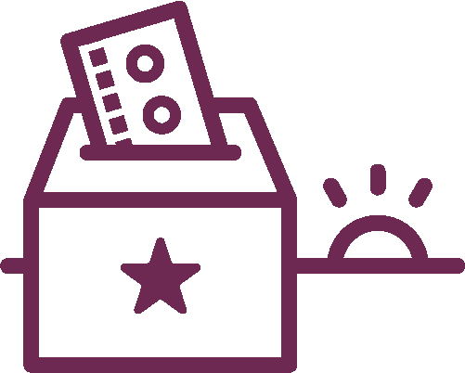
How it Works
Paper / electronic pollbook
In-person voting
Mail ballots
Voter list updates
Mail ballots
Vote by mail
Notes:
So, we’ve discussed registering voters and how voter lists are updated. Now, let’s tie it to voting.
Before each election, officials print the voter registration list or upload it to an electronic device such as a tablet, or both. This list is the pollbook. If you vote in person during early voting or on Election Day, the election worker at the check-in table will look you up in the paper or electronic pollbook, and then, depending on the requirements in your state, they will ask you a question to confirm you are the voter listed or request to see ID, and they’ll ask for your signature.
The voter list is also used to send mail ballots.
If you’re wondering what happens when voters haven’t updated their registration or need to confirm certain information, there are processes in place to help them vote.
In some states, voters can update their address at the polls with proof of their new address and cast a regular ballot. In other states, voters whose registration information can’t be confirmed at check-in may need to vote a provisional ballot. These are just like regular ballots, but are kept separate and counted once your registration record is updated or corrected, often by providing ID or updating voter information.
If a mail ballot is returned as undeliverable even after the pre-election address check mailing, election officials send a forwardable piece of mail to help confirm the voter’s address. If they don’t hear back, they will list the voter as “inactive” and start the clock for removal from the voter list if the election office does not hear from the voter or the voter does not vote in the next two general elections.

Slide 15
Voter registration ✓
Voter list updates ✓
Voting ✓
Notes:
There you have it. Congratulations!
You now know how voter registration and voter list updates work – and how these processes make voting work every election.
You know that election officials across the country follow federal and state laws and established procedures to ensure that all qualified residents – or everyone who is eligible to vote – can register, update their registration as needed, and vote.
And you know what to do if you have questions about voter registration and voter list updates in your area. Reach out to the experts: your local election officials.
Don’t forget, preparation is key! Register on time and check your registration before every election.
Thank you.

Slide 16
Questions?
Notes:
[Here, you can either take all questions or use this script so questions will only be about what was covered in the presentation.] If anyone has questions about what we covered in this presentation, this is the time! But please keep in mind that, beyond the basics, different states follow different rules and procedures. If you have questions about your state’s voter registration or voter list update practices, please direct those to the experts in your local election office. Thank you!

