Slide 1
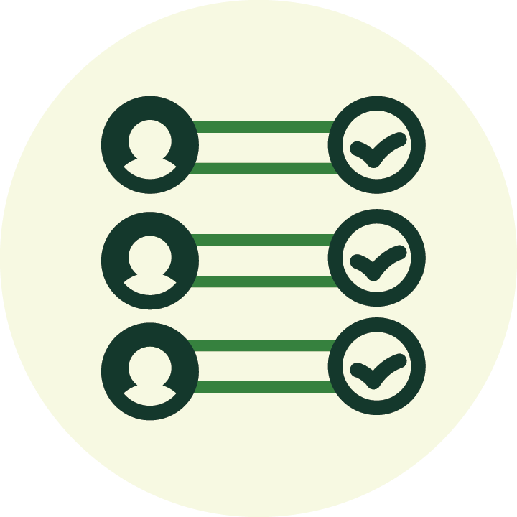
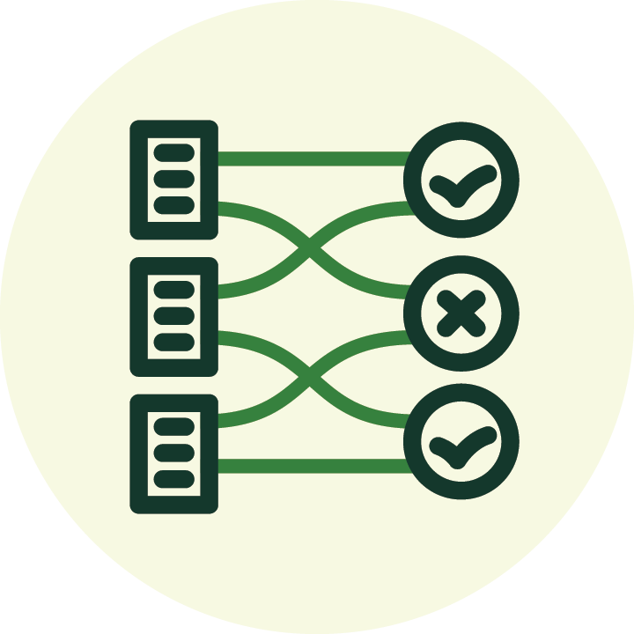
Voter Registration and
Voter List Updates: A Primer
This is a template and may not represent the policies and practices in every state.
YourCounty LOGO
Who is eligible to vote in the U.S.?
You can register and vote if:
You are a U.S. citizen,
You meet your state’s residency requirements,
You will be at least 18 years old on Election Day, and
Depending on where you live, you also meet state-specific requirements, such as no felony convictions or incapacity declaration.¹
Just the facts:
Under the Help America Vote Act, new
voters provide a driver’s license or state
identification number, or the last four
digits of their social security number on
their registration application, and election
officials must confirm this information when processing the application. If this information is missing or can't be matched, new voters must provide identification documentation when voting in person or include a copy of identification with their mail ballot.
North Dakota is the only state that does not require voters to register before they vote. Voters show ID to prove they’re eligible to vote at the polls or when requesting an absentee ballot to vote by mail.²
How do election officials update voter lists?
Election officials receive regular
reports of deaths, new addresses
outside the jurisdiction and felony
convictions, so they can remove
these voters from the voter list.
These reports come from state and
federal agencies, the courts and the post office. And sometimes voters report address changes or ask to cancel their registration.
Did you know? In election years, when there is still time to update voter registrations, election officials send all voters a mailer, usually a sample ballot or candidate guide, to do one more address check. Officials follow up with voters if their mailer is returned undelivered to ensure the voter list is accurate and up-to-date before voting begins.
Why is updating voter registration lists so important?
Accurate, up-to-date voter lists help election officials plan and run transparent, efficient and secure elections. Updated lists not only ensure that only eligible voters cast ballots, but also help election officials assess how many workers and supplies they’ll need to serve everyone who votes in person and by mail.
Voter registration lists are always changing.
The list grows when voters move into the state, register for the first time and turn 18. The list shrinks when voters move out of state, pass away, or experience a felony conviction or declaration of incapacity.
¹ Who can vote? (USA.gov/who-can-vote)
² North Dakota Secretary of State (sos.nd.gov/elections/voter/voting-north-dakota)

