Slide 1
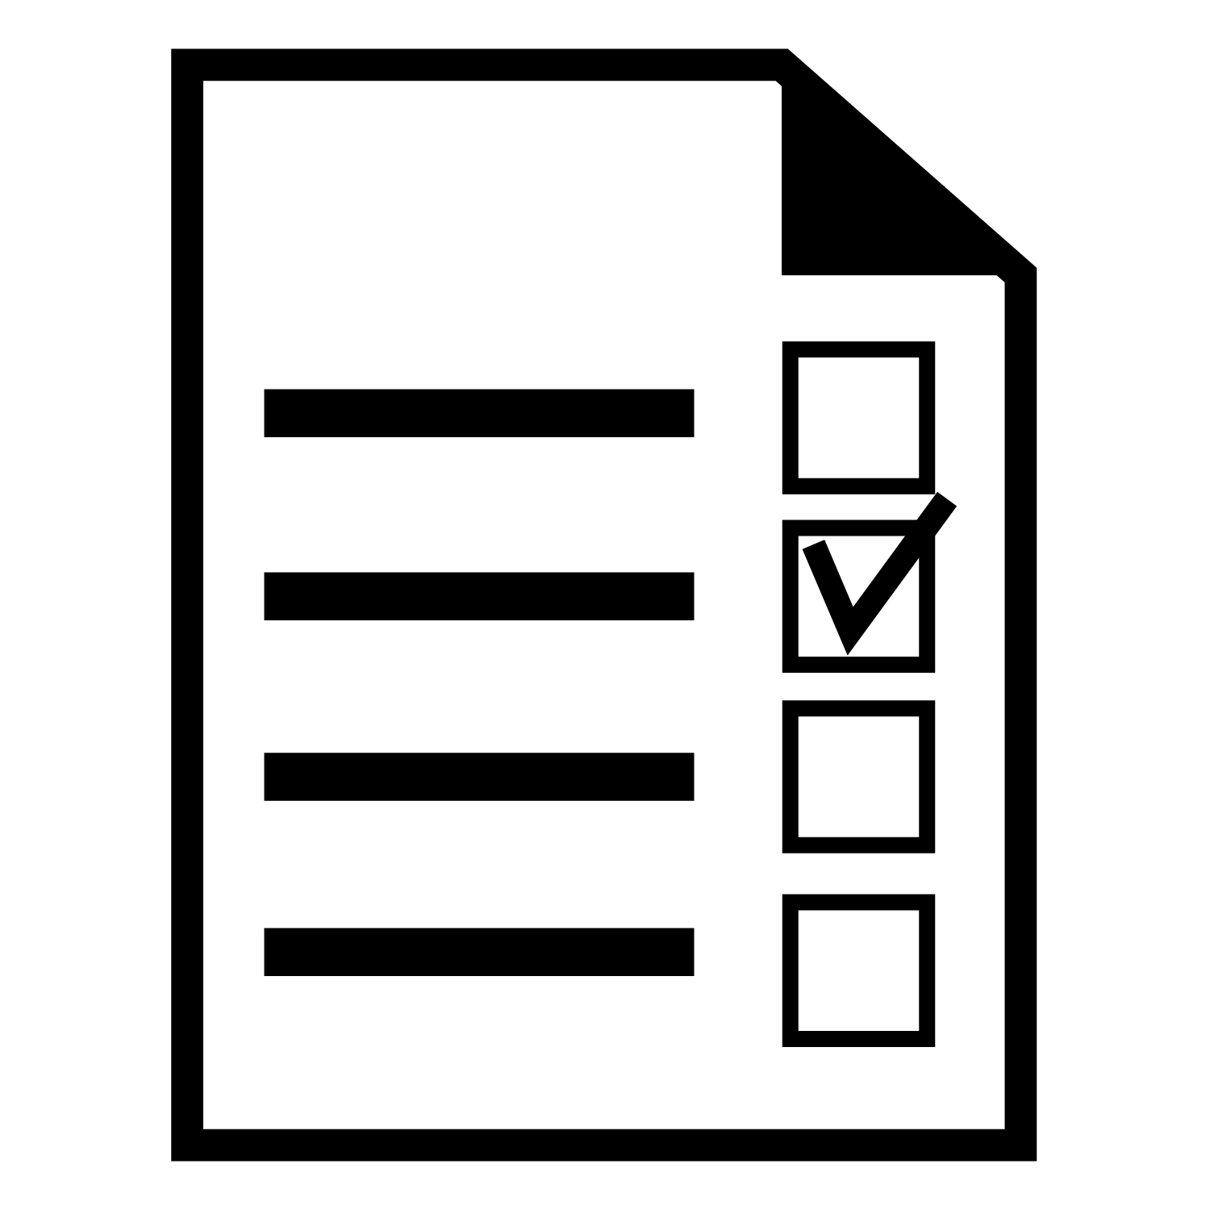
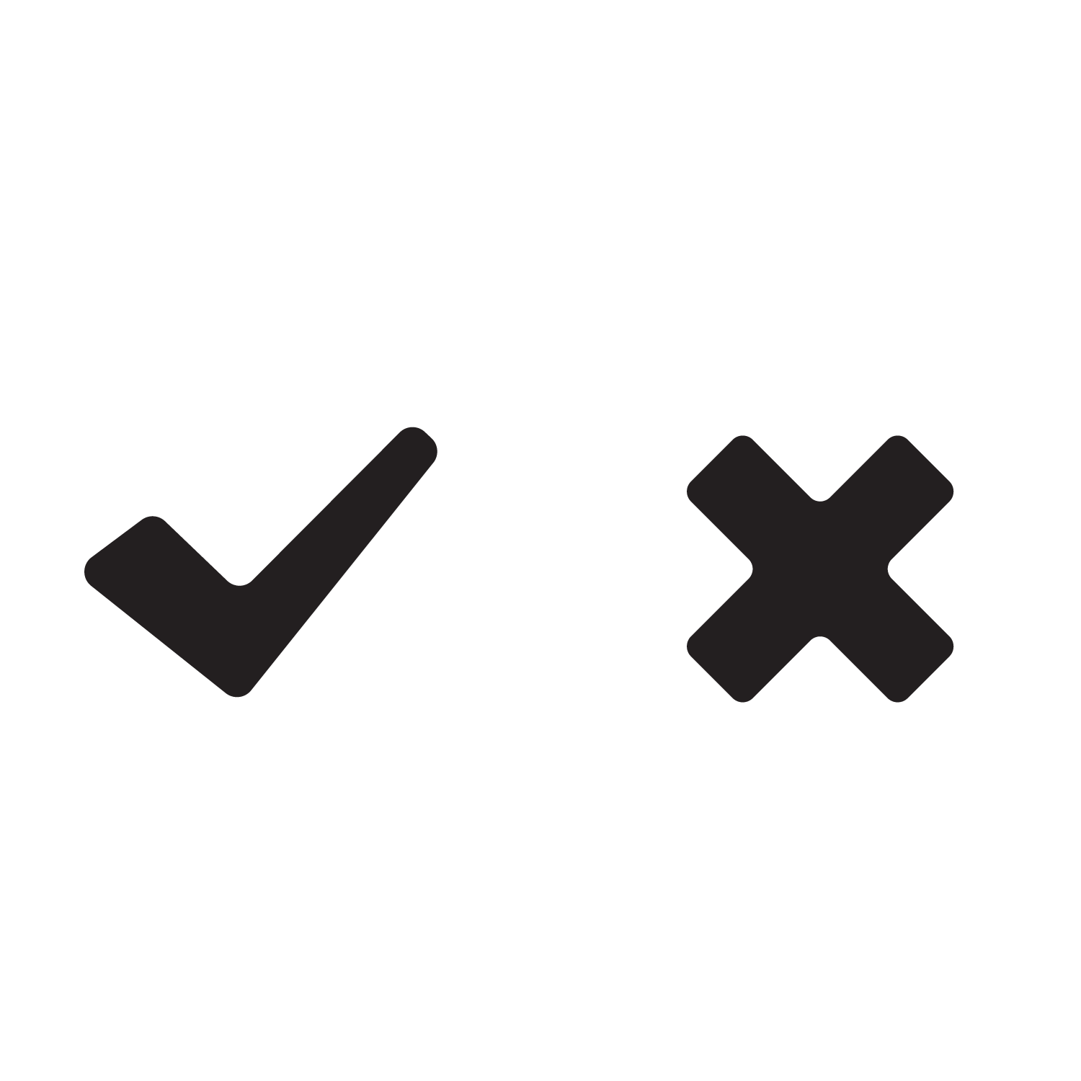
HOW DO I KNOW MY VOTE WAS COUNTED?
Registered voters can return their voted ballots:
by mail,
using a drop box, or
in person at
a vote center,
a polling place, or
the elections office.
Vote-by-mail return envelopes have a unique ID or barcode to help with signature verification and ensure voters only vote once.
“I VOTED” sticker or tracking system graphic lets you know your vote was counted.
1.
Voters return their vote-by-mail ballot.
5.
2.
All received vote-by- mail ballots are sorted to ensure that they are for the current election.
Accepted vote- by-mail ballots are sent to processing, where they are prepared for counting.
4.
3.
All vote-by-mail ballots go through signature verification. Voters are notified by mail if their signature cannot be verified.
Any challenged vote-by-mail ballots are sorted out for further review.
Did you know?
LOGO
Voters can track their vote-by-mail ballot through the entire process with <service>?
To learn more, scan this QR code or visit <website>.
QR CODE

Slide 2
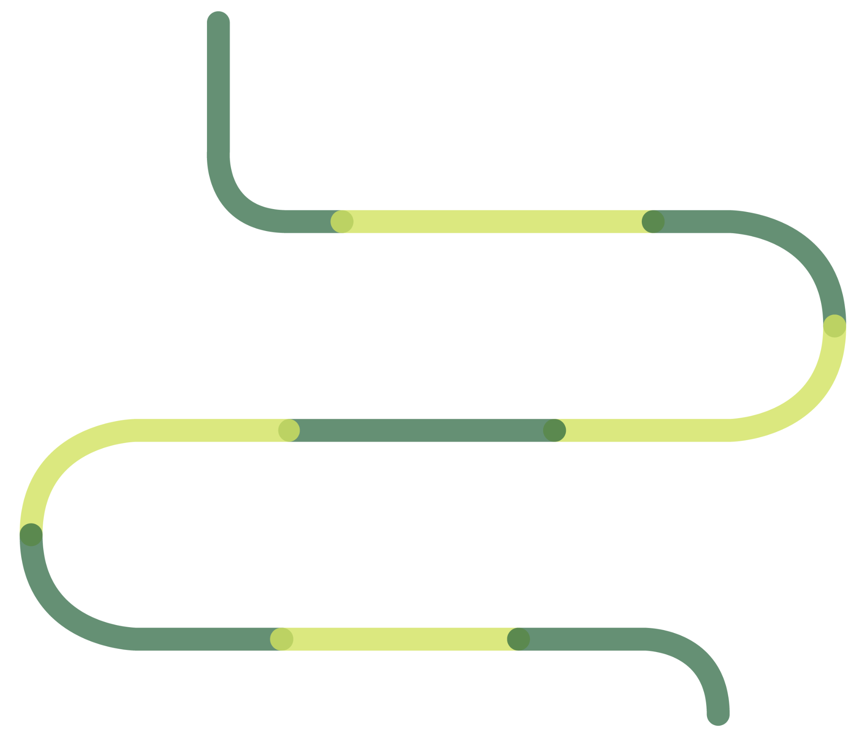
WHY DOES IT TAKE SO LONG TO COUNT THE VOTES?
LOGO
Counting votes involves more than just scanning ballots and tallying results. The roadmap below shows what happens from the time polls close until the election is certified in <Jurisdiction>.
Election Day
3
Vote-by-mail ballots properly postmarked by <time> on Election Day, accepted for <##> calendar days
1
2
Canvass begins to ensure every valid vote is counted. In <Jurisdiction> we have <##> days to complete the canvass and certify the election.
Semi-official results contain:
In-person ballots
VBM Ballots prior to election night
5
4
Cure letters:
For signature challenges received until <##> days prior to election certification.
Ballot processing:
Signature checks
Duplication of damaged ballots
Scanner preparation
6
Provisional ballots and same-day registration
7
Receive ballots from other counties up to <##> days after Election Day
8
1% manual tally and verification that the ballot count is accurate
Roster reconciliation:
Ensures voters only voted once
9
Did you know?
QR CODE
Certification of election
All processes are open to the public for observation.

