Slide 1
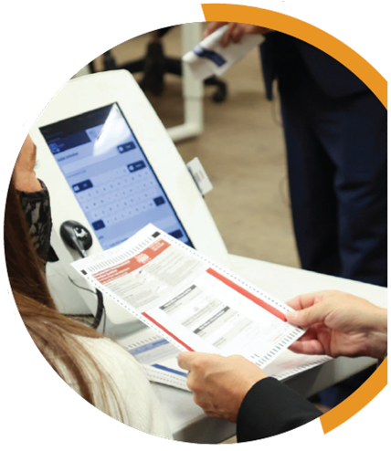
KEYS TO MEANINGFUL OBSERVATION
YOUR COUNTY LOGO
VOTING EQUIPMENT
Meaningful observation is essential for healthy elections. Many observers want to learn more about the machines used to record and tabulate votes. While observers should not touch any voting equipment for security reasons, they can learn a lot by watching both pre-election equipment testing and how election workers use voting equipment during early voting or on Election Day.
What is my role on Election Day? You may start observing before polls open while election workers set up the voting equipment. Remember, you may not touch any voting equipment.
For voting locations with ballot scanners: In addition to observing the setup, you may ask the election workers to print a “zero report” from the tabulator. This will show that no votes have previously been recorded or saved to the machine’s memory device. Once voting begins, you may observe the process of conducting the election. However, please respect local rules about where you may sit or stand. Some jurisdictions require observers to stay in designated areas, while others allow for roaming around the voting location. Regardless, give voters plenty of space and privacy, especially as they insert their ballots into the voting equipment.
How can observers know that voting equipment is accurate? Most jurisdictions publicly test the accuracy of their voting equipment before each election. This process is called logic and accuracy (L&A) testing. L&A testing is a collection of pre-election procedures that ensure that the voting equipment and ballots to be used in an upcoming election can properly collect votes and tabulate and report accurate results.
Any member of the public may attend L&A testing. If you want to observe L&A testing, contact your local elections office well before Election Day. Testing typically occurs several weeks before Election Day. Ask about the L&A testing schedule and request to be put on a mailing list, if one is available in your jurisdiction.
What should observers expect during L&A testing? Your jurisdiction’s election official will explain the process for conducting L&A testing. Before testing, election officials prepare a group of test ballots (known as a test deck), knowing how many votes each candidate will receive. At the test, they turn on the equipment, verify the memory is clear, and run the test deck of ballots through the scanner or voting system. When finished, they will have the machine print a report of the results from the test ballots. If the system is working correctly, its result will match the expected result for the test ballots.
Sometimes, L&A testing will also find other problems such as flaws in the printed timing marks or issues that might cause ballots to jam in the machine.
YOUR COUNTY • BOARD OF ELECTIONS YOURCOUNTY.GOV

Slide 2
How can observers be sure that voting equipment is physically secure? Machines are secured with locks and tamper-evident seals. Locks make it difficult for an unauthorized person to access memory cards slots or controls inside the machine. Seals are often sequentially numbered and cannot be replaced once broken. Broken seals would alert election officials that someone has accessed or tried to access the equipment in any way prior to use. Observers can either see the seal numbers or hear them read aloud as election workers document their setup procedures.
What if a machine malfunctions? Occasionally, a piece of voting equipment may malfunction, but this is not cause for worry. Often, these issues are the result of a fixable issue, like a ballot jamming a machine or a power outage. Election workers are trained to deal with these situations and normally resolve them quickly. More complex problems require the assistance of a repair technician. Until it is fixed, election workers may ask voters to drop their ballots into an auxiliary ballot box. Election workers will feed them into the machine once it is working.
May observers stay after the polls close? Yes. Observers can witness the poll closing and reporting procedures. They may even have more freedom to move around the polling location and monitor activities. However, you should always ask the lead election worker before entering new locations. Remember, do not touch voting equipment, laptops or ballots, even after the polls are closed.
Election workers will close the polls after the last voter has cast his or her ballot. If any ballots from the auxiliary bin have not been processed, election workers will feed them through the voting equipment at this time. You may also watch as the election officials conduct other processes for reporting results and closing the voting location.
How does results reporting work? Generally, election workers will announce unofficial results for their polling place. How unofficial results get from the precinct to the main election office varies by jurisdiction. Some have voting equipment that can transmit unofficial results securely to a central server. Others have election workers call results in to a central phone bank. Still others transport memory devices and printed reports to their main election office.
You may continue to observe as election workers tabulate and report results. Remember that all results are unofficial until they are certified. Certification can take days or even weeks. If you believe there is a discrepancy between what you observed and the results on your jurisdiction’s website, contact your local election official’s office.
IF YOU SEE SOMETHING, SAY SOMETHING
If you see something that concerns you at the polling place or equipment warehouse, tell the proper authority. You should direct inquiries to the official in charge of the location. In some counties, there may be a formal complaint process to follow.
Always be respectful and realize that front line election workers may not be able to address all of your concerns – and they may need to defer questions to the elections office. If that occurs, document your observations and inform your local election official.
YOUR COUNTY • BOARD OF ELECTIONS YOURCOUNTY.GOV

