Slide 1
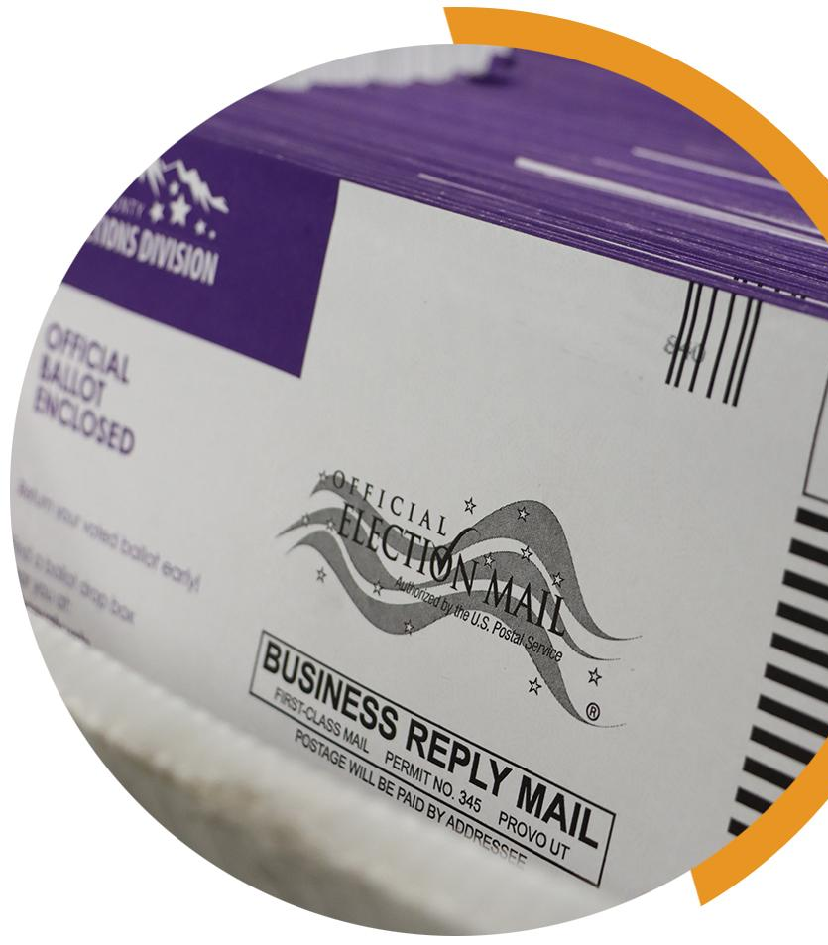
KEYS TO MEANINGFUL OBSERVATION
YOUR COUNTY LOGO
MAIL BALLOT VALIDATION
Meaningful observation is essential for healthy elections. Observers want to know that mail ballots were submitted by the qualified, registered voters who requested them. Observers may not be able to watch the entire mail ballot validation process for any given election; however, they can learn more about the many security measures that election offices use to ensure that only validly requested and submitted mail ballots count toward an election result.
What is mail ballot validation? Mail ballot validation refers to the processes that states use to verify that the individual who receives a mail ballot is the same individual who completes and submits that ballot.
How do mail ballot validations work? The most common method of ballot validation is signature verification. Voters must sign their mail ballot envelopes, and their signatures are compared against reference signatures, usually from the department of motor vehicles or the voter registration database. A ballot is counted only if the ballot envelope signature matches the reference signature.
Some jurisdictions use other processes to validate mail ballots. Examples include:
Witness or notary signatures. In these jurisdictions, voters must obtain one or more signatures from witnesses or notaries before submitting their mail ballot. The witness or notary attests that the appropriate registered voter is the one who completed the mail ballot. Some jurisdictions perform signature verification on witness or notary signatures, while others do not.
The inclusion of personally identifying information, such as a driver’s license number or the last four digits of the voter’s social security number. In these jurisdictions, voters provide the required number next to their signature on the mail ballot return envelope. If the number provided does not match information in the voter registration database, department of motor vehicles record or other government record, then the ballot is not counted.
A fully completed affidavit. All states require some form of completed voter affidavit. Typically, these affidavits require the voter to affirm their identity under penalty of perjury. Individuals who submit fraudulent mail ballots face the possibility of criminal penalty, up to and including a prison sentence.
YOUR COUNTY • BOARD OF ELECTIONS YOURCOUNTY.GOV

Slide 2
Can I watch as mail ballots are validated? The possibility of watching mail ballot validation varies from jurisdiction to jurisdiction and can depend on how and when mail ballots are validated. Jurisdictions that do signature verification typically allow observers to witness all or some of the process. Observers are never permitted to see computer screens or documents that contain private information about a voter. Ask your local election official if you can observe the mail ballot validation process.
What if election workers find a counterfeit ballot? It is not counted. There are many safeguards that ensure counterfeit mail ballots are not counted. Election officials only count one official ballot from each registered voter.
Mail ballots are only sent to registered voters at their designated residence or mailing address. The local election office only sends mail ballots to qualified, registered voters in their jurisdiction.
Only official mail ballots returned by registered voters are counted toward the election result. Election staff will only process mail ballots that were requested and returned by a registered voter. Election staff can quickly distinguish an authentic official ballot from a fraud. Official mail ballots are printed on special paper, have several signifying markings and are returned in the privacy envelope that the election office sends with any properly requested mail ballot.
In the extremely rare event that a counterfeit mail ballot is run through a vote tabulator, the tabulator typically will not count the ballot. The ballot must have been printed with the right kind of ink, must be on the right paper stock and must be marked and completed in a way that the tabulator can read. Any individual who submits a fraudulent ballot is potentially liable for a felony penalty for committing voter fraud.
What if I still have concerns? The nation’s election systems are carefully designed to prevent voter fraud and to ensure that each qualified, registered voter gets one vote. The information in this guide highlights just a few of the many safeguards that protect mail ballots. For more information, reach out to your local election office before Election Day and ask how they secure your jurisdiction’s mail ballots.
IF YOU SEE SOMETHING, SAY SOMETHING
If you see something that concerns you during mail ballot validation, tell the proper authority. You should direct inquiries to the official in charge of the location. In some counties, there may be a formal complaint process to follow.
Always be respectful and realize that front line election workers may not be able to address all of your concerns – and they may need to defer questions to the election office. If that occurs, document your observations and inform your local election official.
YOUR COUNTY • BOARD OF ELECTIONS YOURCOUNTY.GOV

