Slide 1
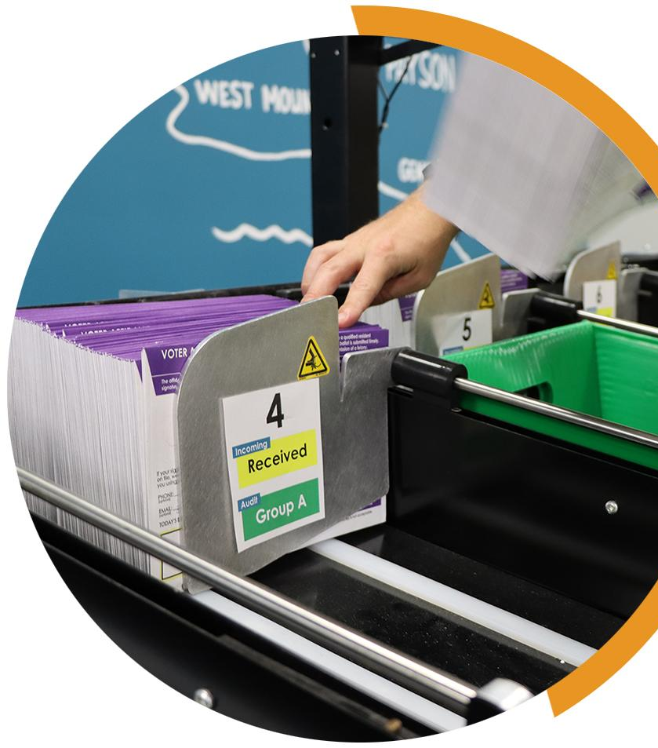
KEYS TO MEANINGFUL OBSERVATION
YOUR COUNTY LOGO
MAIL BALLOT RECEIVING
Meaningful observation is essential for healthy elections. Many observers want to know more about what happens to mail ballots, including how they are tracked and transported. While observers cannot touch any mail ballots for security reasons, they can learn a lot by watching mail ballot receiving and processing. A secure, transparent receiving process sets the foundation for the mail ballot validation and counting processes.
What should I know before I observe mail ballot receiving? Whether a jurisdiction conducts its elections entirely by mail or with just a few mailed absentee ballots, election officials follow strict procedures to ensure the security of those ballots. These procedures include documenting the chain of custody and physical security of the ballots. The jurisdiction’s voter registration system tracks every qualified, registered voter who is mailed a ballot, whether automatically in vote-by-mail jurisdictions or by a formal request.
Registered voters who mark their ballots return them in a ballot packet made up of a security envelope with a signed affidavit. In some jurisdictions, voters use an outer envelope to send their ballot and security envelope to a mail ballot processing center.
When election officials receive a mail ballot packet, they check to make sure it is from the registered voter who received a mail ballot. This is done either by scanning a barcode on the envelope or by looking up the voter’s name in the registration database. This step ensures that only ballots from authorized mail ballot voters move forward to the validation and counting steps.
When an official checks in a mail ballot, the system adds a note to the voter’s file to indicate that their marked ballot was received. As part of the voter’s file, this note would be visible in the paper or electronic pollbook. So, if the same voter were to check in at a polling place, the note prevents the voter from receiving a ballot and voting at the polls. The note also lets the voter know that their ballot was received.
What can I do as an observer? It depends on the state. Generally, observers can be present to watch mail ballot receiving as it takes place. They may not be able to personally verify seal numbers or names on ballot envelopes, but they can verify that workers follow secure practices. This includes making sure ballot packets are never left unattended or in an unsecured location. They can verify that election officials are maintaining a chain of custody. They can also observe that no one enters the workspace without proper identification and that no envelopes are opened. Some jurisdictions have designated areas for observers while others provide tours of the facility. Do not touch any materials. Direct questions to designated officials.
YOUR COUNTY • BOARD OF ELECTIONS YOURCOUNTY.GOV

Slide 2
What should I expect to see during mail ballot receiving? Ballot packets may come in from different sources: United States Postal Service (USPS) deliveries, ballot drop boxes and vote centers. Ballot packets from USPS may come in open trays. Ballot packets from drop boxes may come in official, secure containers or transfer cases. Teams of election workers will return ballots from vote centers in secure containers. Those teams will check in with an official and begin paperwork to verify the transfer cases were properly secured, verifying seal numbers against a chain of custody log.
Officials may also weigh the transfer cases as they’re received and prior to breaking the seals to record the weight on the appropriate audit log. Once the receptacle is weighed and the number is recorded, the seal may be broken and recorded on the chain of custody log. The broken seal is placed in a box with the chain of custody paperwork to be retained for a specific amount of time after the election. Election officials then transfer the mail ballot packets to sorting trays so they’re ready for pre-processing.
How is the mail ballot receiving process secured? Mail ballot couriers are often bipartisan teams of authorized workers who have passed background checks and received training on the proper handling of ballots. Some counties use staff or law enforcement officers to transfer ballots. Ballot transfer cases are sealed with numbered, tamper-evident seals. Mail ballot receiving locations often have video surveillance and are limited to authorized staff and observers.
What unique events might I observe? If a ballot transfer case seal is broken during transit, you can observe officials as they complete an incident report, inspect the envelopes for evidence of tampering, and re-establish chain of custody. If any ballot packets are severely damaged, they may be placed in a clear pouch and kept separate for duplication by a trained election official. If the facility receives any ballot packets from other jurisdictions, they will be separated and prepared for delivery to the correct jurisdiction.
Does observation continue after Election Day? The majority of mail ballot receiving ends on Election Day. However, some states permit counties to accept and count mail ballots that are postmarked by Election Day. Others accept military and overseas ballots after Election Day. Counties will continue receiving – but not counting – late and undeliverable ballots.
What reports are available? It depends on the jurisdiction, since methods for reporting mail ballots received differ. When ballot packets are received, they are scanned into the voter registration system. Observers may be able to receive reports showing the mail ballot status (e.g. sent, received, undeliverable) for each voter or a summary report. Some counties receive post office reports that show delivery information for mail ballot packets.
IF YOU SEE SOMETHING, SAY SOMETHING
If you see something that concerns you at the mail ballot receiving and processing center, tell the proper authority. You should direct inquiries to the official in charge of the location. In some counties, there may be a formal complaint process to follow. Always be respectful and realize that front line election workers may not be able to address all your concerns – and they may need to defer questions to the election office. If that occurs, document your observations and inform your local election official.
YOUR COUNTY • BOARD OF ELECTIONS YOURCOUNTY.GOV

