Slide 1
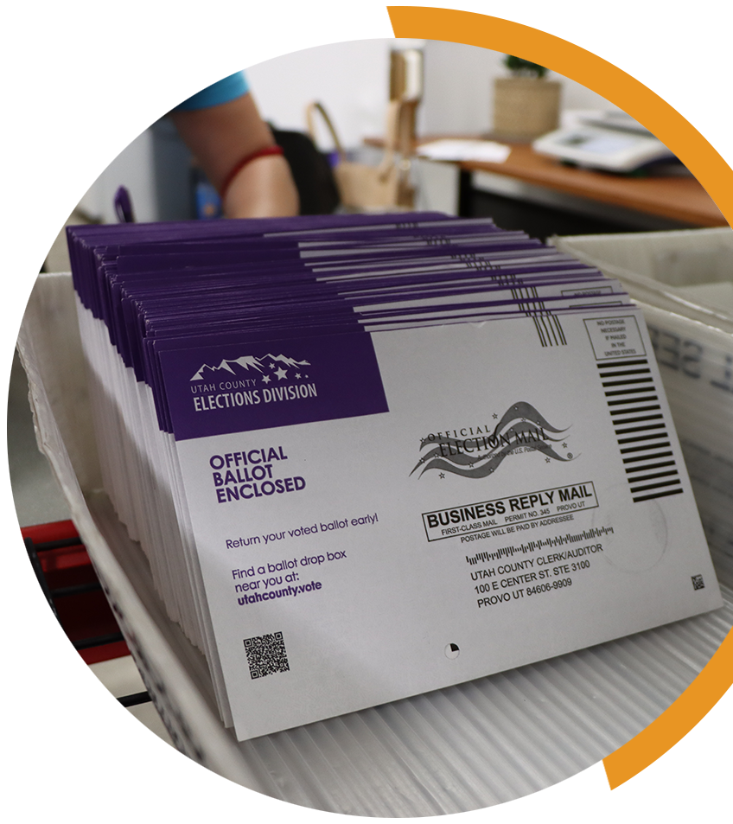
KEYS TO MEANINGFUL OBSERVATION
YOUR COUNTY LOGO
MAIL BALLOT PROCESSING
Meaningful observation is essential for healthy elections. Observers want to know where and how to observe mail ballot processing. Observers should have the opportunity to observe mail ballot receiving, intake, sorting, pre-processing and aspects of signature verification.
How are mail ballot packets processed? The way election workers process mail ballot packets (the security envelope and ballot) can vary from state to state and county to county based on technology, equipment and policy.
After election workers receive and align mail ballot packets to be scanned, they are ready for pre-processing. Each mail ballot packet has a unique barcode tied to the voter, which is scanned. Jurisdictions may use hand scanners or a mail ballot processing machine with an integrated scanner. This checks the voter database to ensure that each voter has not already voted. If a mail ballot packet cannot be scanned, it will be pulled out for review later.
What can I expect to see during pre-processing? During pre-processing, mail ballot packets are opened if they have not already been sliced by the mail ballot sorter, and the mail ballot packet is disassembled. Each component – the return mail envelope, the secrecy sleeve and the mail ballot – are placed in separate stacks. This is done by a bipartisan team of trained election officials prior to counting to ensure that there is no way to track the way that a specific voter voted.
Mail ballots are then marked “ready” and are prepared for transport to the counting room. Return envelopes and secrecy sleeves are grouped in stacks and retained for a specified amount of time after the election with any appropriate audit logs.
How are mail ballots verified? Many states use signature verification to ensure that the ballot was completed by the voter who requested it. Some states require voters to provide an ID number or a copy of their photo ID. Other states require the signature of a witness or a notary.
Can I participate in signature verification? No. Observers may observe the process from the designated observer space, but they are not permitted to verify signatures. Because the signature verification judge’s screens may contain confidential voter information, observers are usually not permitted to view them. This may vary depending on observer type and statute.
YOUR COUNTY • BOARD OF ELECTIONS YOURCOUNTY.GOV

Slide 2
How does signature verification work? If signature verification is required, the signature on the ballot return envelope is compared with the signature on file for the same voter. This comparison may be done manually or with the assistance of computerized automatic signature verification (ASV). Ballots that have not been accepted by ASV must go through a manual signature verification process.
Trained election officials work in bipartisan teams and evaluate the signature on the mail ballot packet and compare it to the image stored in the voter’s registration record. If the team finds a match, the ballot packet is accepted for pre-processing. If the comparison is not a match, the ballot is sent for a second review.
A second review is performed on all mail ballot packets that have not passed the first signature verification judges or ASV. At the second level of signature verification, judges review the signature and compare it to images saved in the voter’s registration record and either accept or reject the signature. The selection is marked in the system. Accepted mail ballot packets are placed in the appropriate tray for pre-processing. Rejected mail ballot packets are sent to be cured. This means that the voter is notified that there is a problem with their ballot and is permitted to fix – or cure – it, so their ballot can be counted.
What happens to accepted mail ballot packets? All voters whose mail ballot packets are accepted through signature verification or other verification receive credit for having voted. Accepted mail ballot packets are then placed in the appropriate trays with the appropriate paperwork for pre-processing.
What happens to rejected mail ballot packets? When election workers cannot verify a mail ballot packet, the voter’s status is marked as “rejected” with the appropriate reason code. Voters may have an opportunity to cure signature discrepancies or provide correct ID numbers. Election officials send correspondence to the voter by both mail and email, advising the voter of their status and describing the cure process. This is documented in the voter’s record. Voters who fail to cure their ballots may be referred to the district attorney for further investigation after the election.
What happens if a ballot is damaged? If a ballot is torn or damaged and cannot be scanned, a bipartisan team of trained election officials duplicates the ballot using procedures required by state law.
IF YOU SEE SOMETHING, SAY SOMETHING
If you see something that concerns you during mail ballot processing, tell the proper authority. You should direct inquiries to the official in charge of the processing room(s). In some counties, there may be a formal complaint process to follow.
Always be respectful and realize that front line election workers may not be able to address all your concerns – and they may need to defer questions to the election office. If that occurs, document your observations and inform your local election official.
YOUR COUNTY • BOARD OF ELECTIONS YOURCOUNTY.GOV

