Slide 1
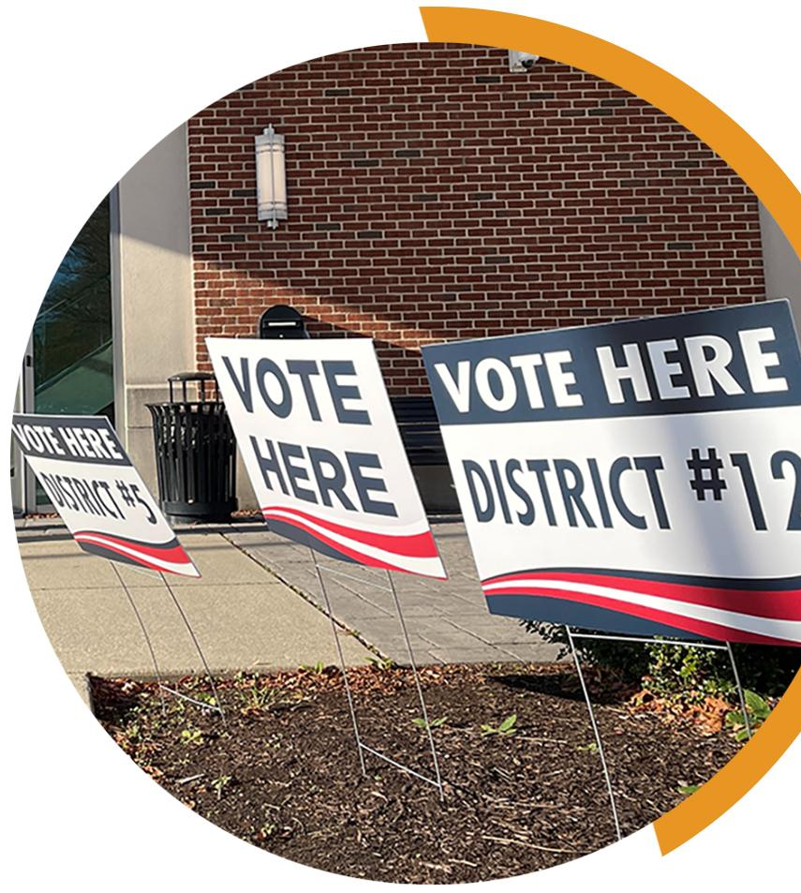
KEYS TO MEANINGFUL OBSERVATION
YOUR COUNTY LOGO
ELECTION RESULTS
Meaningful observation is essential for healthy elections. Observers often want to know where and how to monitor election results after the polls close. Observers can follow unofficial results from voting locations to the county clerk or board of elections office and track them online using government and media election results websites until official, certified results become available.
How and when can I see unofficial election results for a precinct? In general, election results start at in-person voting locations, where registered voters in that precinct use paper ballots or touchscreen voting equipment to cast their votes. Tabulating equipment keeps the vote totals secret until the polls close. If election workers are still processing absentee ballots or completing reconciliation paperwork, results may not be available right after the polls close.
When all ballots have been processed, election workers print the unofficial results for the polling place, often posting them for anyone present to see. This process is generally open to the public, and you have the right to be there to hear and see the precinct results.
Depending on what races are on the ballot, local candidates or their representatives may be at the polling place to find out whether they won or lost. Political parties may also have volunteers on hand to gather precinct results and call them into headquarters.
In some places, counties may have a central location where they count all ballots or just absentee ballots. The public has a right to observe there, too.
How can observers track results from the precinct to the county election office? In most states, unofficial election results move from each polling place to the office of the county’s election authority, such as the clerk or the board of elections. There are many safeguards in place to ensure no one tampers with the unofficial results while they are in transit.
Election workers or law enforcement transport ballot containers, memory devices and other election records from voting locations to the county’s central office. They use security seals and chain-of-custody logs to ensure the integrity of the results along the way. In some places, election workers also transmit unofficial results electronically, so the county doesn’t have to wait for results to arrive physically. These transmissions are encrypted for security.
The county clerk or election board’s office should be open to the public on election night. Anyone interested in observing the steps the office takes to make unofficial election results public should call ahead to verify hours and the type of information that will be available.
YOUR COUNTY • BOARD OF ELECTIONS YOURCOUNTY.GOV

Slide 2
How can observers verify the accuracy of the data received from the voting locations? Observers should start by documenting the results from voting locations. In some places, election workers will print extra copies of the unofficial results on request. Elsewhere, observers can see and capture photos of the results tapes with their phones. At the county office, election workers receive the unofficial results, tabulate them and report them to the public, the media and often to the state. They might even post paper copies of results or show the latest results on a screen or large video monitors. If precinct results are available, observers can make sure the numbers from voting locations match the numbers at the county. If there is a difference, observers should bring it to the county election official’s attention. It is possible that someone transposed a number during data entry.
Where can I get unofficial election results for the state ? Many states have systems in place for counties to report unofficial results on election night. The county may have deadlines for reporting unofficial results. In those states, the secretary of state or state election authority will have a website where the unofficial results will be posted. The level of detail will vary, but this is another chance for observers to verify that the unofficial numbers reported by the county match. If there is no state system, the media will often tabulate and publish unofficial results for statewide and legislative races.
What about the results reported by the media? Unofficial election results from voting locations and counties may not always match the numbers reported by local and national media outlets on election night. Media organizations use their own methods to collect unofficial results, which can be faster than the election office’s methods Differences and changing numbers on election night do not necessarily mean there is a problem with the reporting system. If the media’s numbers change, it could be to correct to an error made earlier in the night.
On election night, all results are unofficial. News organizations and TV networks will often “declare” winners, but those declarations are not official or final. They are simply opinions or predictions of which candidate will have the most votes once results become official later.
How do unofficial results become official? Unofficial results from election night become official after an election goes through a public process called the canvass. This is when the county’s board of canvassers double-checks all the numbers before certifying the results. After the county’s canvass, the official county results are filed with the state. The state canvasses all county results, double-checking those numbers, before certifying the results, which makes the election results official and declares the winners. That certification may happen at a public meeting.
IF YOU SEE SOMETHING, SAY SOMETHING
If you see something concerning at a voting location, tell the proper authority.
Direct inquiries to the official in charge of the location. In some counties, there may
be a formal complaint process to follow.
Always be respectful and realize that front line election workers may not be able to address all your concerns – and they may need to defer questions to the election office.
If that occurs, document your observations and inform your local election official.
YOUR COUNTY • BOARD OF ELECTIONS YOURCOUNTY.GOV

