Slide 1
BALLOTS HAVE BEEN MAILED!

Slide 2
Find your nearest ballot drop box by visiting <website>

Slide 4
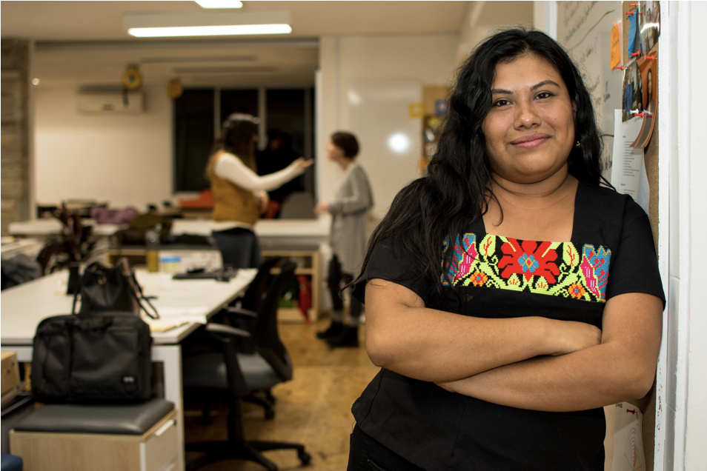
Team Spotlight
Jane Doe
<text>
<text>

